Slide 1




Tracking of Lines in Spherical Images via Sub-Riemannian Geodesics in SO(3)
A.P. Mashtakov¹
Collaborators: R. Duits², Yu. Sachkov¹, E.J. Bekkers², I. Beschastnyi³
Program System Institute of RAS¹, Eindhoven University of Technology²,
International School of Advanced Studies³
Funded by RFBR
The International Conference on
Differential Equations and Dynamical Systems
Suzdal, Russia, July 11, 2016

Slide 2
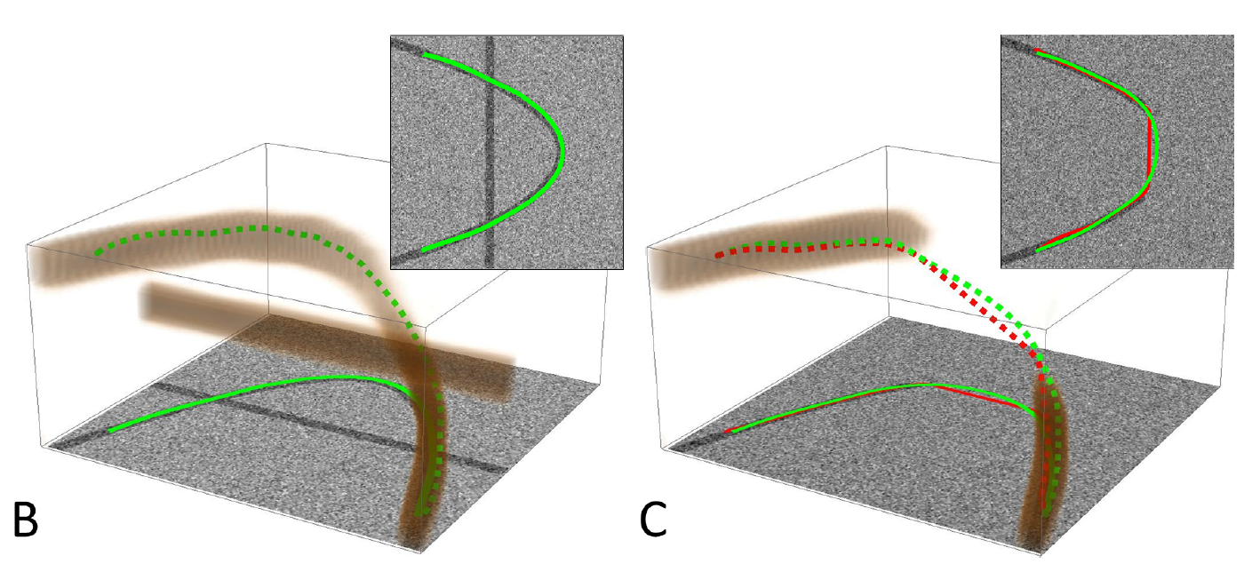
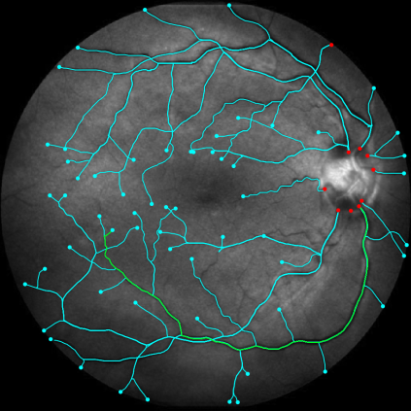
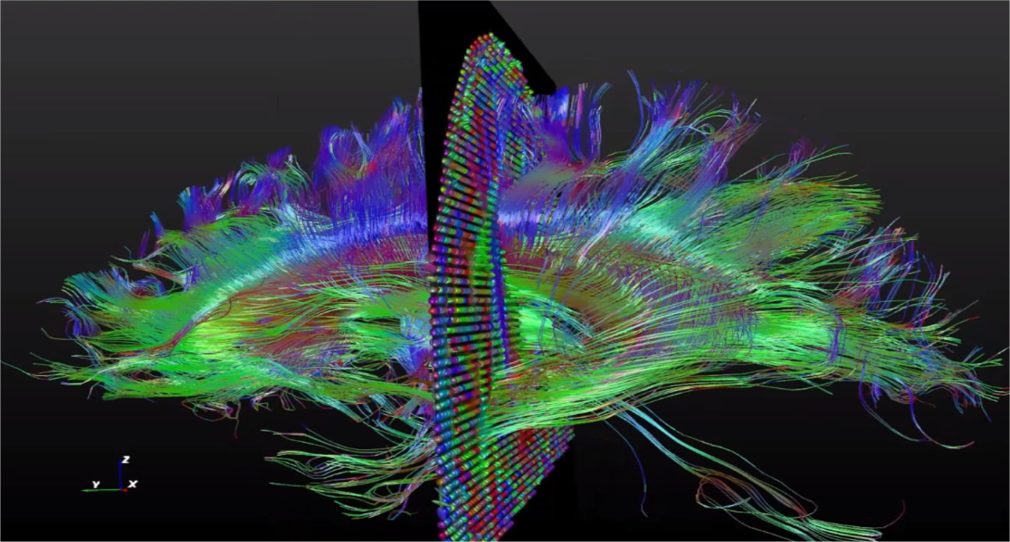
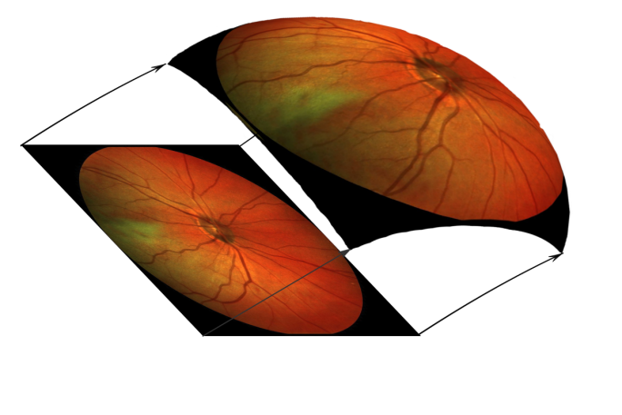
SR geodesics on Lie Groups in Image Analysis
Crossing structures are disentangled
Restoration of corrupted contours
based on model of human vision
Applications in medical image analysis
SE(2)
SO(3)
SE(3)

Slide 3


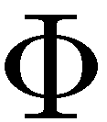
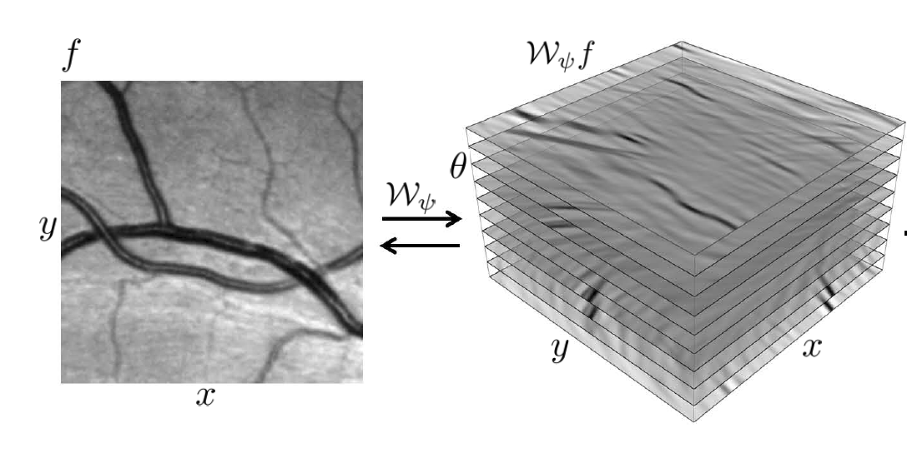
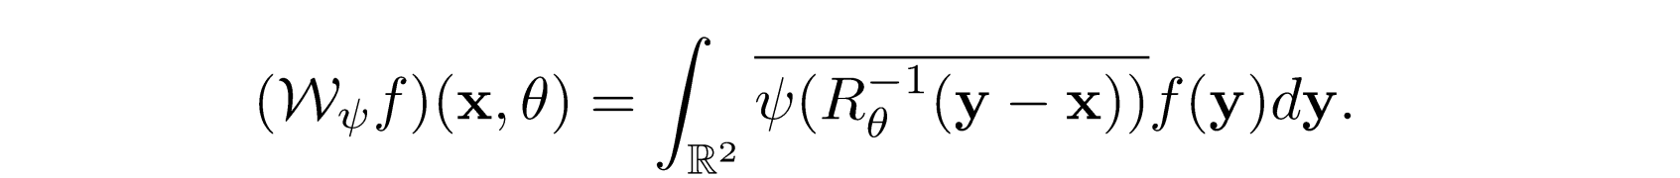
Lie Group Analysis via Invertible Orientation Scores
Image
Score
Processed
image
Processed
Score
3

Slide 4
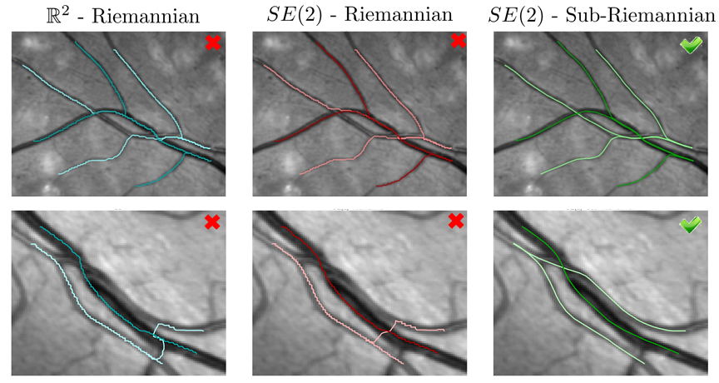

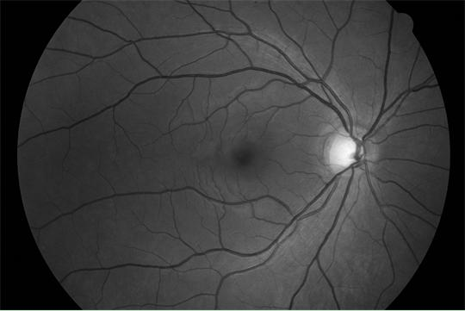
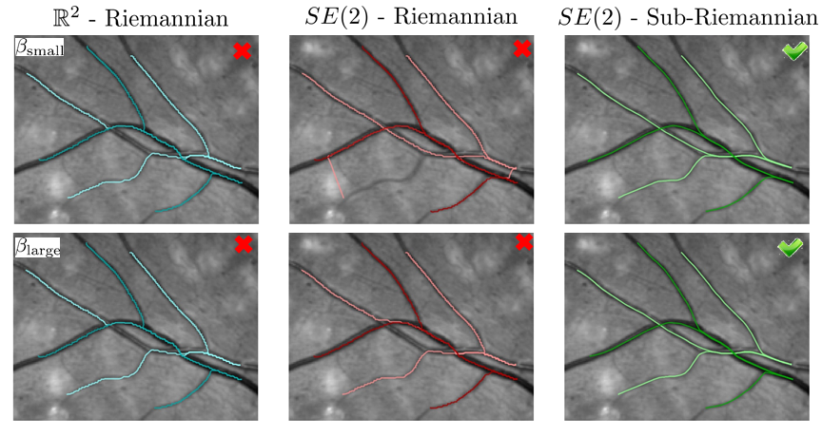
Traccking of Lines in Flat Images via
Sub-Riemannian Geodesics in SE(2)

Slide 5
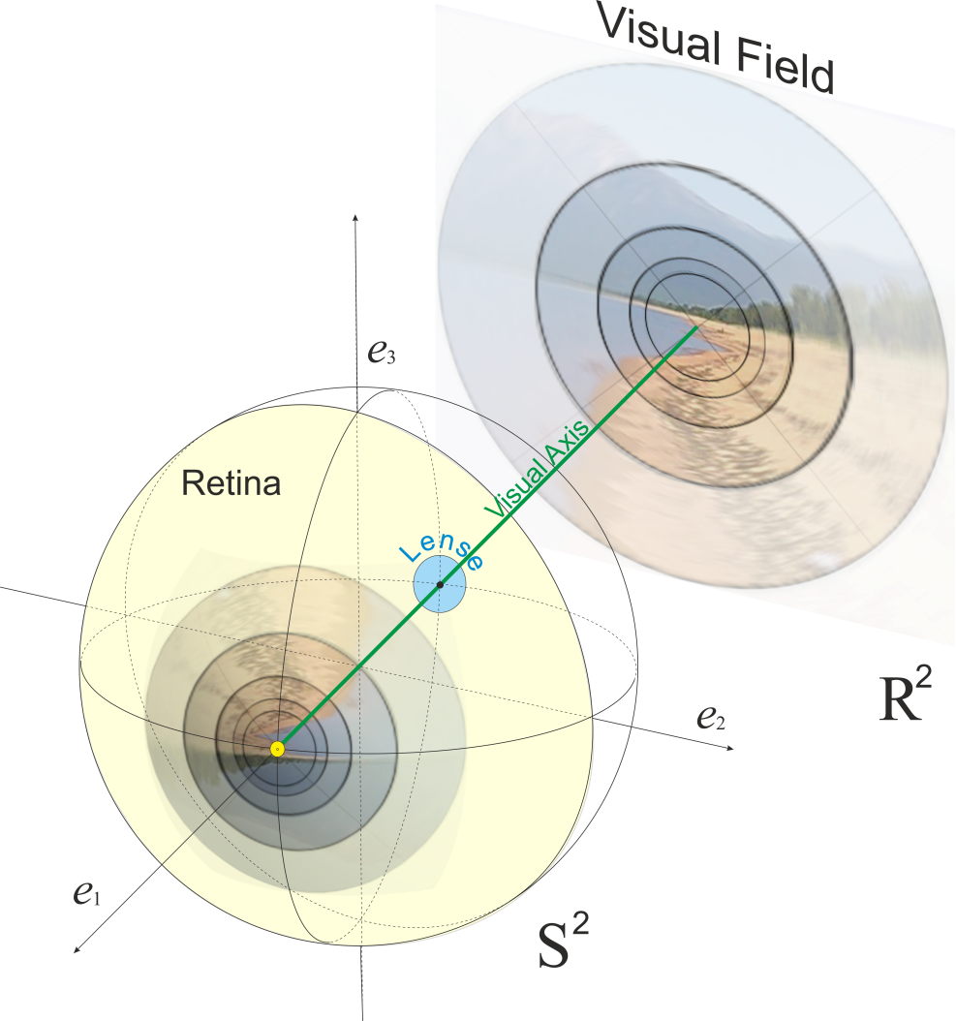
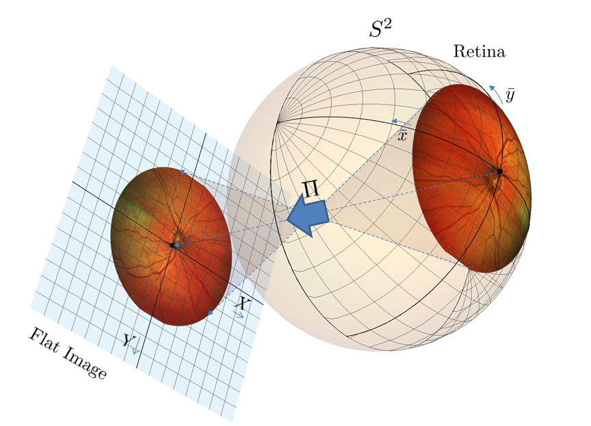
Motivation
Aim: data-driven SR geodesics on SO(3) for detection and analysis of vessel tree in spherical images of retina, to reduce distortion.
Spherical extension of cortical based model of perceptual completion on retinal sphere
5

Slide 6
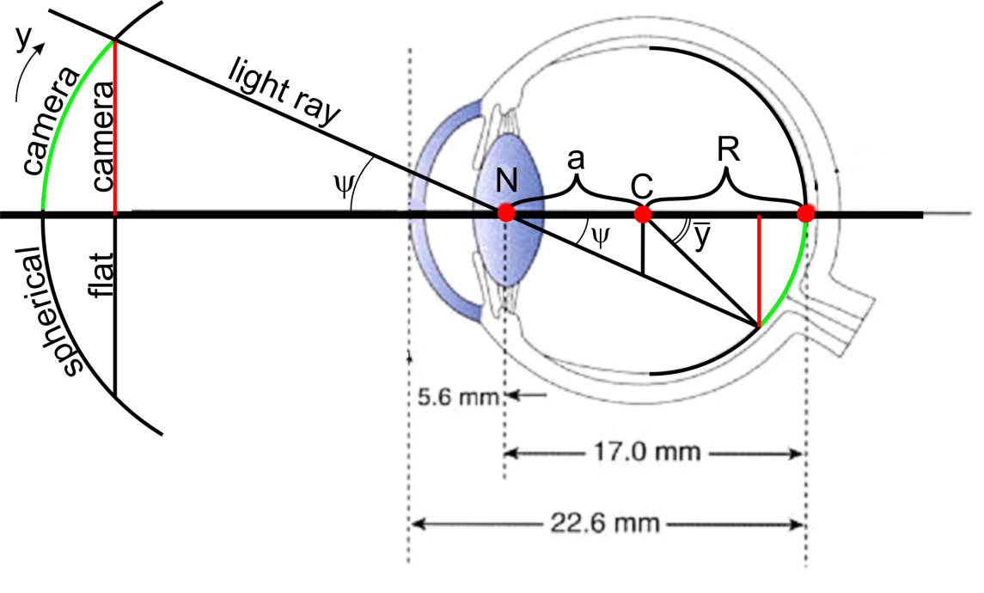
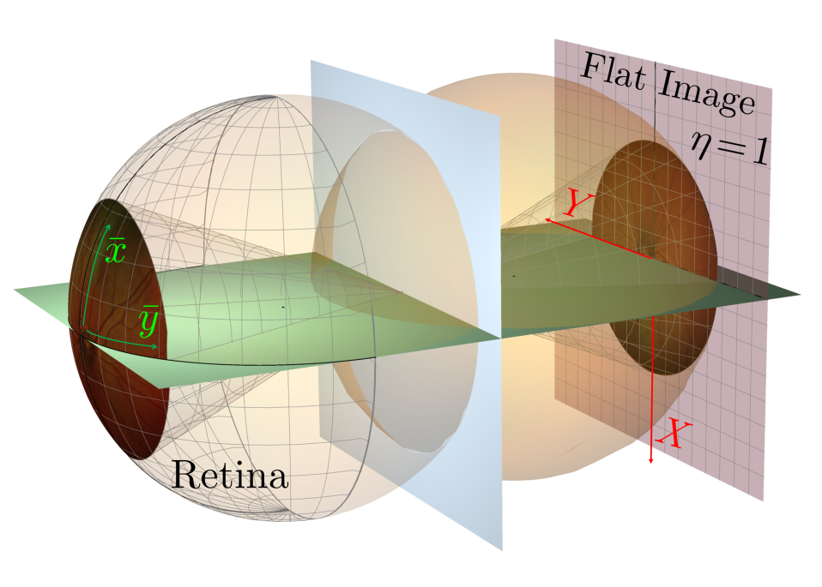
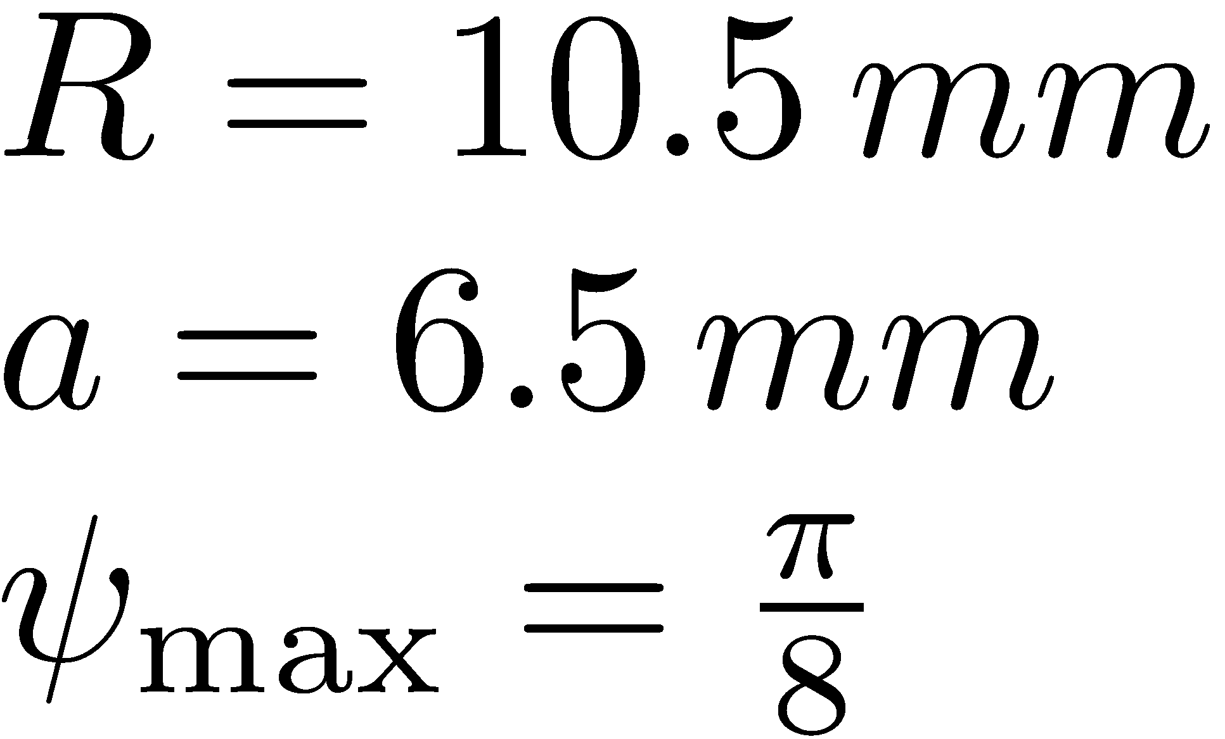
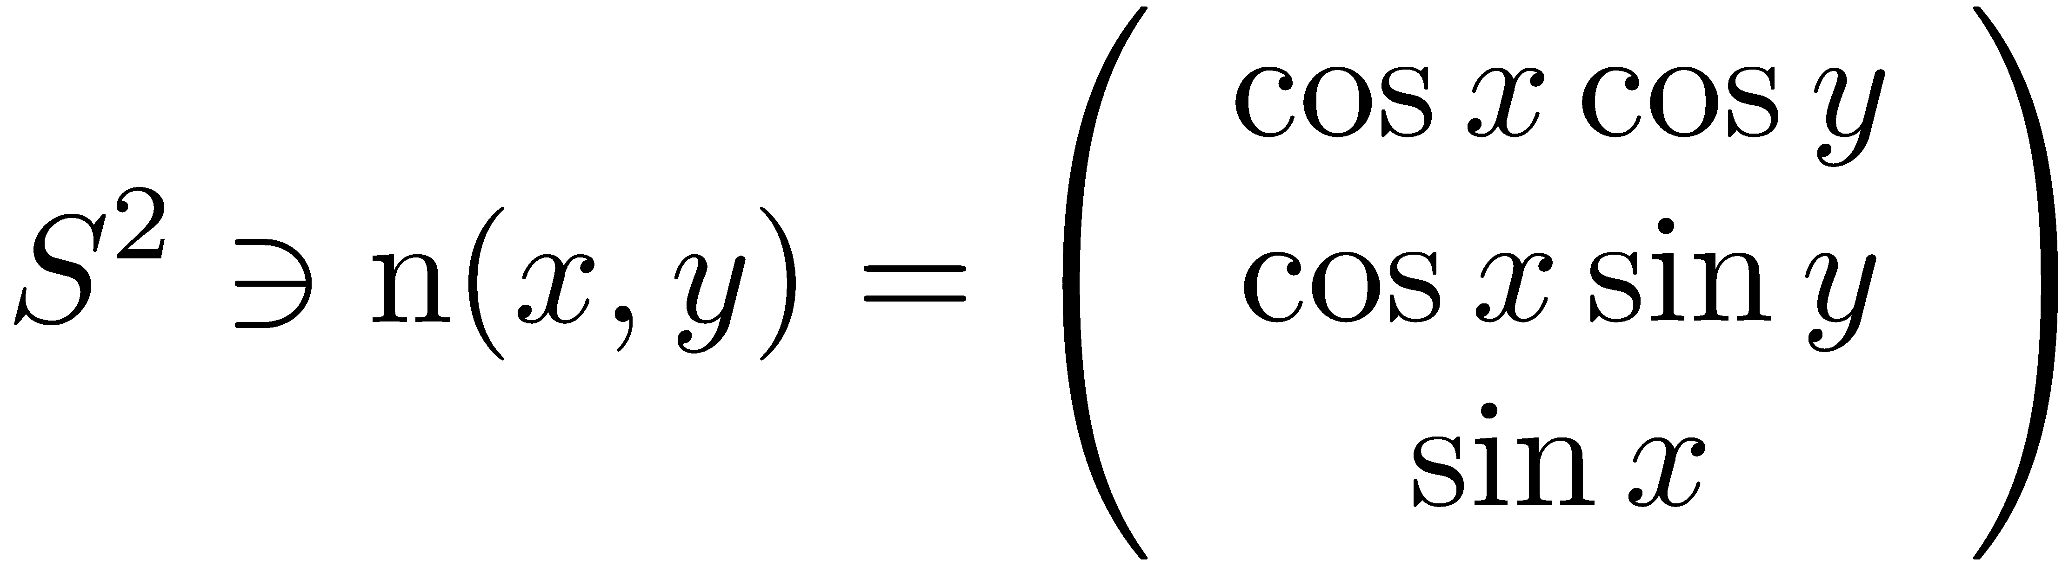
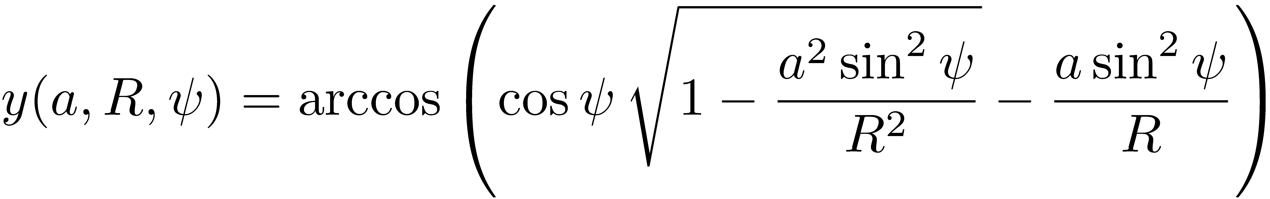
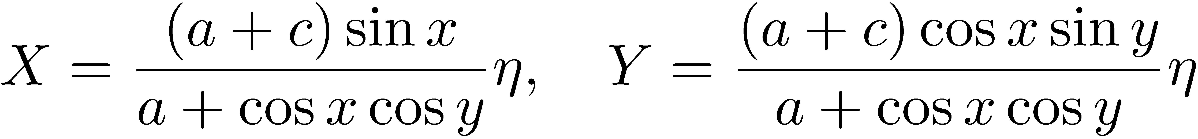
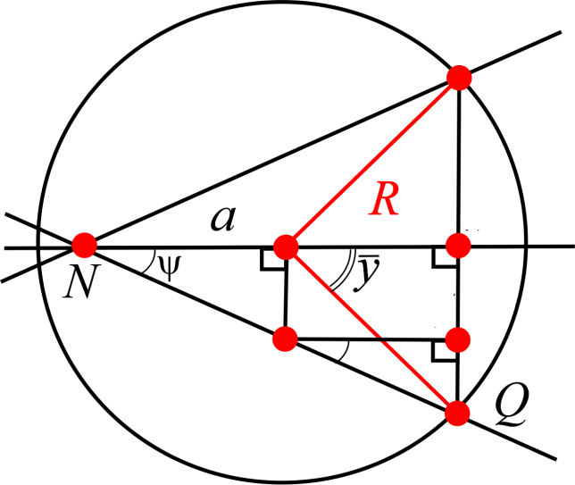
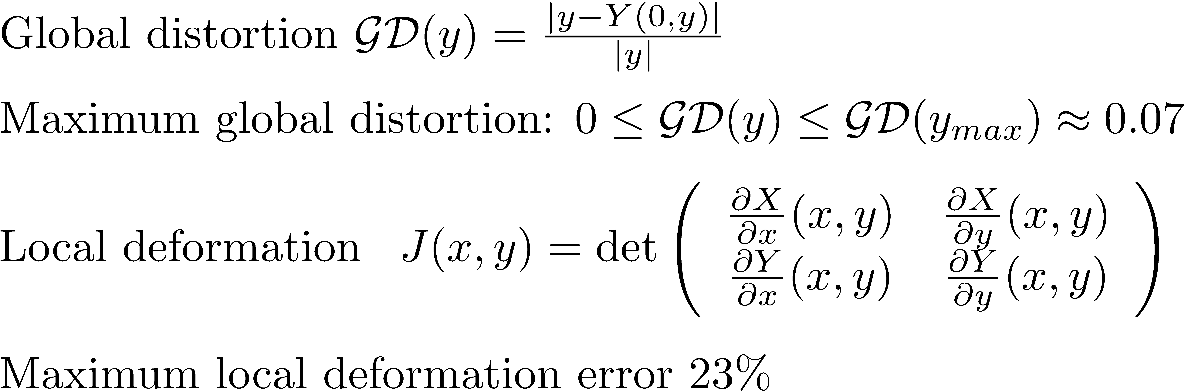
Spherical Images of Retina

Slide 7
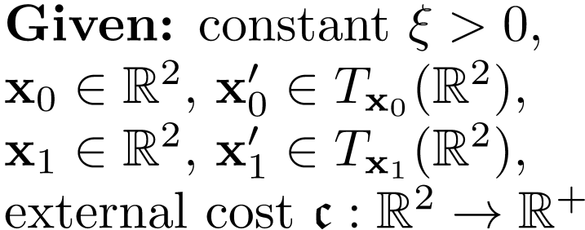
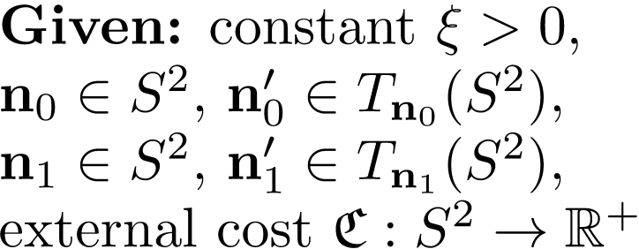
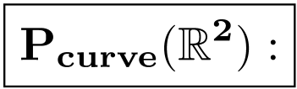
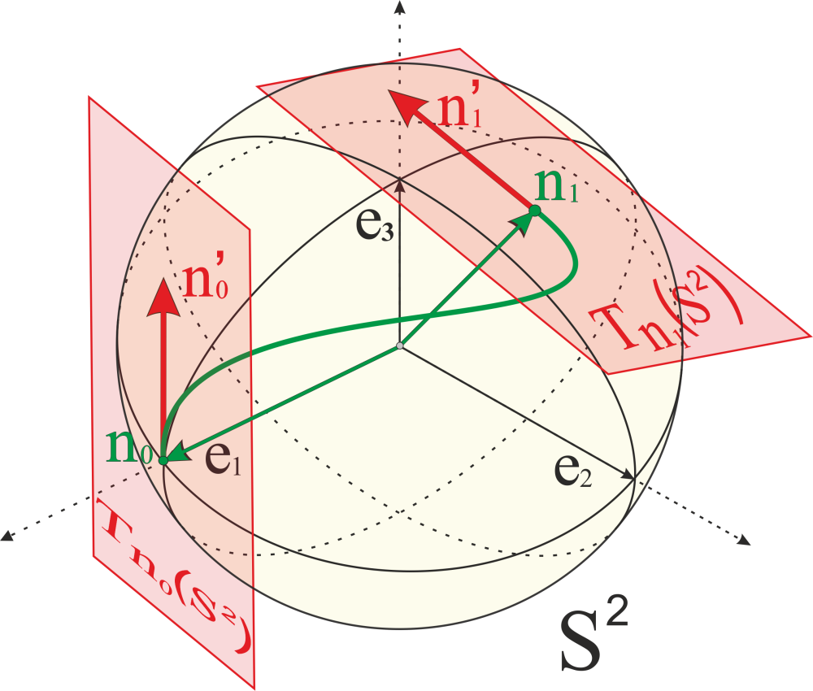
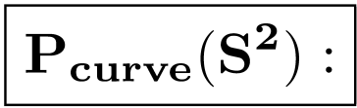
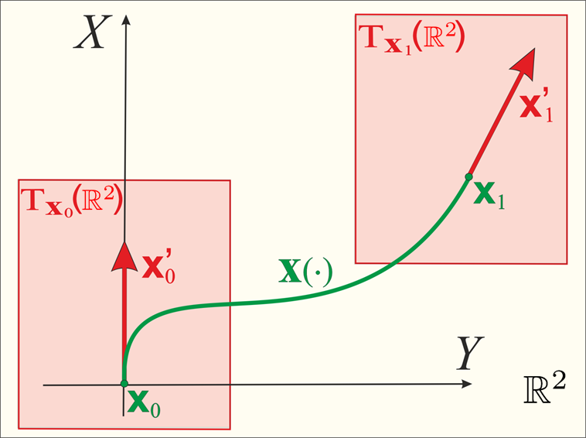
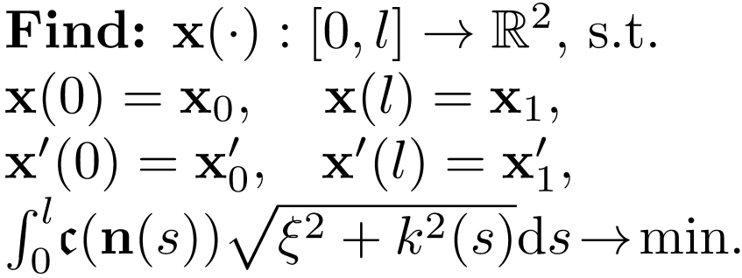
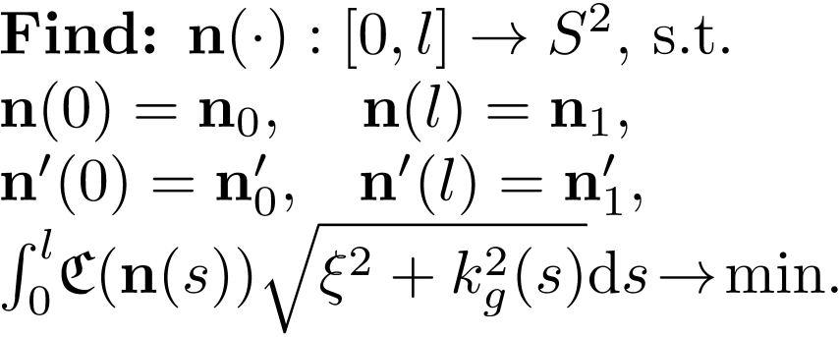
Spherical Extension of Flat Model

Slide 8
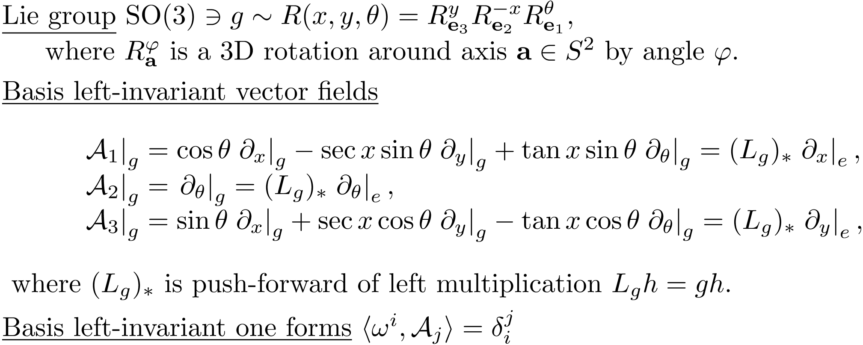
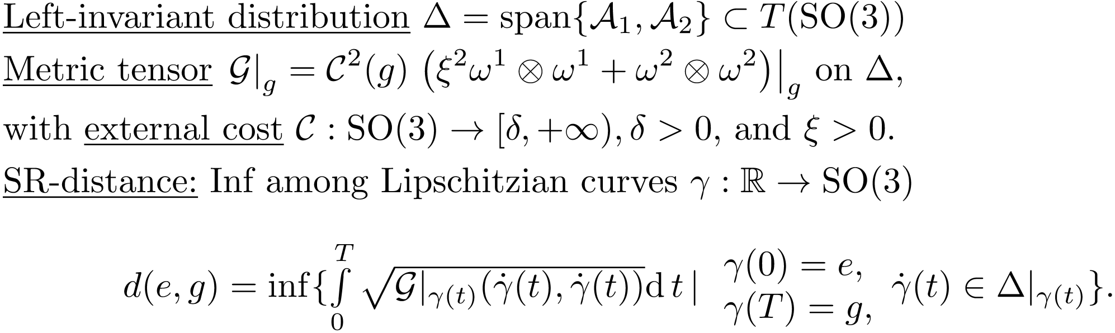
Sub-Riemannian Structure in SO(3)
8

Slide 9
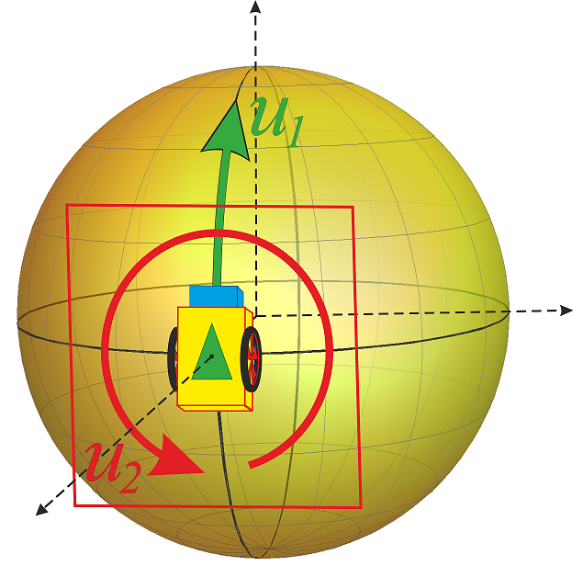
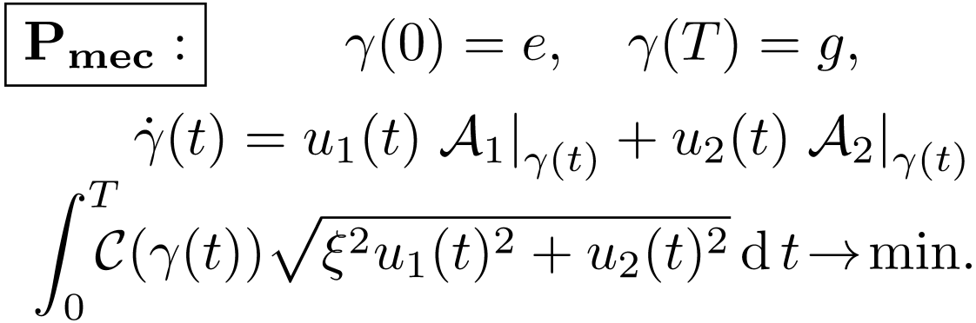
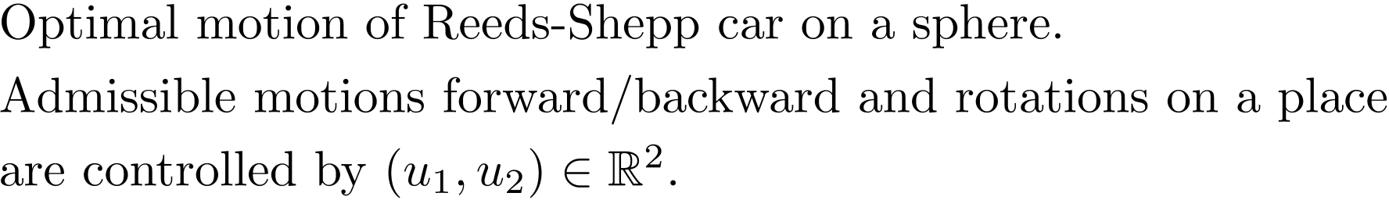
Mechanical Interpretation of Problem Pmec
9

Slide 10

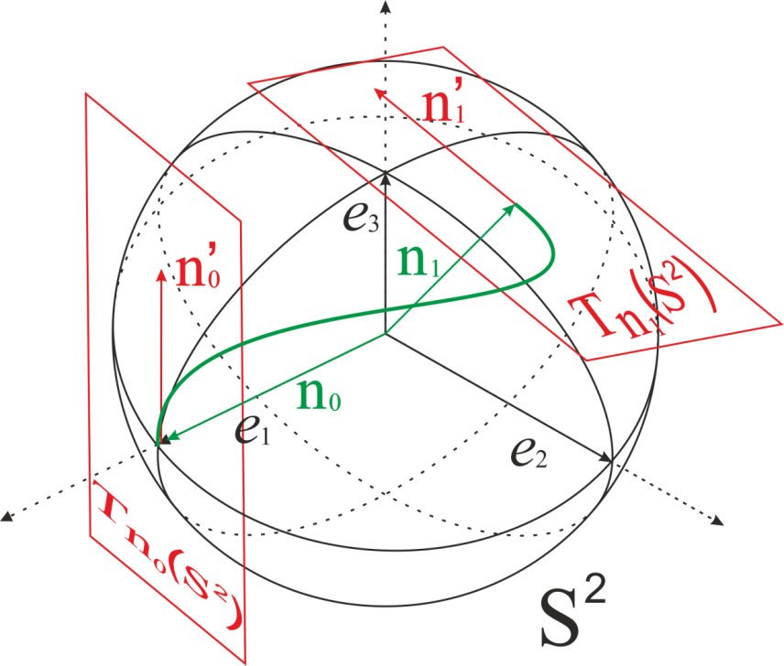


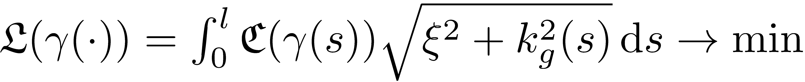
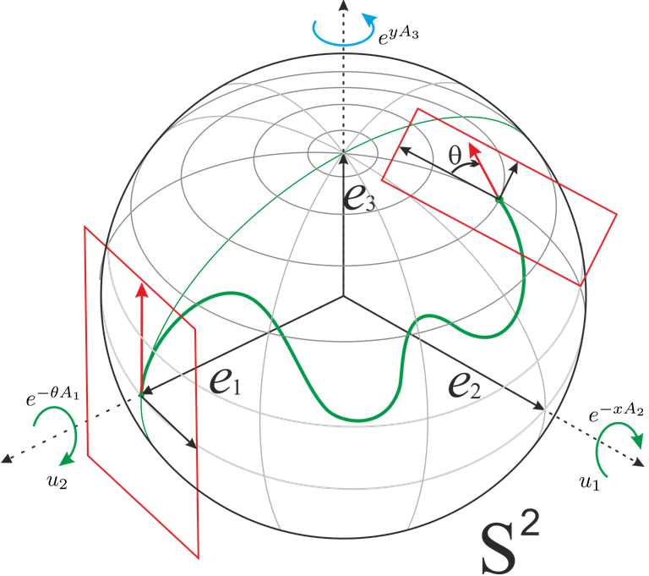
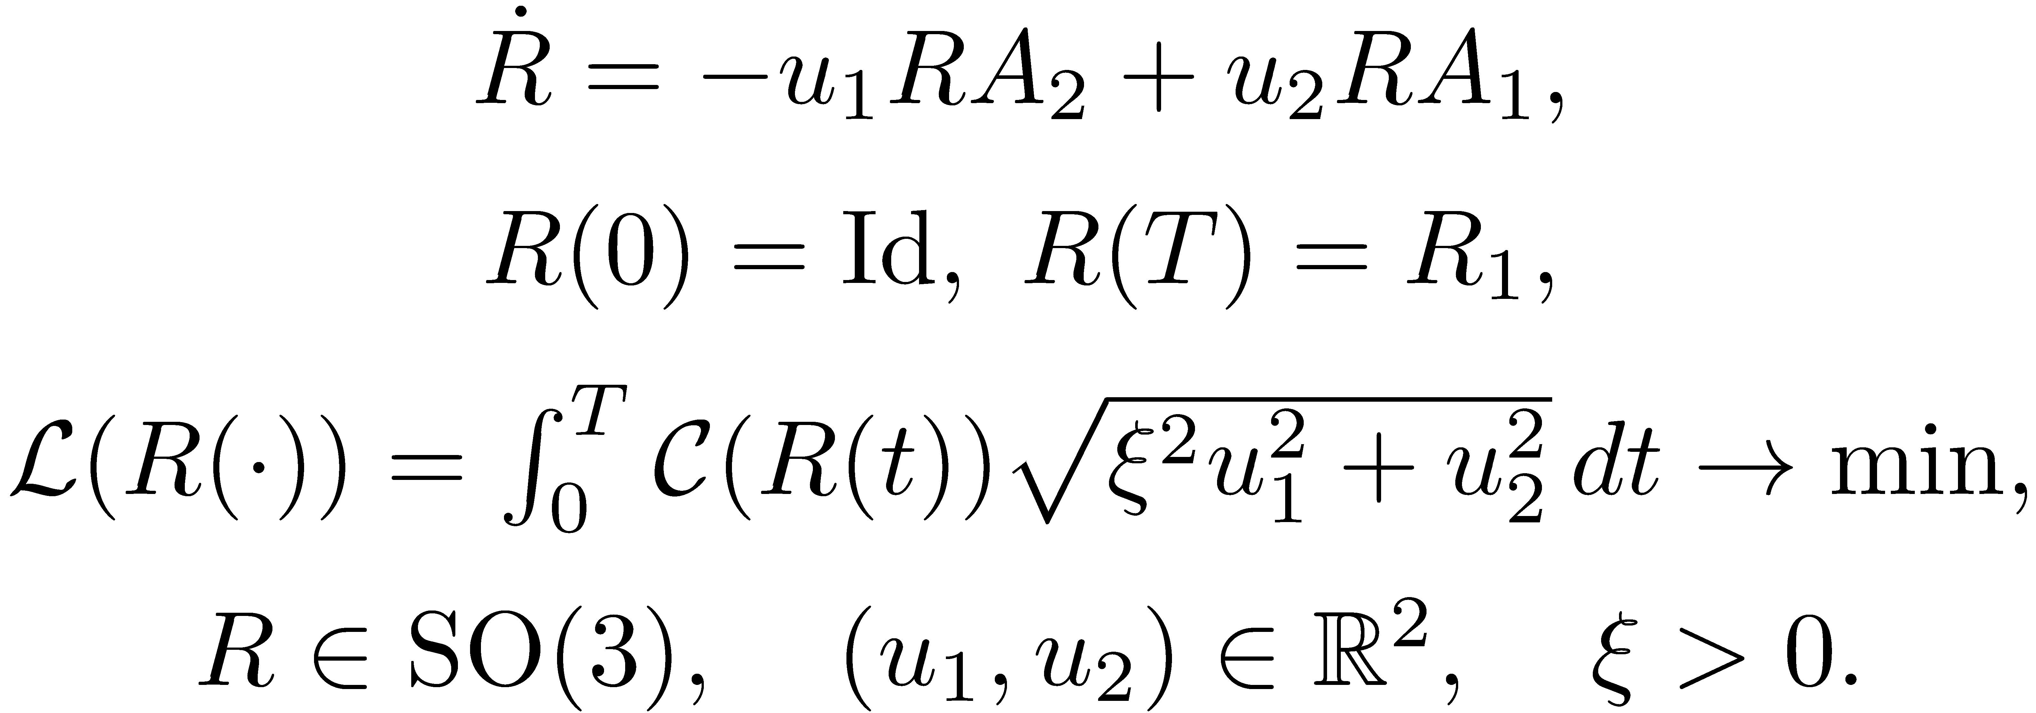


Problem Pcurve(S²) and Pmec(SO(3))
Given
Pcurve(S²)
Find a smooth curve
s. t.:
where
Pmec(SO(3))
10
Notes:
e^{y A_3} e^{- x A_2} e^{\theta A_1}

Slide 11
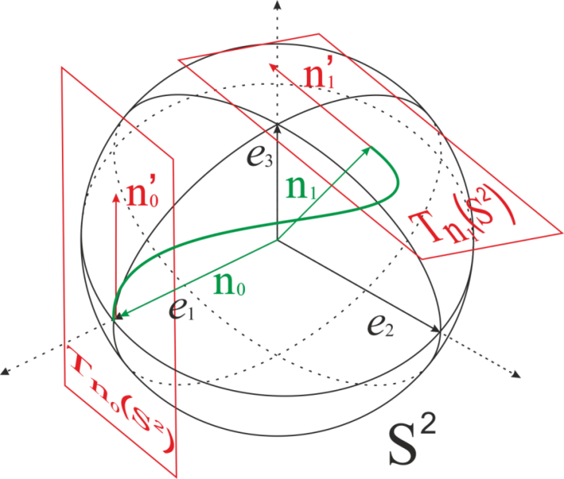
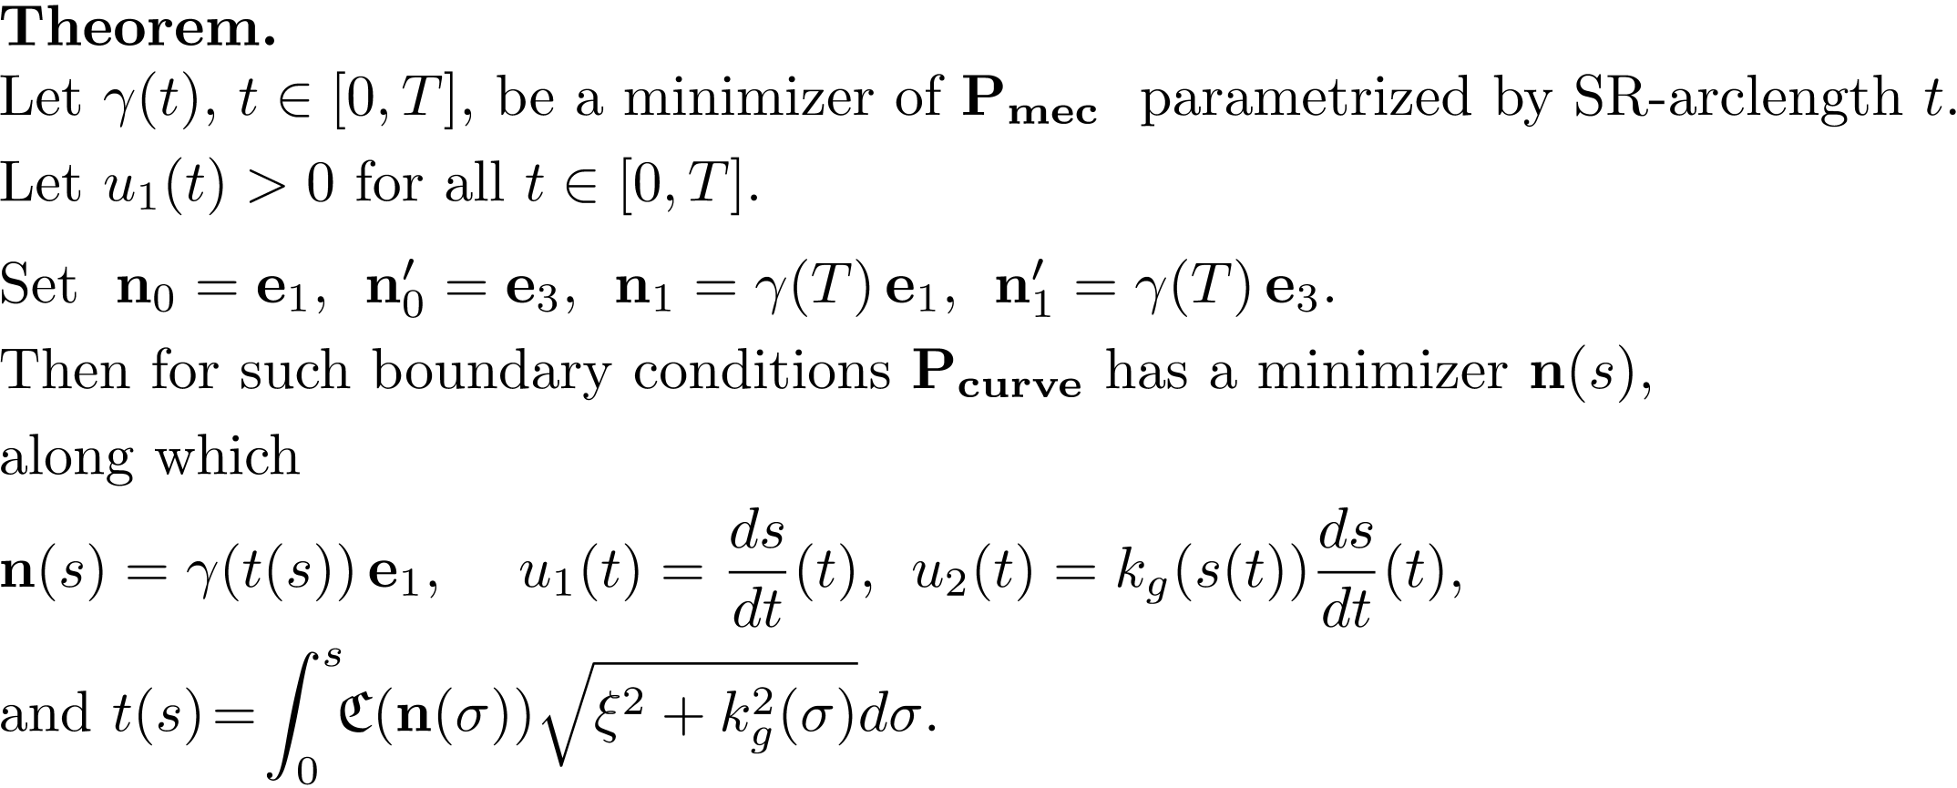
Relation between Pmec and Pcurve
Pmec
Pcurve
11

Slide 12
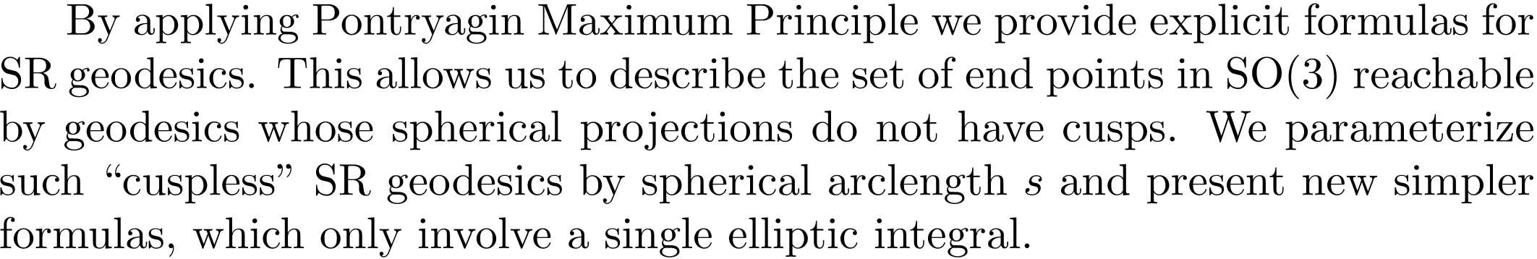
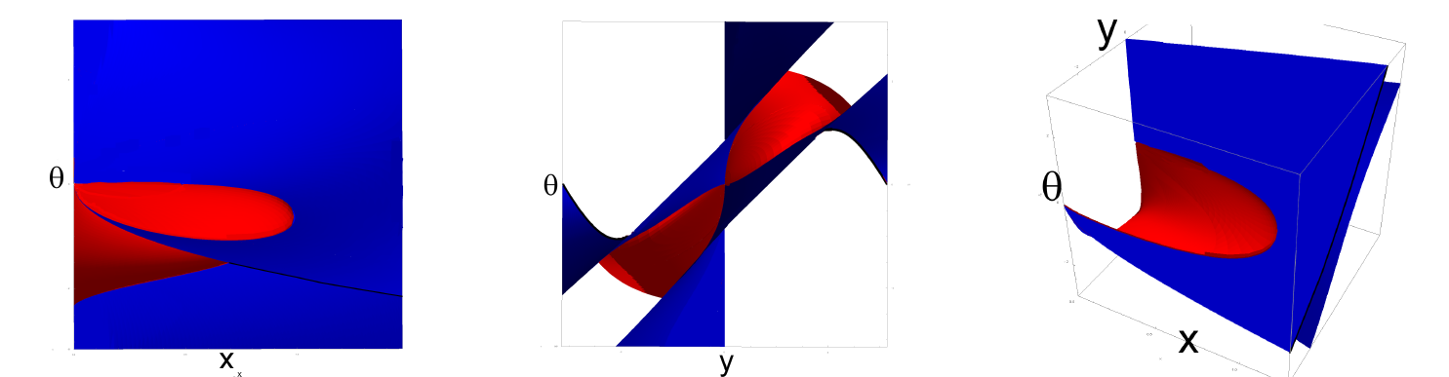
Geodesics in Problem Pmec for C= 1
Red surface: endpoints of geodesics starting from cusp.
Blue surface: endpoints of geodesics ending in cusp.

Slide 13
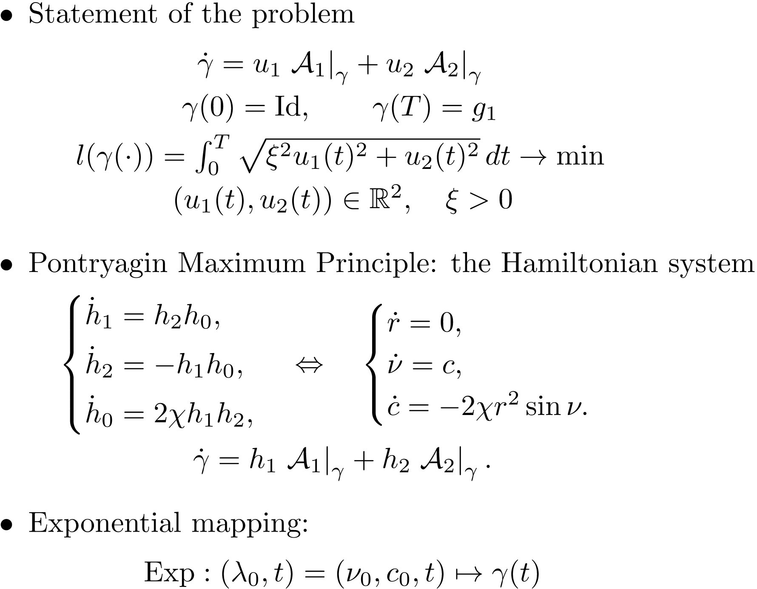

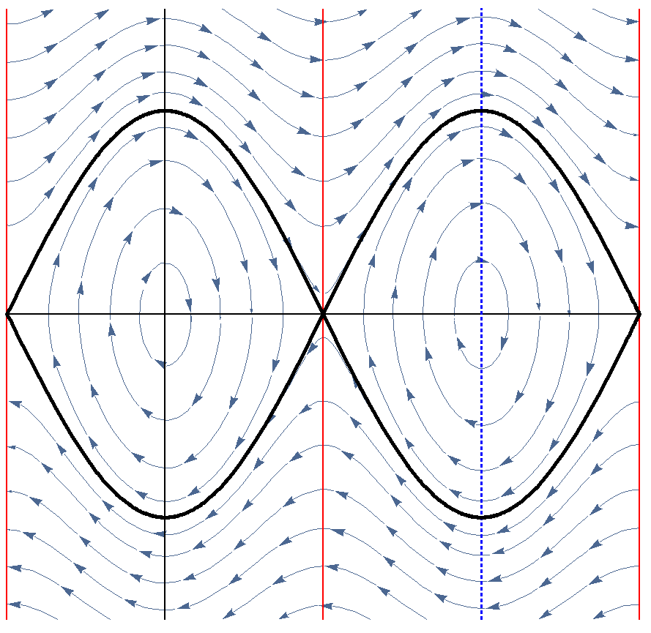



Optimal Control Problem: ODE-based Approach

Slide 14
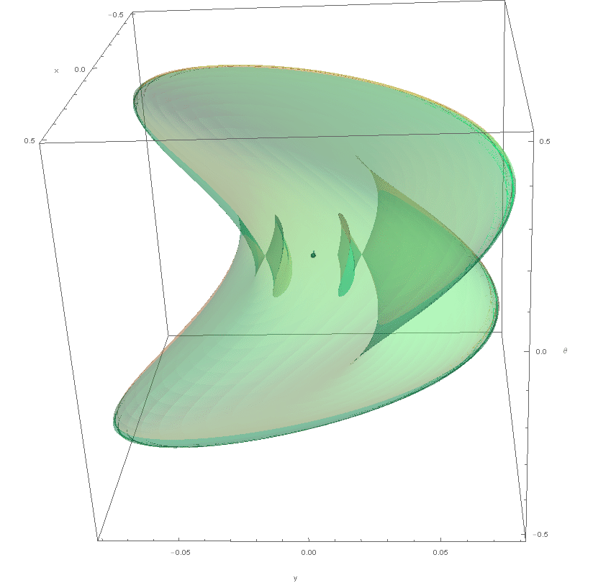

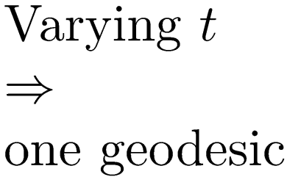
Sub-Riemannian Wave Front

Slide 15

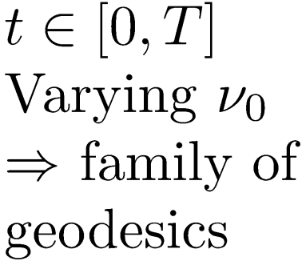
Sub-Riemannian Wave Front
Notes:
By Varying of initial angle of mathematical pendulim th_0 we obtain one-parametric family of geodesics.

Slide 16
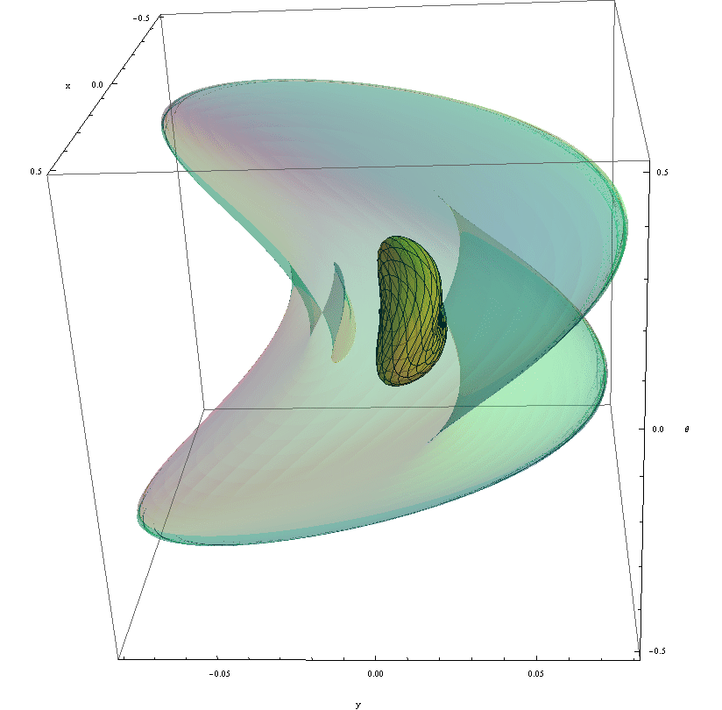


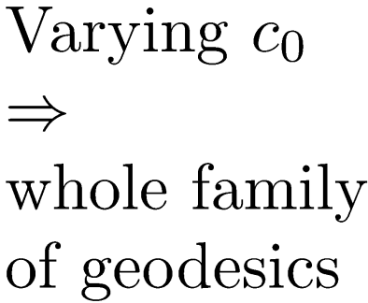
Sub-Riemannian Wave Front
Notes:
Then, by Varying of initial anglular velocity of mathematical pendulim c_0 from -\ifinity to \infinity we will obtain whole family of geodesics. Their endpoints form wavefront. You can see that wavefront intersect itself. It happends when geodesic reach first Maxwell set. So geodesic ending in interior part of wavefront is not SR minimizer, since there exists another geodesic reaches the same point in less time.

Slide 17
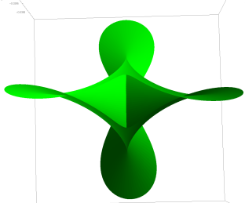
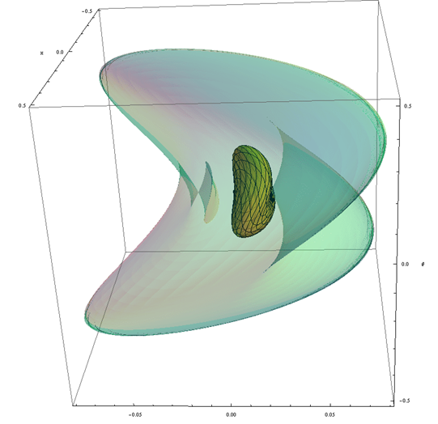

Self intersection of Sub-Riemannian Wave Front
General case: astroidal shape of conjugate locus
Special case with rotational symmetry
A.Agrachev, Exponential mappings for contact sub-Riemannian structures. JDCS, 1996.
H. Chakir, J.P. Gauthier and I. Kupka, Small Subriemannian Balls on R3. JDCS, 1996.

Slide 18

Sub-Riemannian Sphere

Slide 19

SR-minimizers in Problem Pmec

Slide 20







Riemannian Approximation and Fast Marching

Slide 21






Validation for Uniform Cost C = 1

Slide 22






Vessel Tracking in Spherical Images of Retina
via Data-driven SR-geodesics on SO(3)

Slide 23


Vessel Curvature via Data-driven SR-geodesics on SO(3)
23

Slide 24
Conclusion
Data-driven SR-geodesics - useful tool for retinal vessel tracking
Fast and accurate method for computing data-driven SR-geodesics
Data-driven SR-geodesics - reasonable model of V1
Spherical images of retina reduce the distortion
Considerable difference in vessel tracking via SE(2) and SO(3) geodesics
Bigger effect in curvature measurement
24

Slide 25
Thank you for your attention!

