Slide 1
Tracking of Lines in Spherical Images via Sub-Riemannian Geodesics in SO(3)
A.P. Mashtakov¹
Collaborators: R. Duits², Yu. Sachkov¹, E.J. Bekkers², I. Beschastnyi³
Program System Institute of RAS¹, Eindhoven University of Technology²,
International School of Advanced Studies³
International Workshop on
Geometry, PDE’s and Lie Groups in Image Analysis
Eindhoven, The Netherlands, August 24, 2016

Slide 2
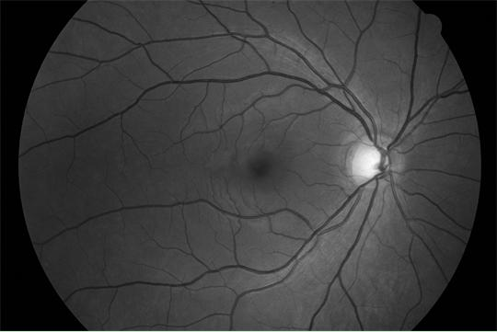
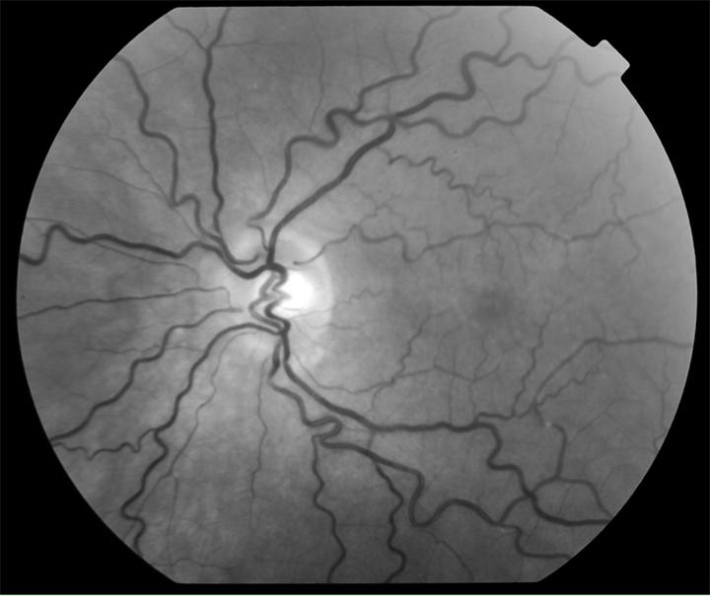
Analysis of Images of the Retina
Diabetic retinopathy --- one of the main causes of blindness.
Epidemic forms: 10% people in China suffer from DR.
Patients are found early --> treatment is well possible.
Early warning --- leakage and malformation of blood vessels.
The retina --- excellent view on the microvasculature of the brain.
Healthy retina
Diabetes Retinopathy with
tortuous vessels

Slide 3
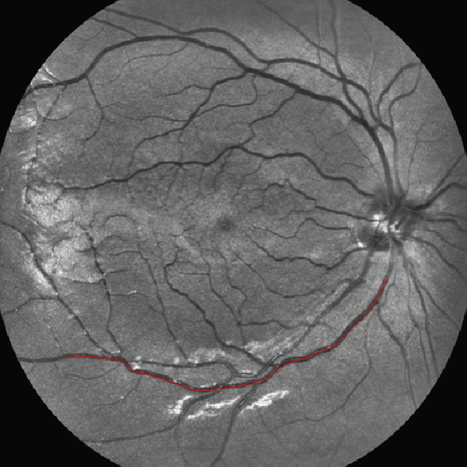
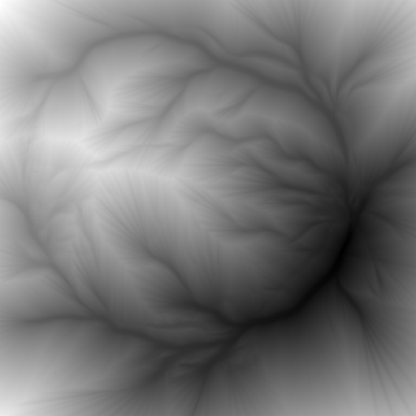
Geodesic Methods in Computer Vision
Image
Distance from source point
Source Point
Source Point
Sink Point
Sink Point
Geodesic
Geodesic
Tracking of salient lines via data-driven minimal paths (or geodesics).
Data-driven Geodesic – curve that minimizes length functional weighted by external cost (function with high values at image locations with high curve saliency).
Fast Marching method to compute geodesics:
1) Computation of distance map from source point, 2) Geodesic via steepest decent on distance map.
3

Slide 4
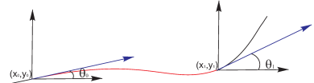
Sub-Riemannian Geodesics:
Cortical Based Model of Perceptual Completion

Slide 5
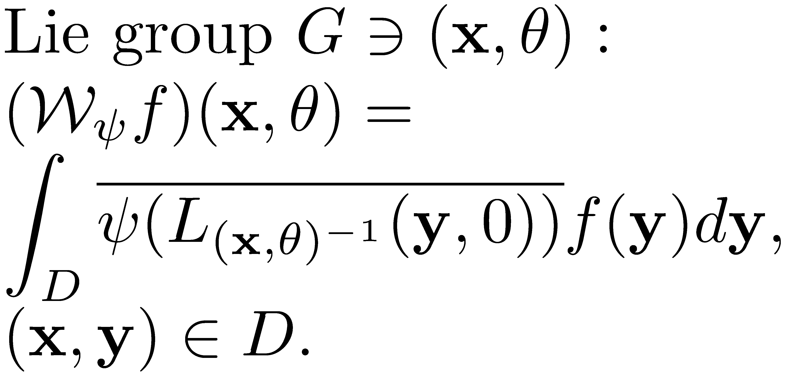



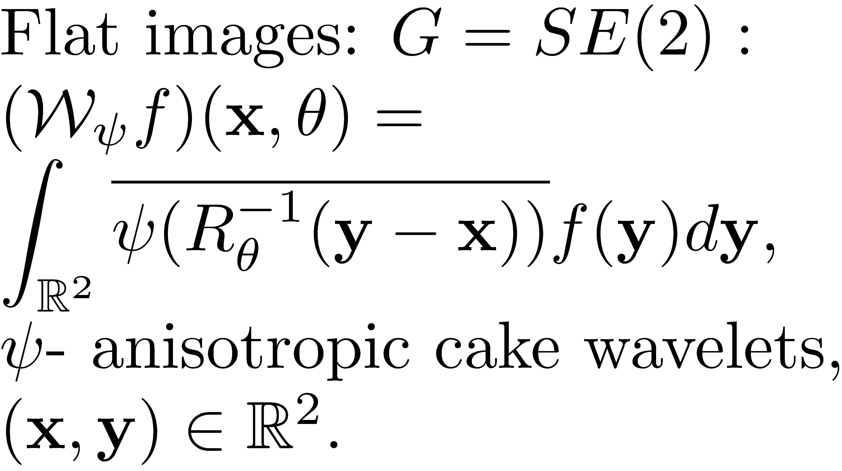
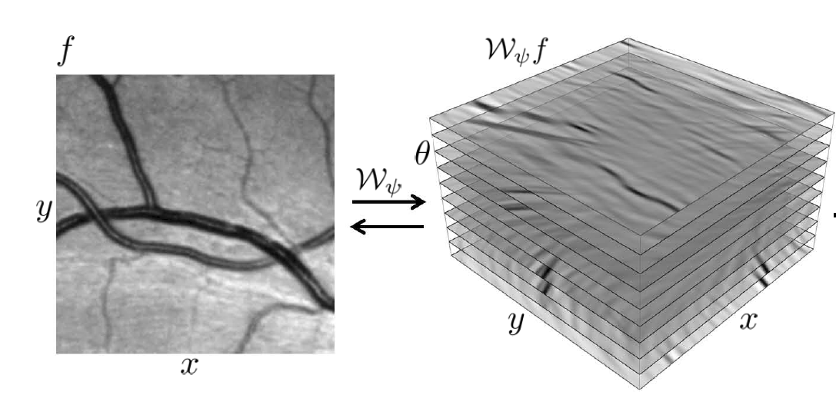
Lie Group Analysis via Invertible Orientation Scores
Image
Score
Processed
image
Processed
Score
R. Duits, Perceptual Organization in Image Analysis, PhD Thesis, 2005.

Slide 6
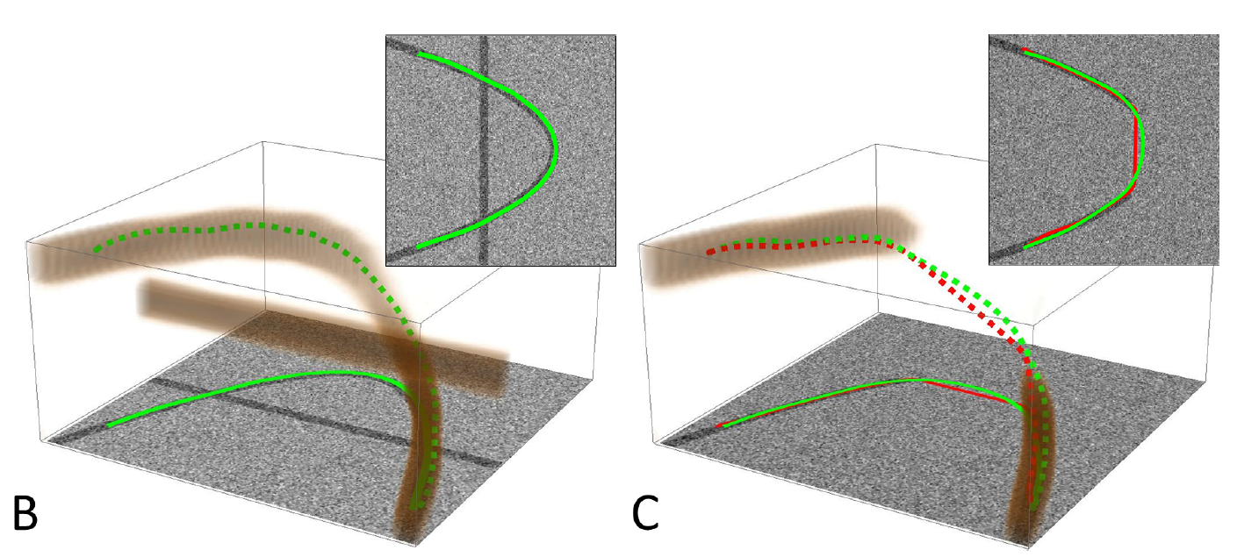
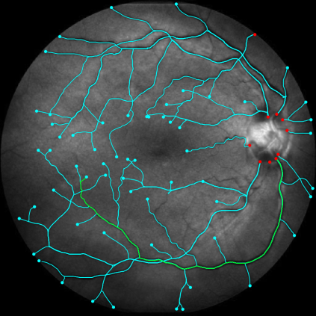
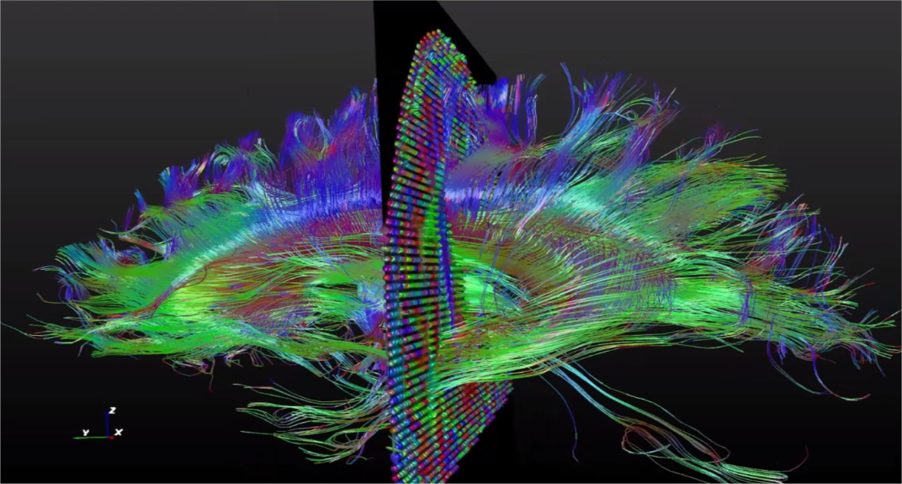
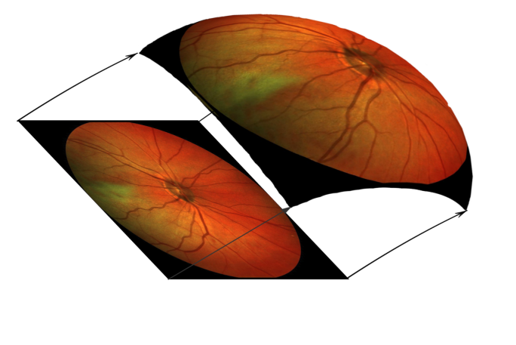
SR geodesics on Lie Groups in Image Analysis
Crossing structures are disentangled
Restoration of corrupted contours
based on model of human vision
Applications in medical image analysis
SE(2)
SO(3)
SE(3)

Slide 7
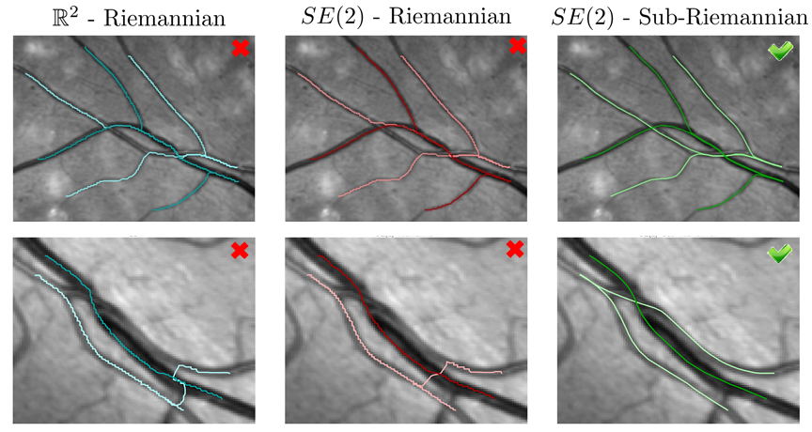
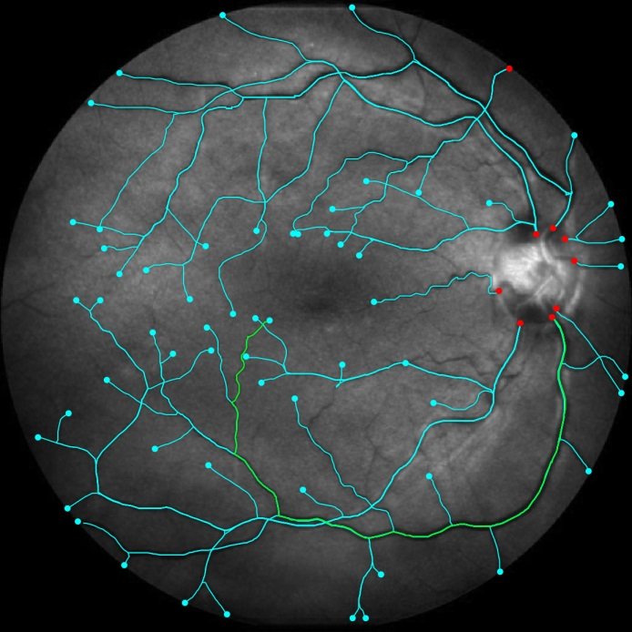
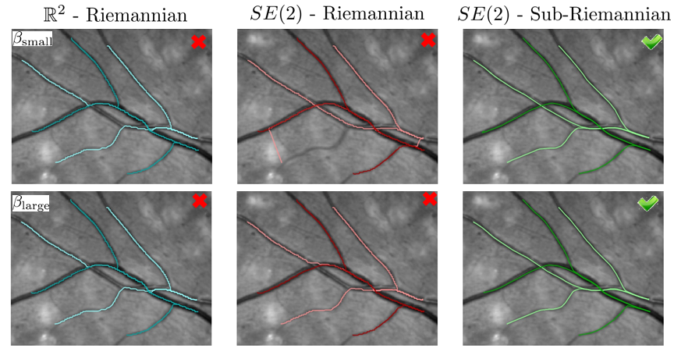
Traccking of Lines in Flat Images via
Sub-Riemannian Geodesics in SE(2)

Slide 8
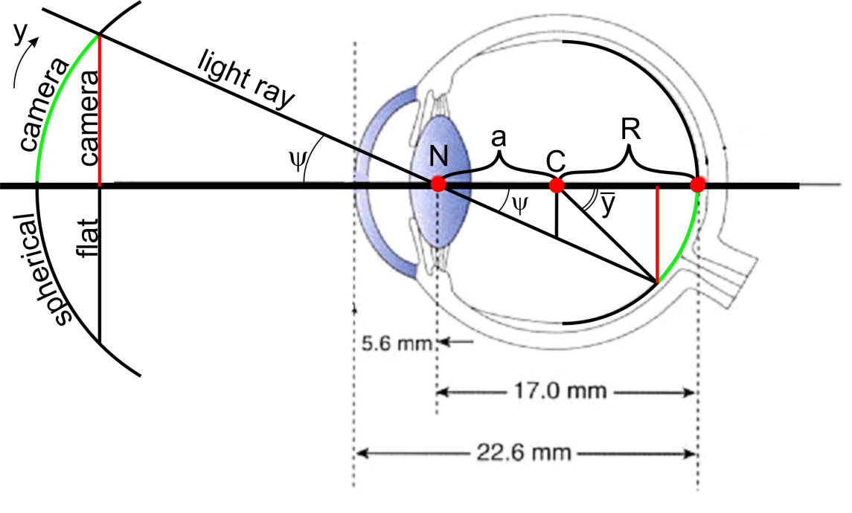
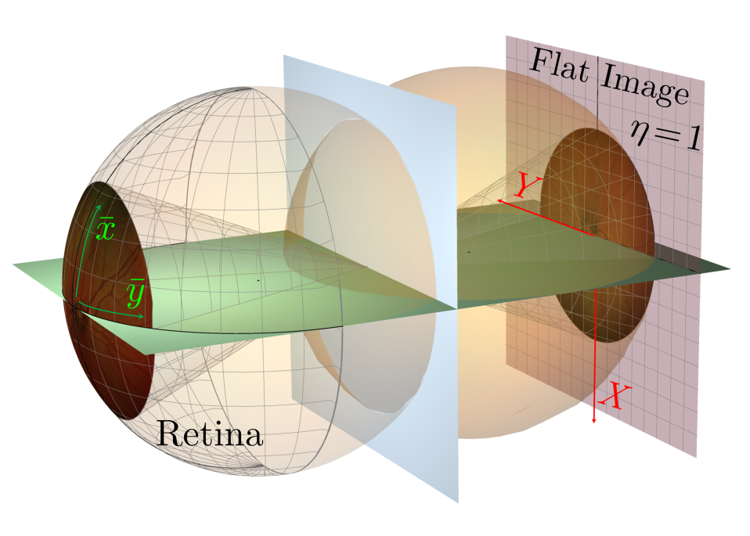
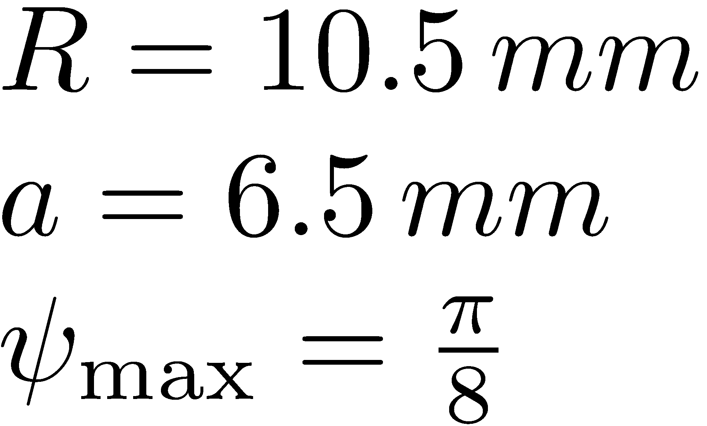
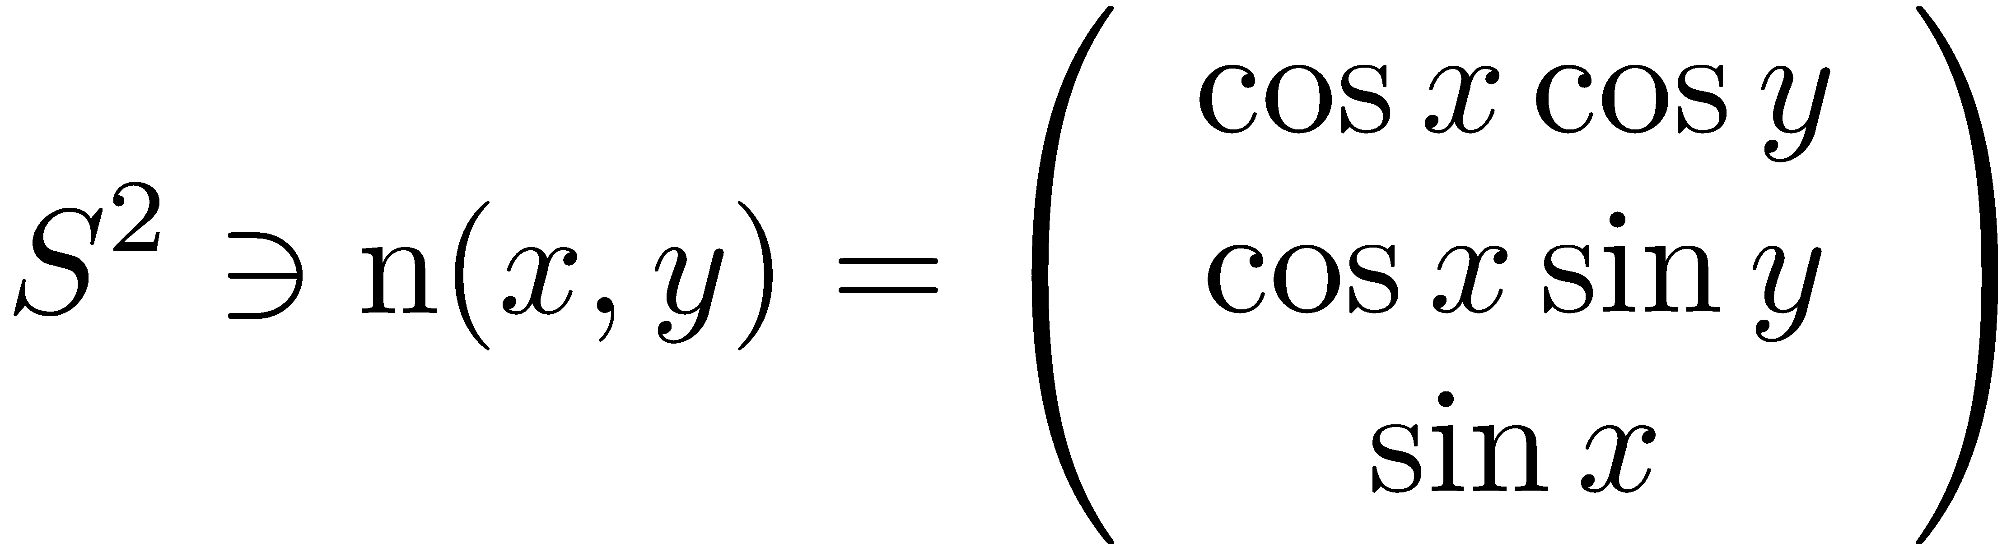
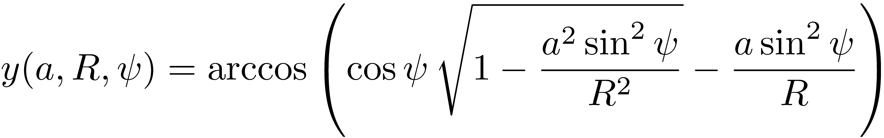
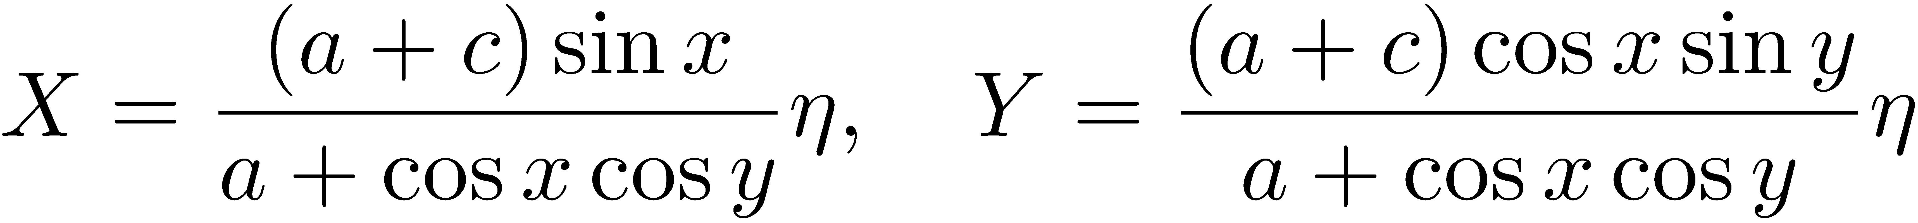
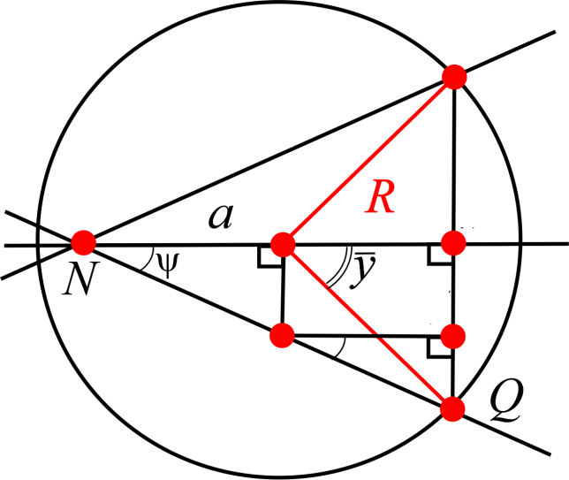
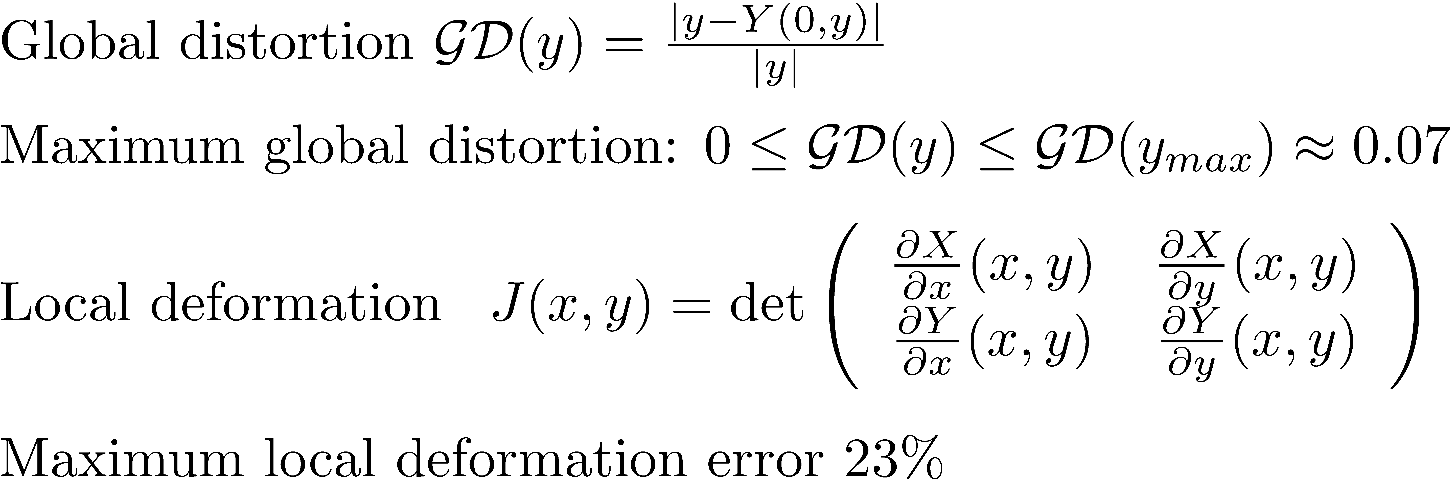
Spherical Images of Retina

Slide 9
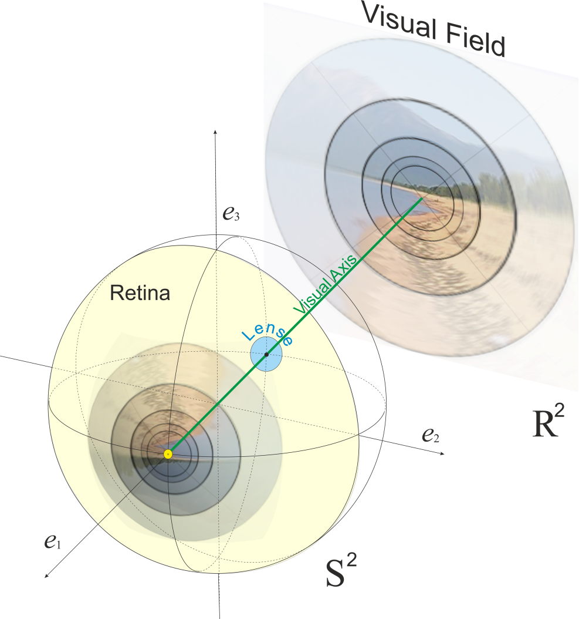
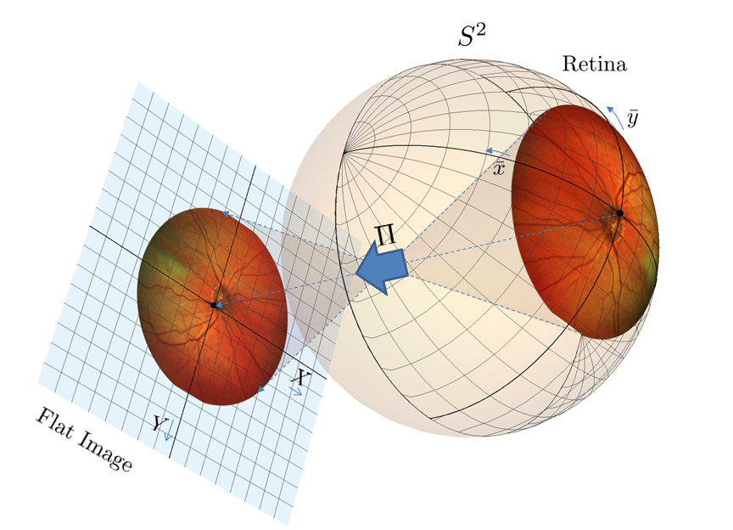
Motivation
Aim: data-driven SR geodesics on SO(3) for detection and analysis of vessel tree in spherical images of retina, to reduce distortion.
Spherical extension of cortical based model of perceptual completion on retinal sphere
9

Slide 10
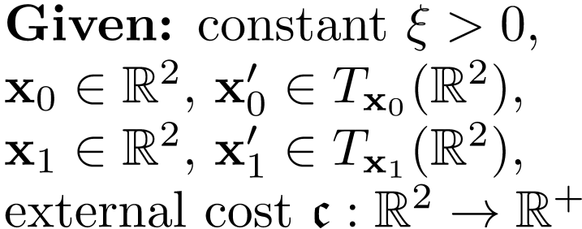
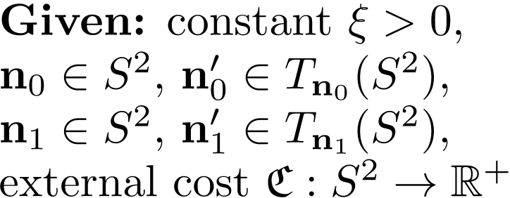
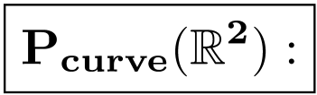
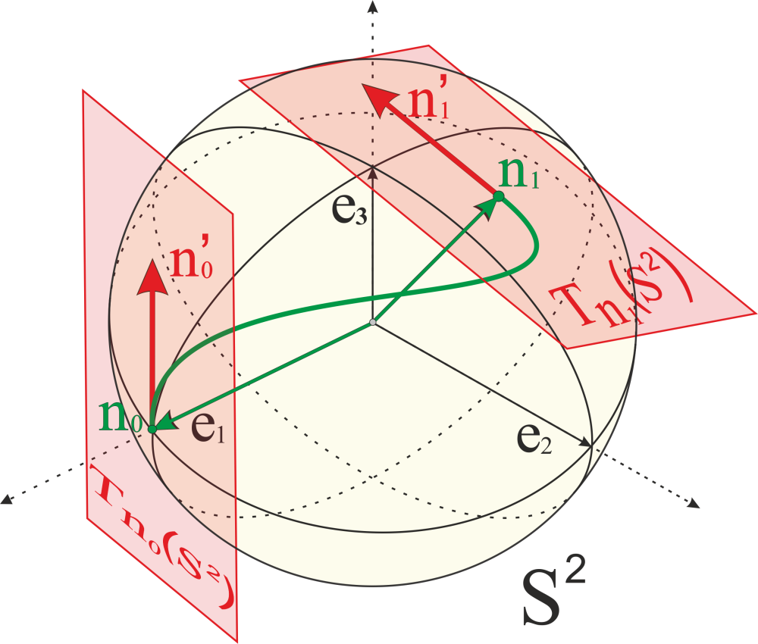
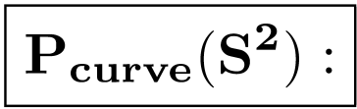
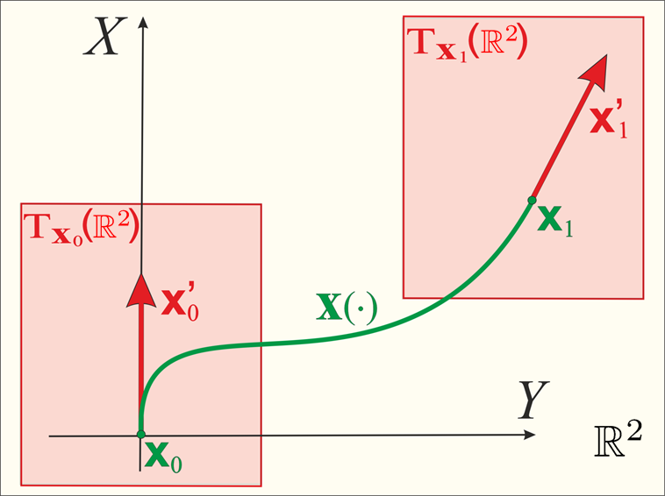
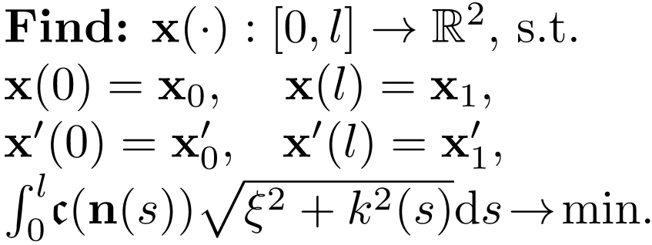
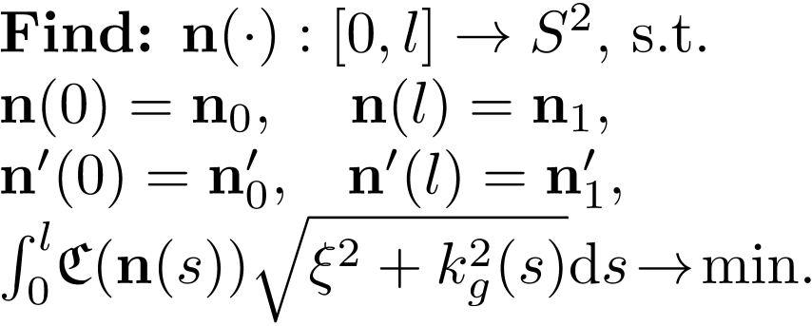
Spherical Extension of Flat Model

Slide 11
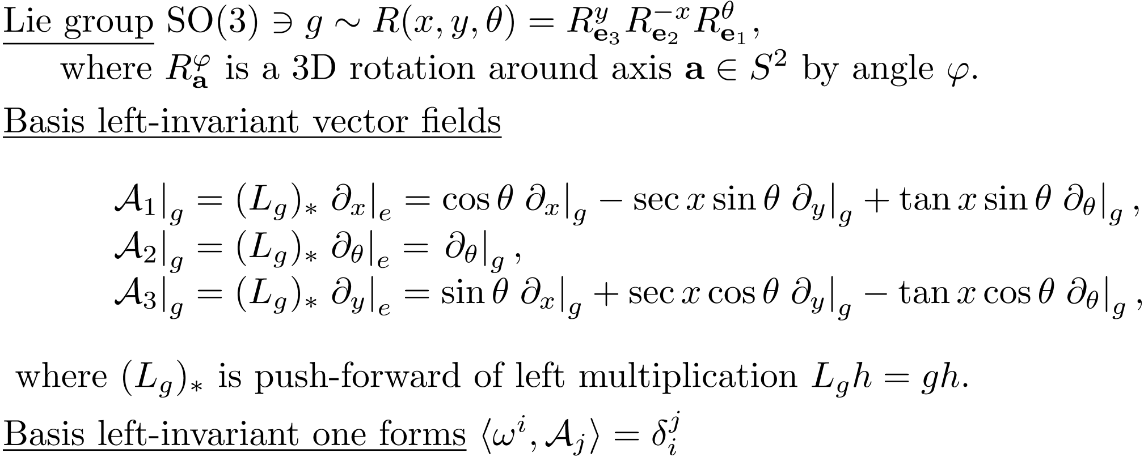
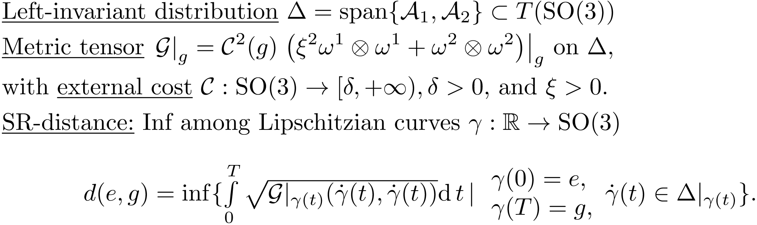
Sub-Riemannian Structure in SO(3)
11

Slide 12
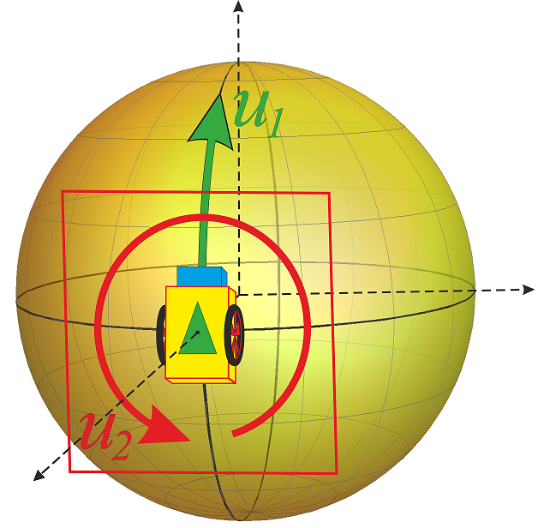
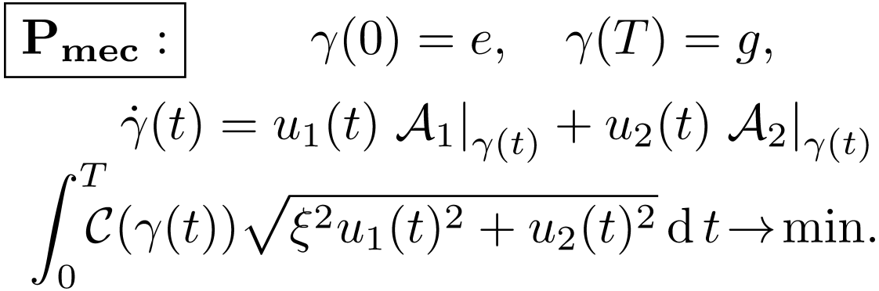
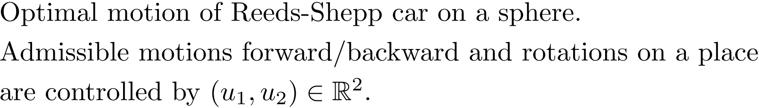
Problem Pmec: Sub-Riemannian Problem in SO(3)
U. Boscain and F. Rossi, Invariant Carnot-Caratheodory metrics on S^3, SO(3), SL(2) and Lens Spaces, JCO, 2008.
12

Slide 13
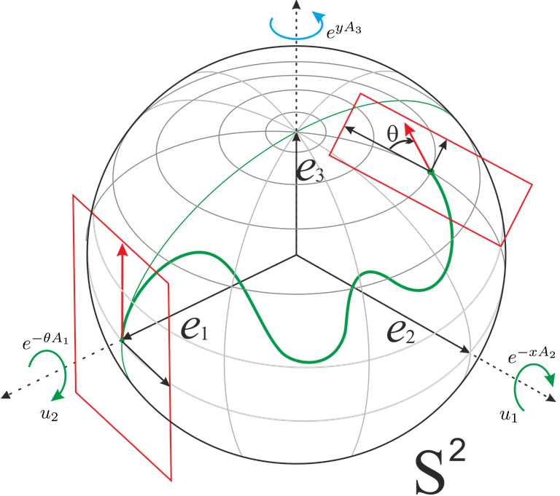
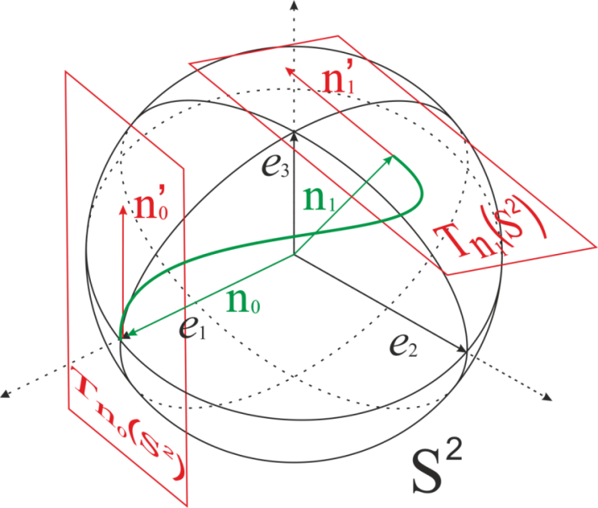
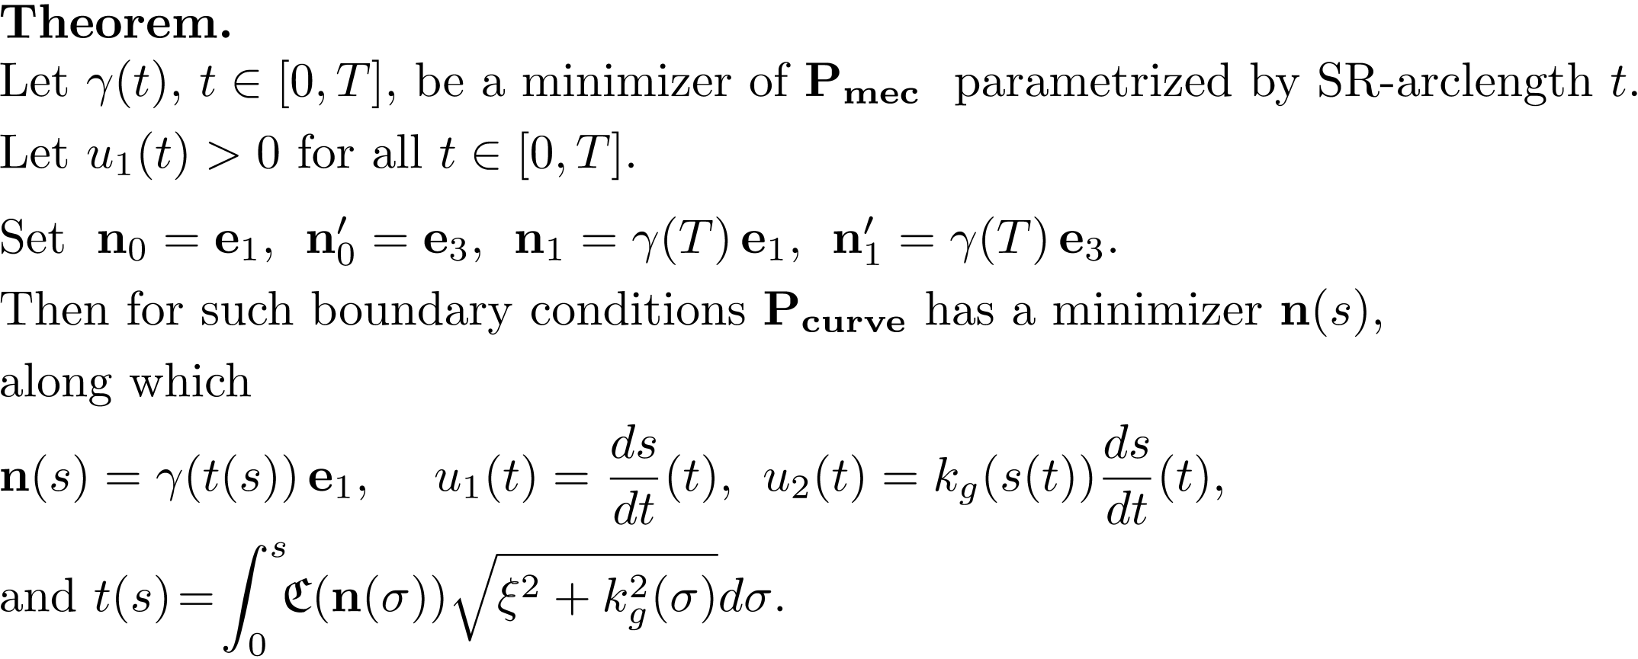
Relation between Pmec and Pcurve
Pmec
Pcurve
13

Slide 14
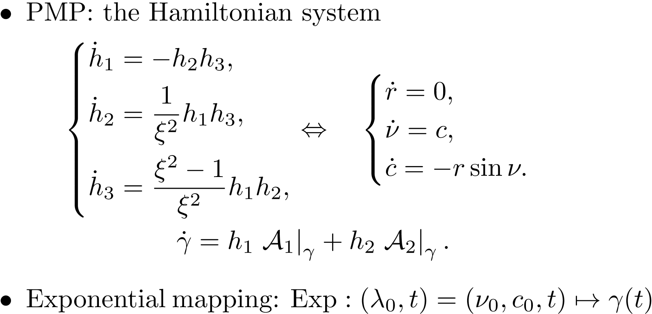

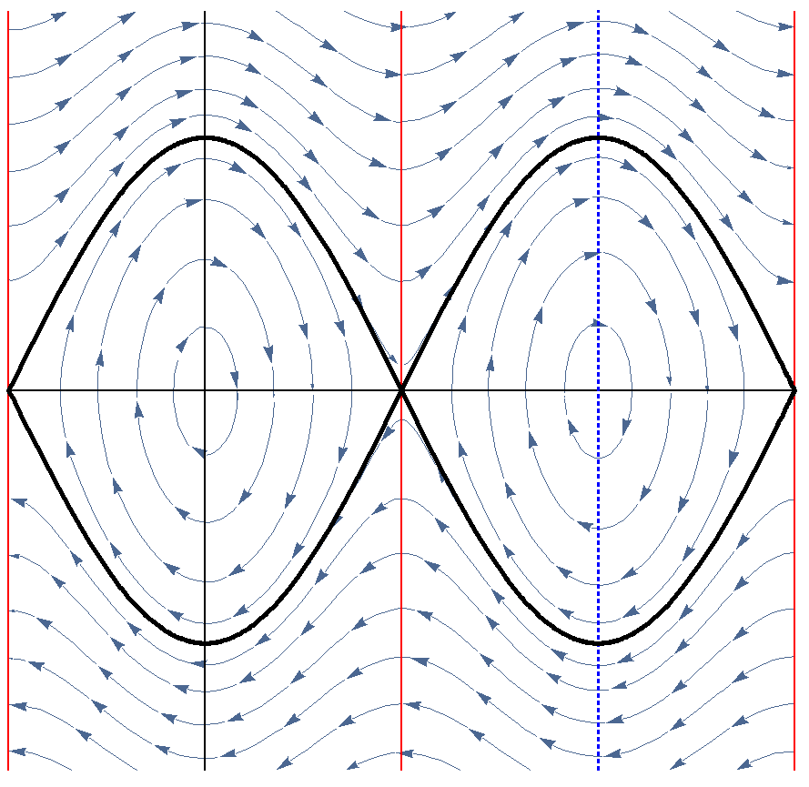



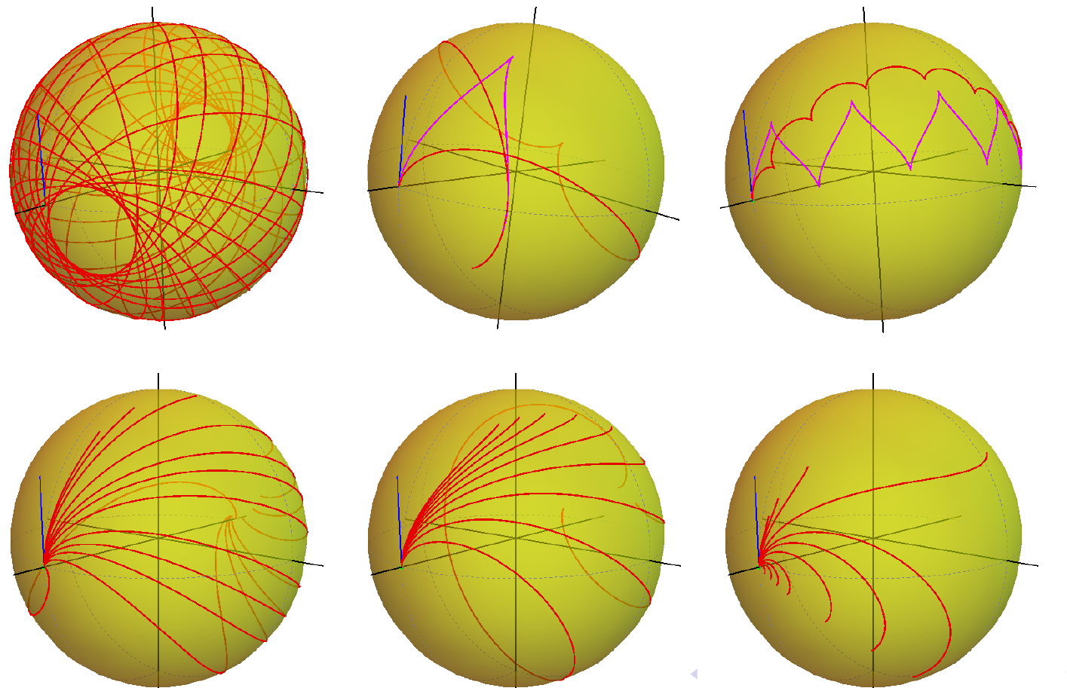
Optimal Control Problem: ODE-based Approach
Cusp Point

Slide 15
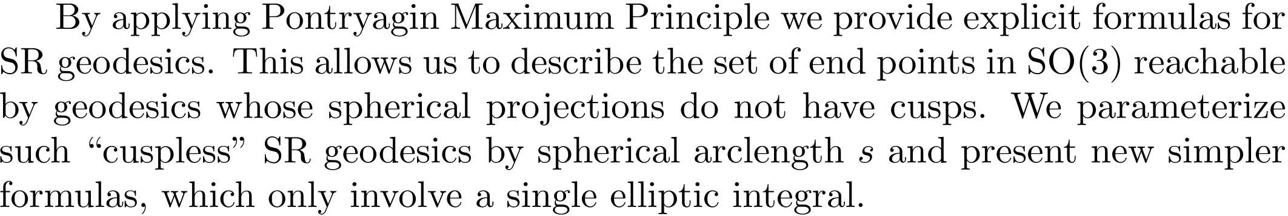
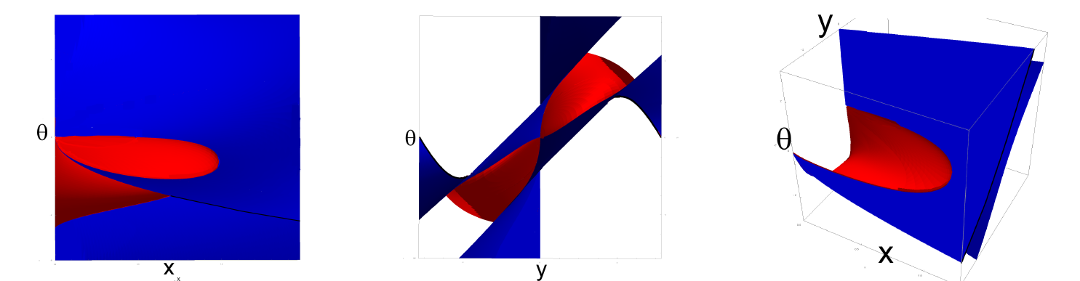
Geodesics in Problem Pmec for C= 1
Red surface: endpoints of geodesics starting from cusp.
Blue surface: endpoints of geodesics ending in cusp.

Slide 16
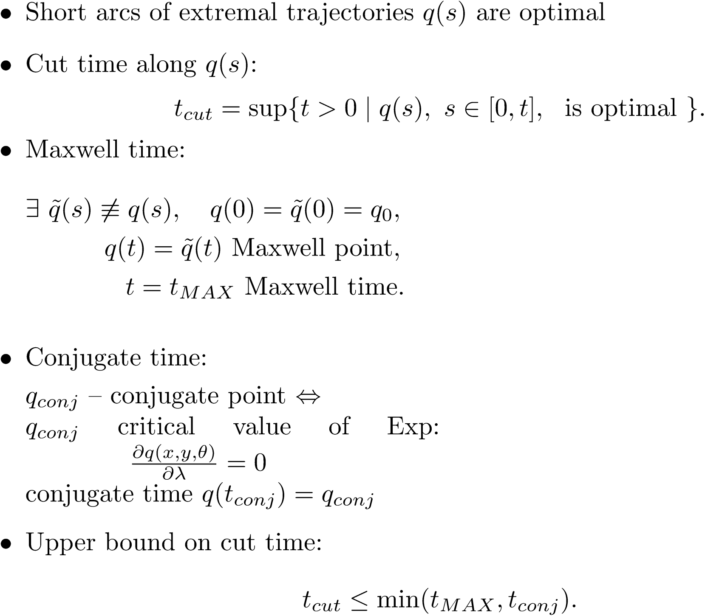

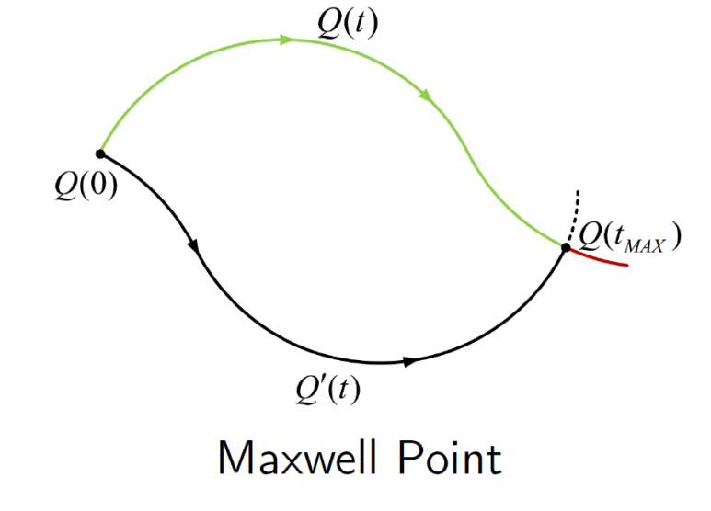



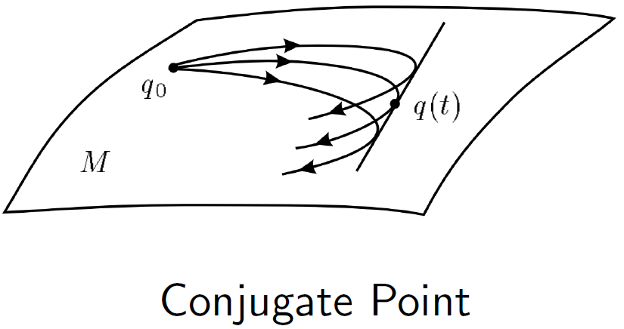

Optimality of Extremal Trajectories
Notes:
The question of optimality of extremal trajectories is much more complicated.

Slide 17
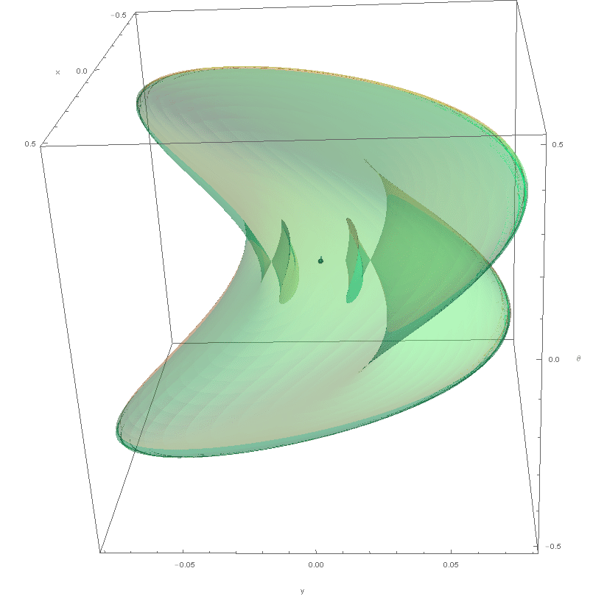


Sub-Riemannian Wave Front

Slide 18


Sub-Riemannian Wave Front
Notes:
By Varying of initial angle of mathematical pendulim th_0 we obtain one-parametric family of geodesics.

Slide 19




Sub-Riemannian Wave Front
Notes:
Then, by Varying of initial anglular velocity of mathematical pendulim c_0 from -\ifinity to \infinity we will obtain whole family of geodesics. Their endpoints form wavefront. You can see that wavefront intersect itself. It happends when geodesic reach first Maxwell set. So geodesic ending in interior part of wavefront is not SR minimizer, since there exists another geodesic reaches the same point in less time.

Slide 20



Self intersection of Sub-Riemannian Wave Front
General case: astroidal shape of conjugate locus
Special case with rotational symmetry
A.Agrachev, Exponential mappings for contact sub-Riemannian structures. JDCS, 1996.
H. Chakir, J.P. Gauthier and I. Kupka, Small Subriemannian Balls on R3. JDCS, 1996.

Slide 21

Sub-Riemannian Sphere

Slide 22

SR-minimizers in Problem Pmec

Slide 23







Riemannian Approximation and Fast Marching

Slide 24






Validation for Uniform Cost C = 1

Slide 25






Vessel Tracking in Spherical Images of Retina
via Data-driven SR-geodesics on SO(3)

Slide 26


Vessel Curvature via Data-driven SR-geodesics on SO(3)
26

Slide 27
Conclusion
Data-driven SR-geodesics - useful tool for retinal vessel tracking
Fast and accurate method for computing data-driven SR-geodesics
Data-driven SR-geodesics - reasonable model of V1
Spherical images of retina reduce the distortion
Considerable difference in vessel tracking via SE(2) and SO(3) geodesics
Bigger effect in curvature measurement
27

Slide 28
Future Works
Numerical computation of the 1-st Maxwell set,
Adaptation for tracking by only cuspless geodesics,
SR-problem on PTR^2 – tracking in space of positions and orientations,
Comparison of tracking by SO(3) and SE(2) SR-geodesics on large retinal imaging benchmark sequences,
Extension to arbitrary 3D Lie groups.
28

Slide 29
Thank you for your attention!

