Slide 1

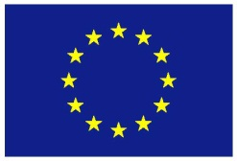
Субримановы геодезические на группах Ли в обработке изображений
A.P. Mashtakov
Supervisors: R. Duits & Bart ter Haar Romeny
Collaborators: Y.L. Sachkov, G.R. Sanguinetti, E.J. Bekkers, I. Beschastnyi
G. Citti, A. Sarti, B. Franceschiello
Funded by
the European Union
Семинар ИПС им. А.К. Айламазяна РАН,
Переславль-Залесский, 27.05.2016

Slide 2

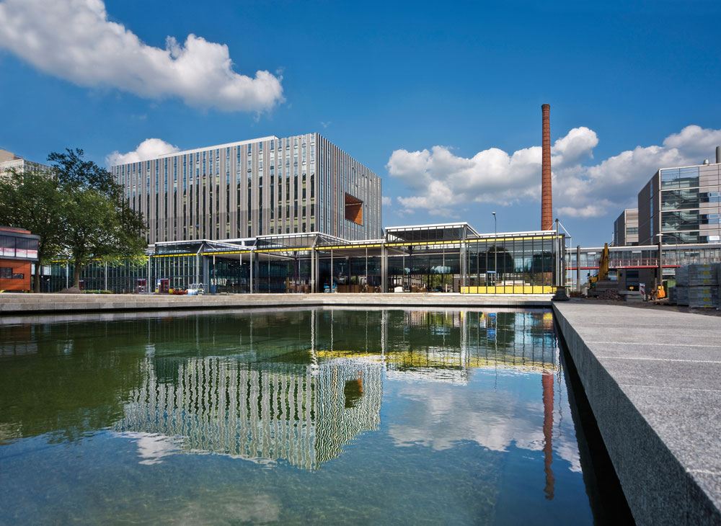

Slide 3
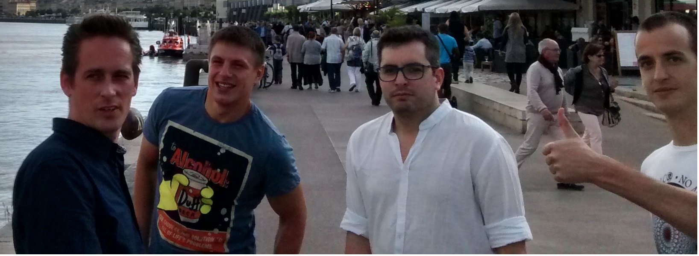
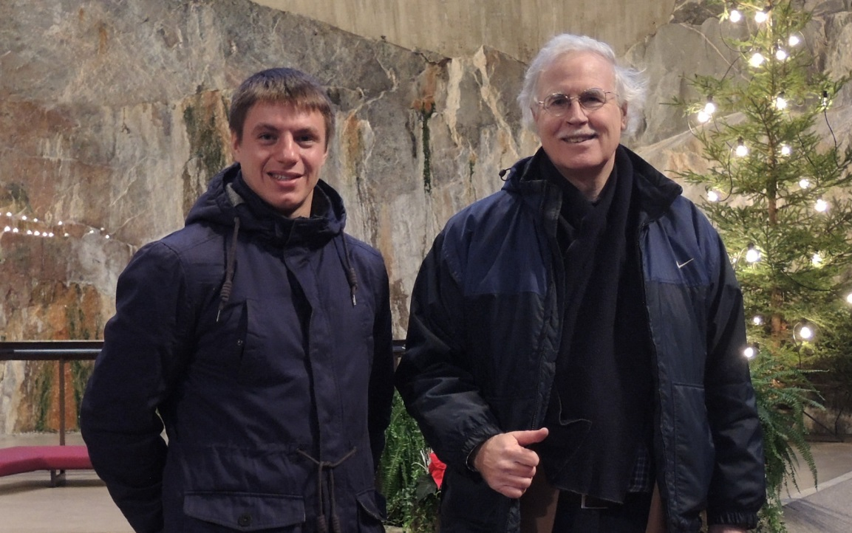
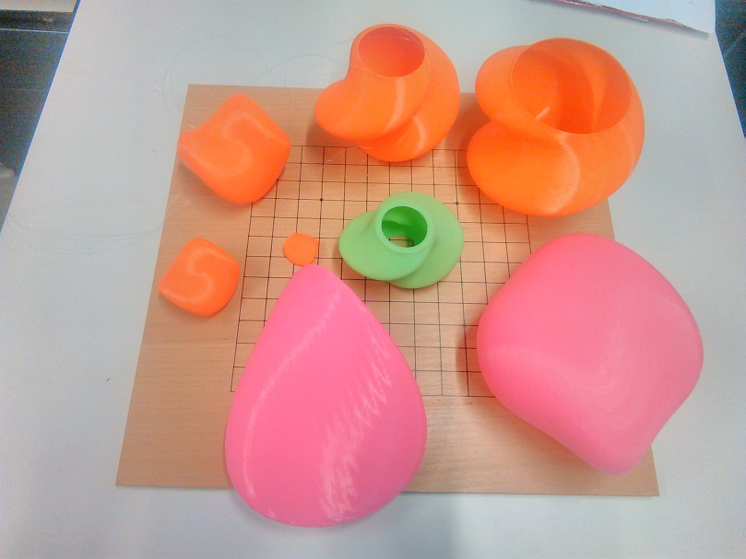
Team in Eindhoven University of Technology
Remco
Duits
Gonzalo Sanguinetti
Erik
Bekkers
Bart M. ter Haar Romeny

Slide 4
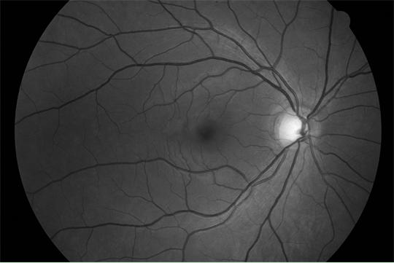
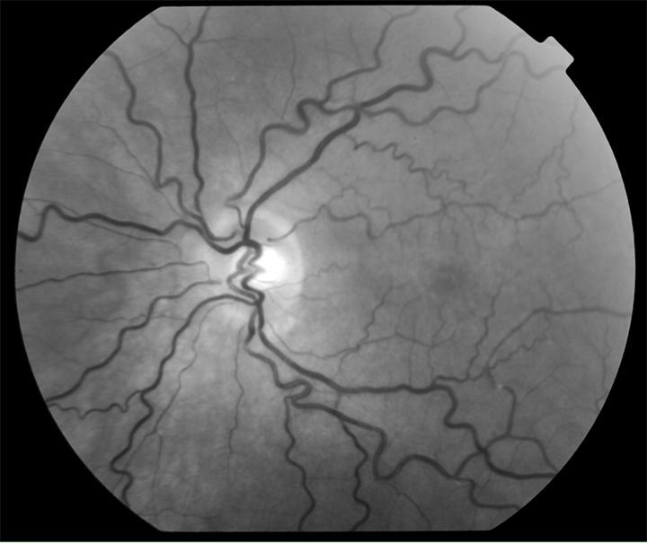
Analysis of Images of the Retina
Diabetic retinopathy --- one of the main causes of blindness.
Epidemic forms: 10% people in China suffer from DR.
Patients are found early --> treatment is well possible.
Early warning --- leakage and malformation of blood vessels.
The retina --- excellent view on the microvasculature of the brain.
Healthy retina
Diabetes Retinopathy with
tortuous vessels

Slide 5
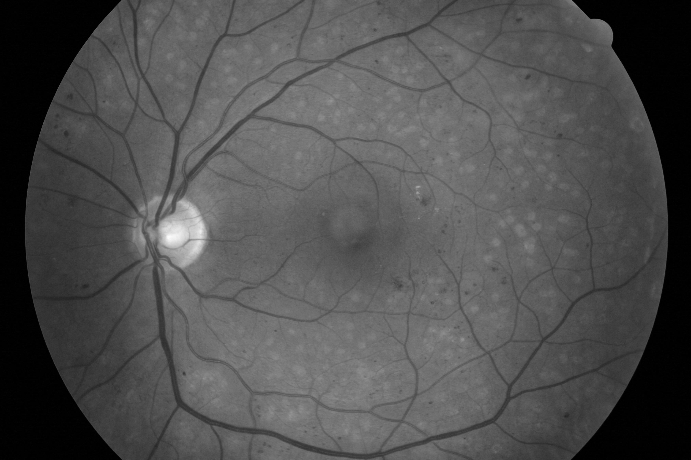
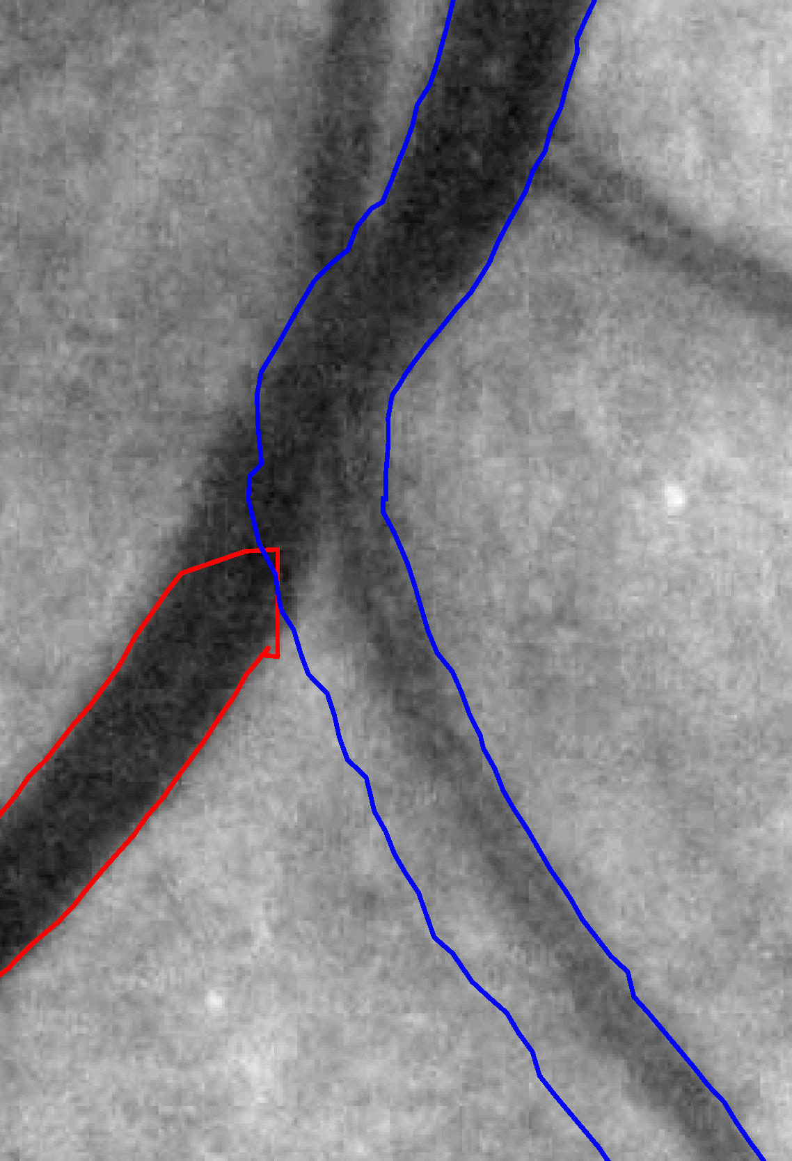
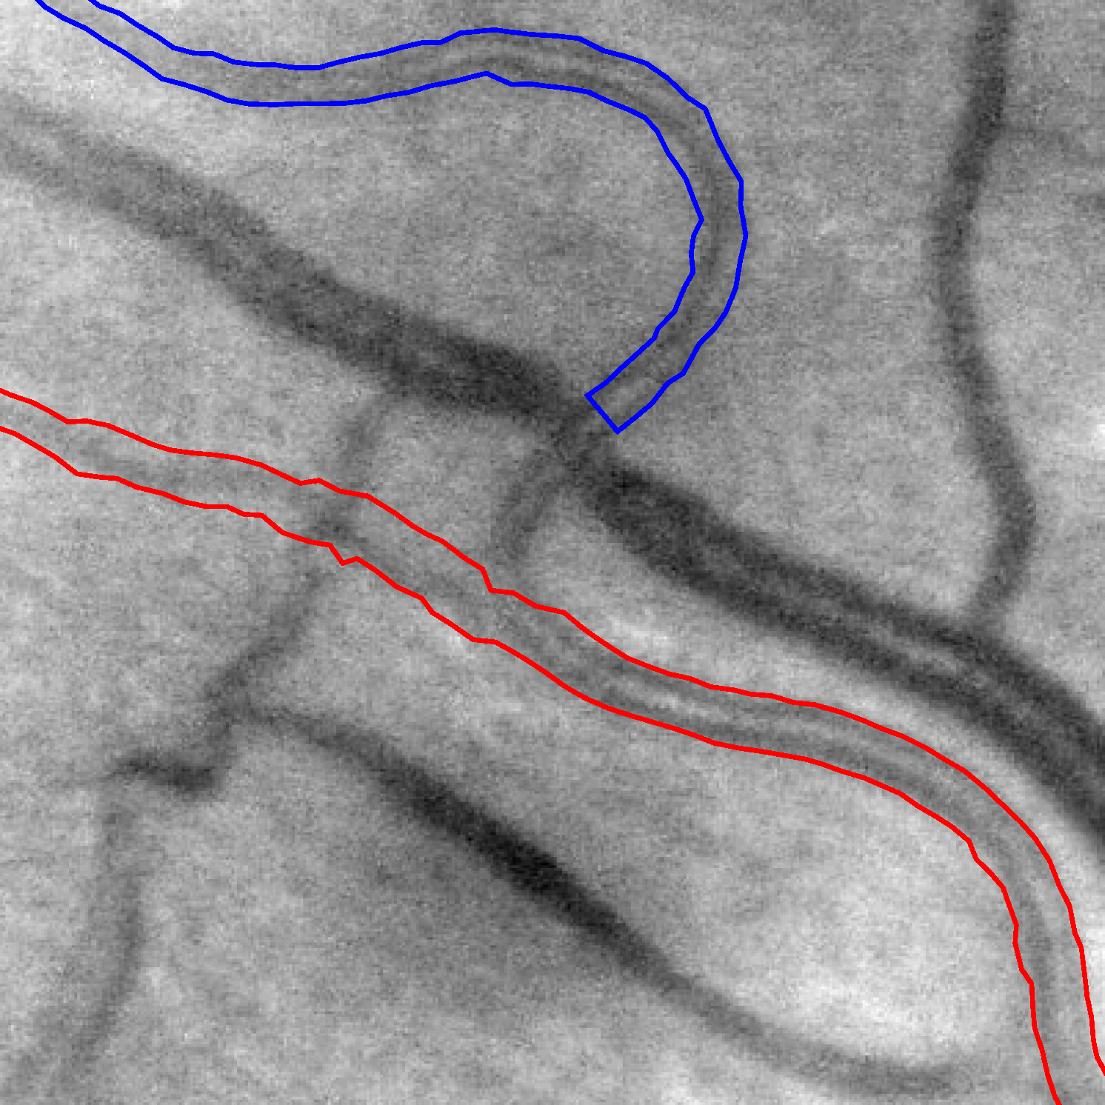
Detect Vascular Tree in Images of the Retina
Application: Early diagnosis of diabetes
Problem: Low contrast & crossings & bifurcations & scales
Aim: Reliable tracking of all blood vessels in retina

Slide 6



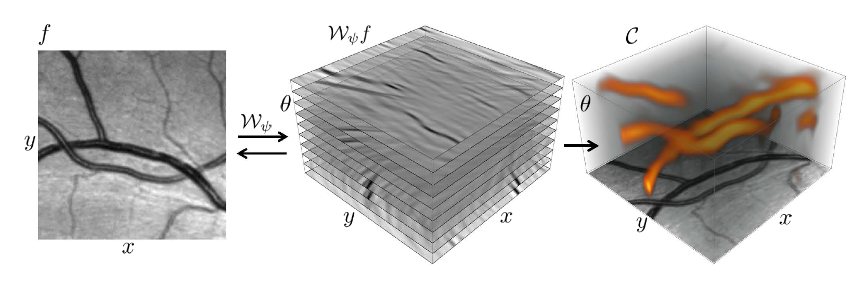
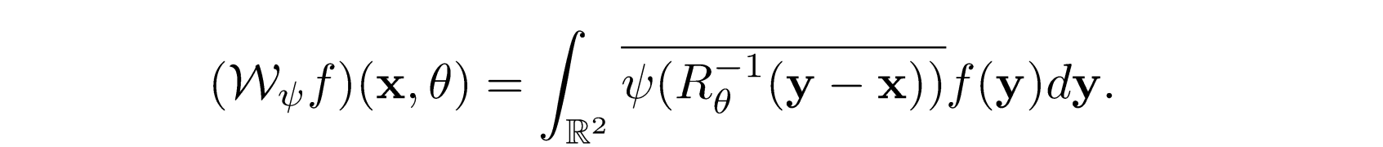
Lie Group Analysis via Invertible Orientation Scores
Image
Score
Processed
image
Processed
Score
6

Slide 7
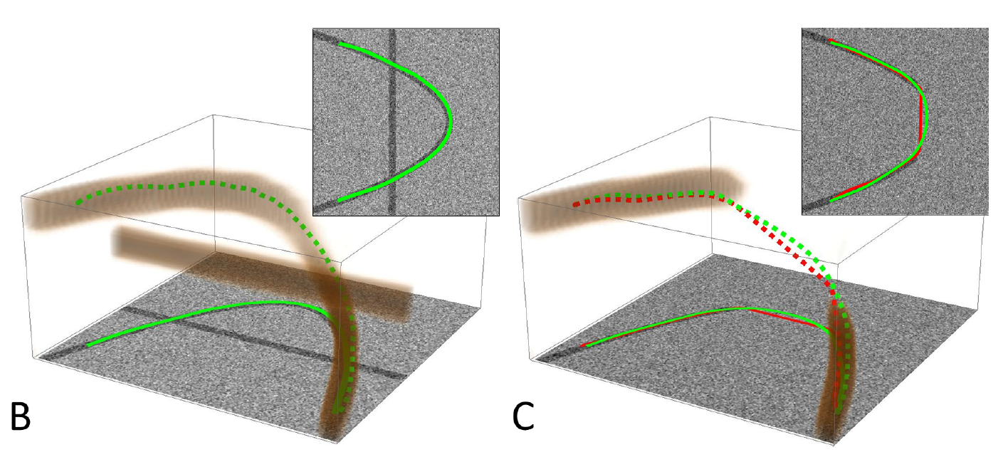
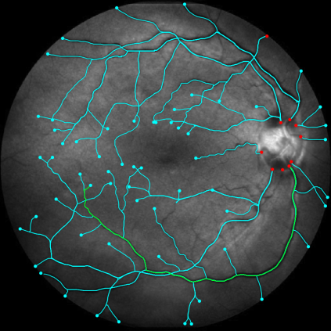
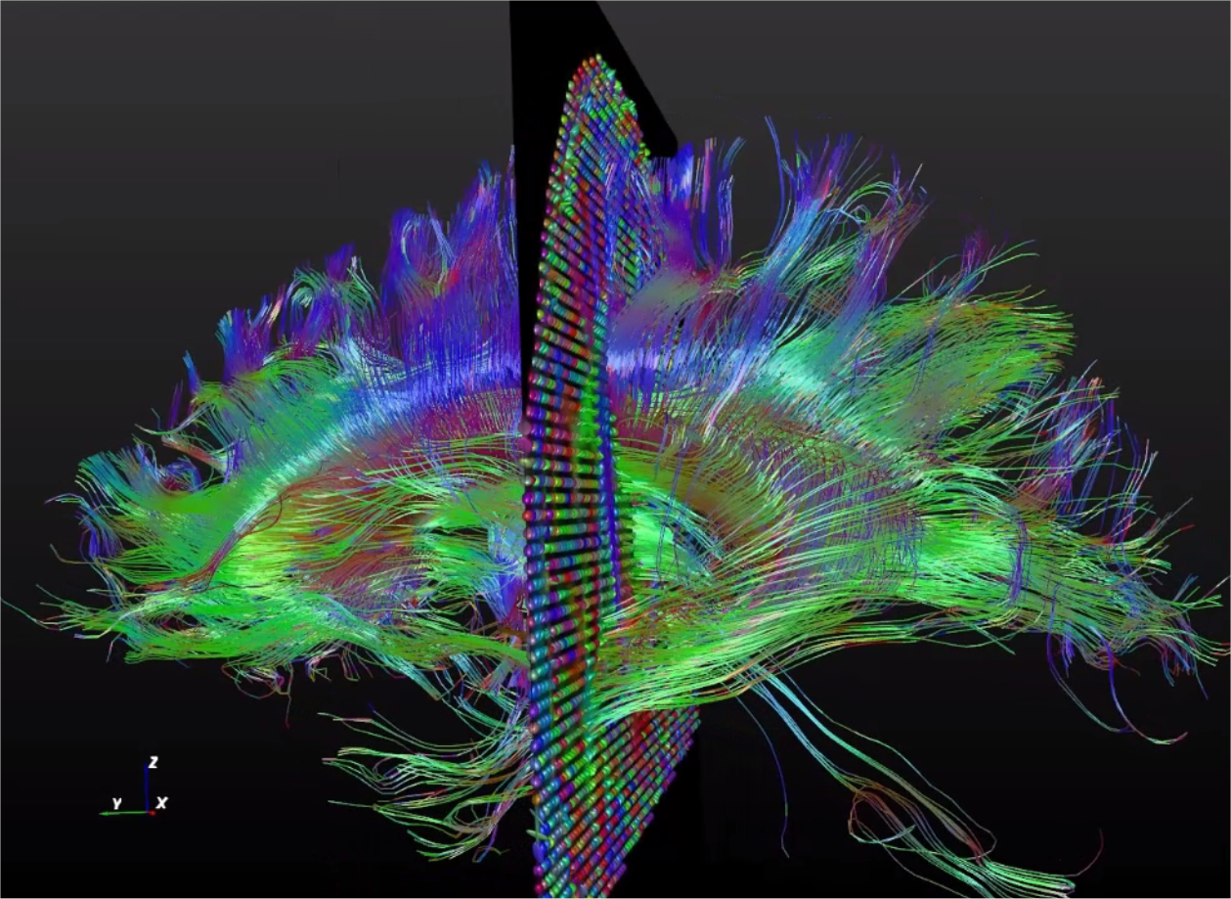
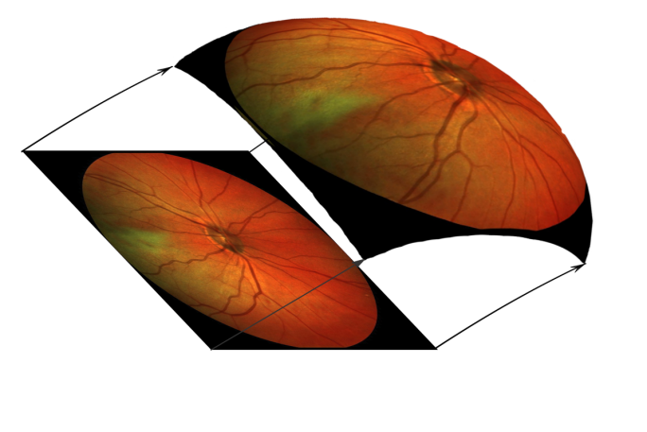
SR geodesics on Lie Groups in Image Analysis
Crossing structures are disentangled
Restoration of corrupted contours
based on model of human vision
Applications in medical image analysis
SE(2)
SO(3)
SE(3)

Slide 8
Brief tour in
Sub-Riemannian geometry
on Lie Groups
8

Slide 9
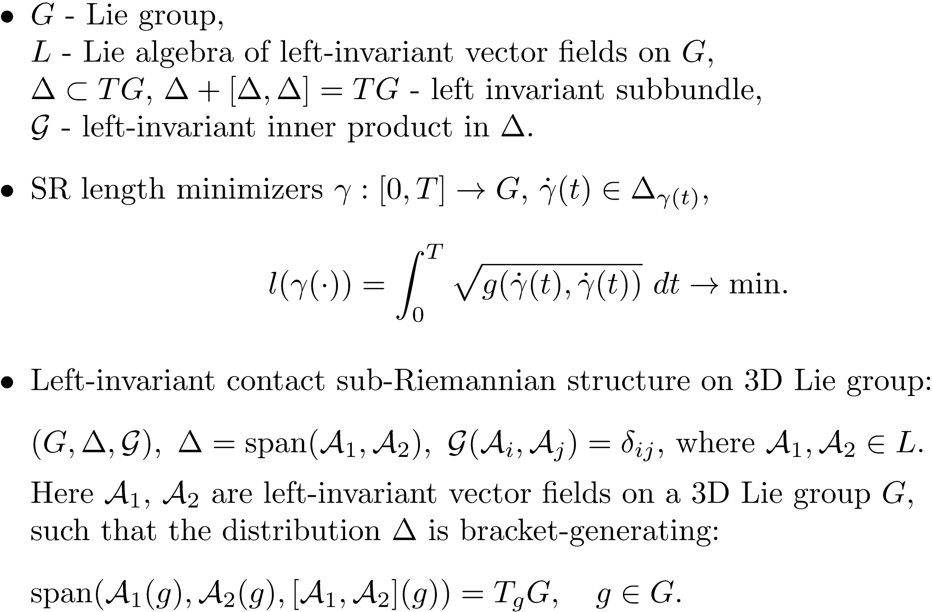
Left-invariant sub-Riemannian structures

Slide 10
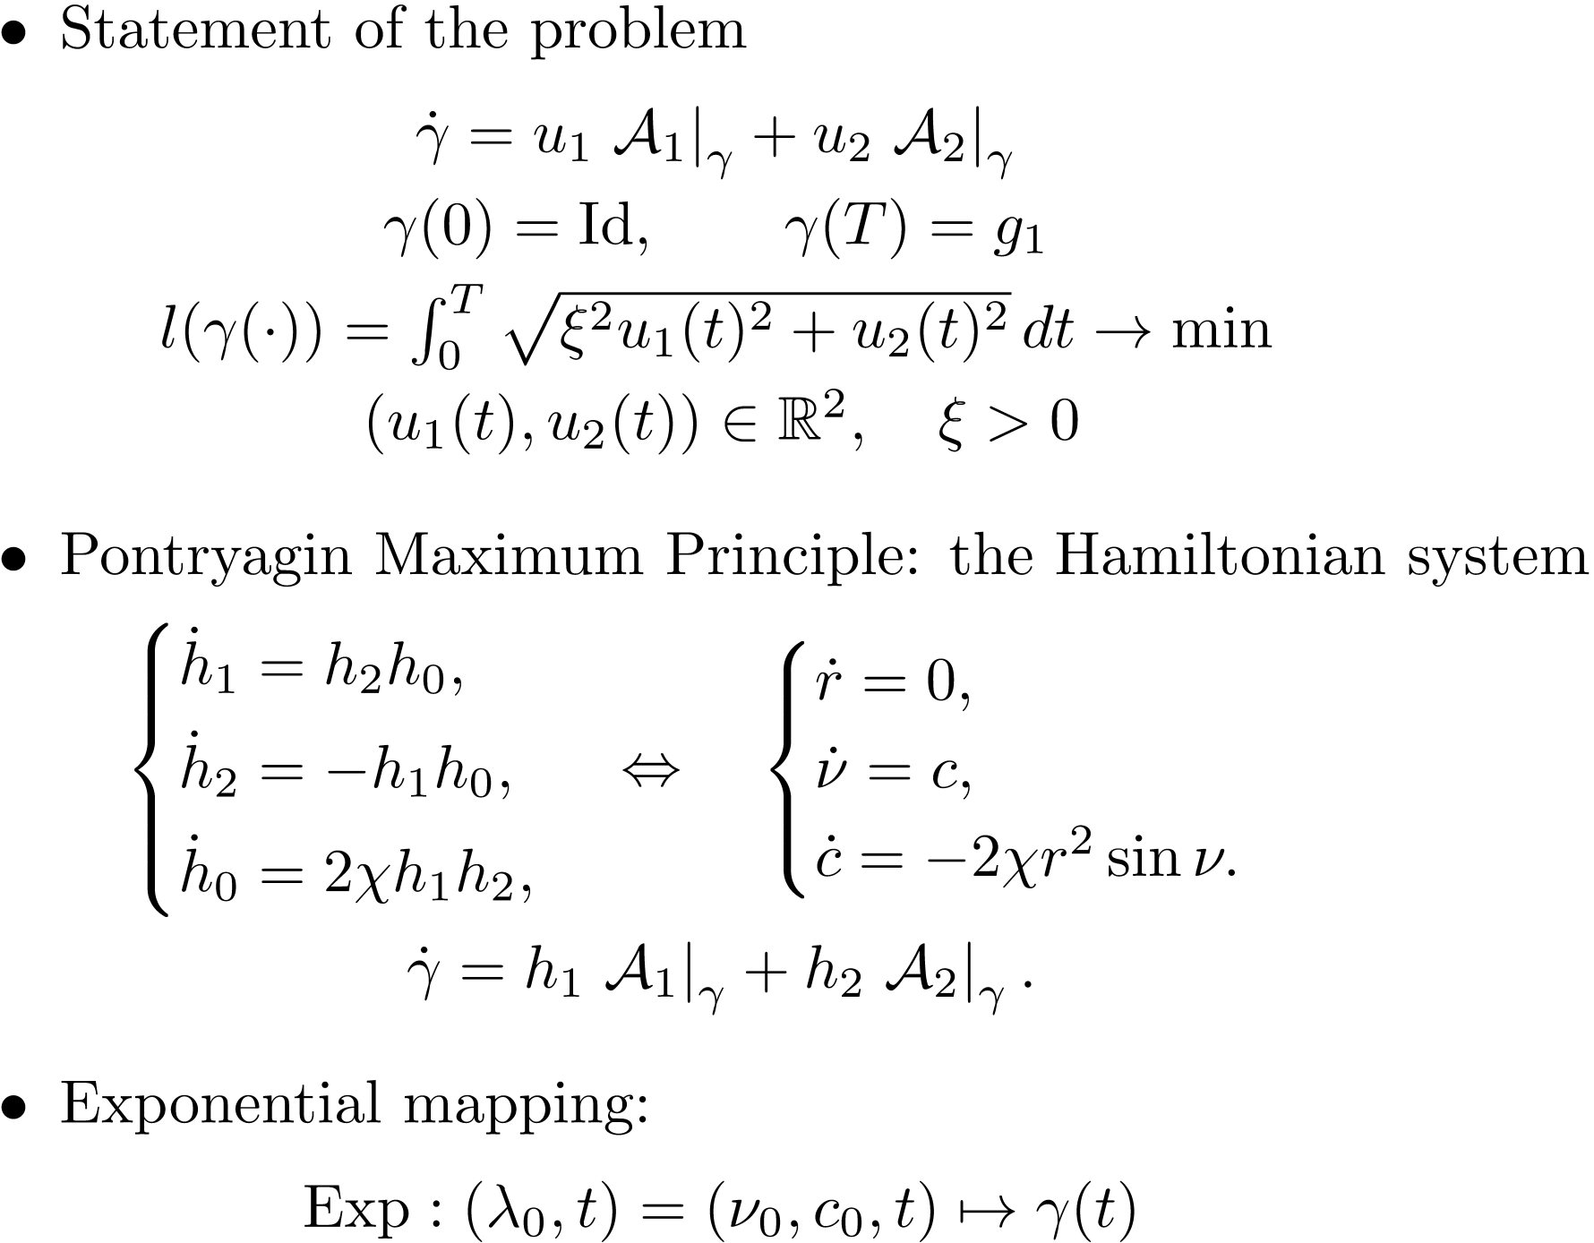

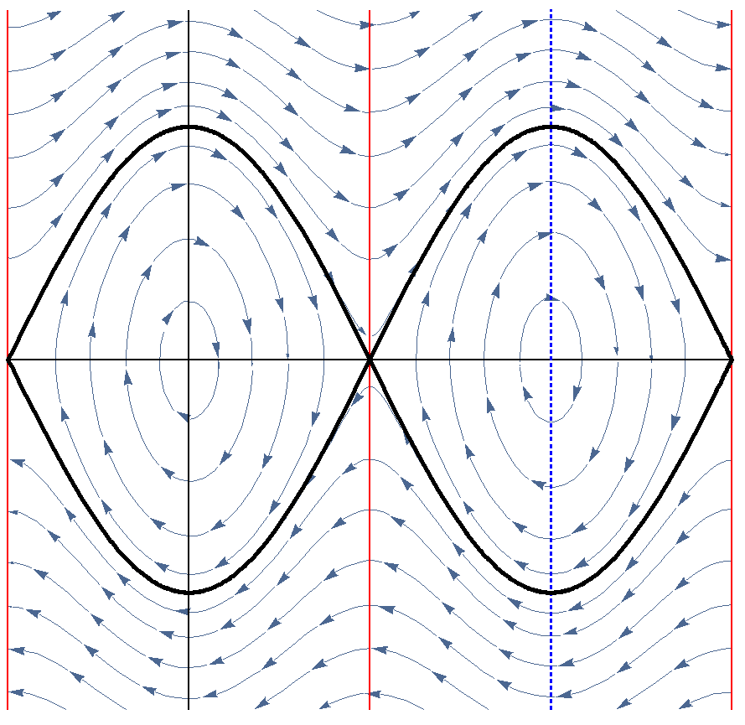



Optimal Control Problem: ODE-based Approach

Slide 11
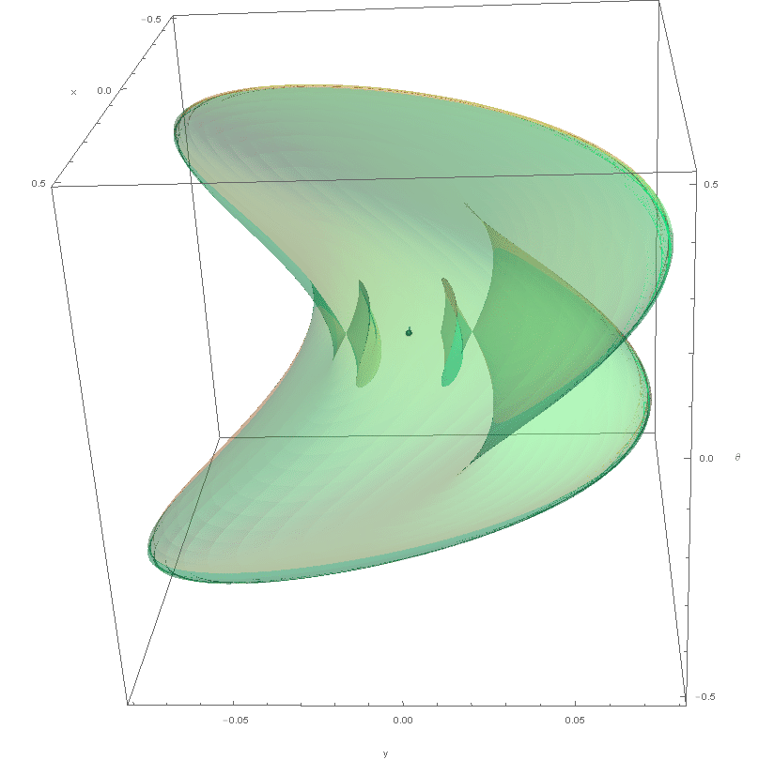

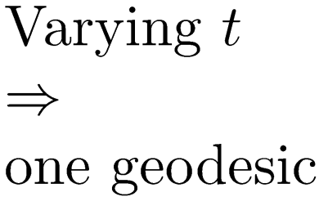
Sub-Riemannian Wave Front

Slide 12

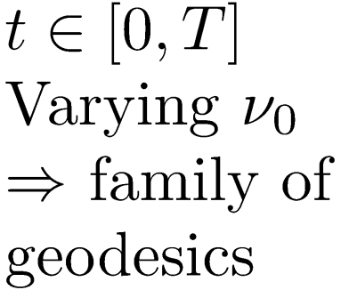
Sub-Riemannian Wave Front
Notes:
By Varying of initial angle of mathematical pendulim th_0 we obtain one-parametric family of geodesics.

Slide 13
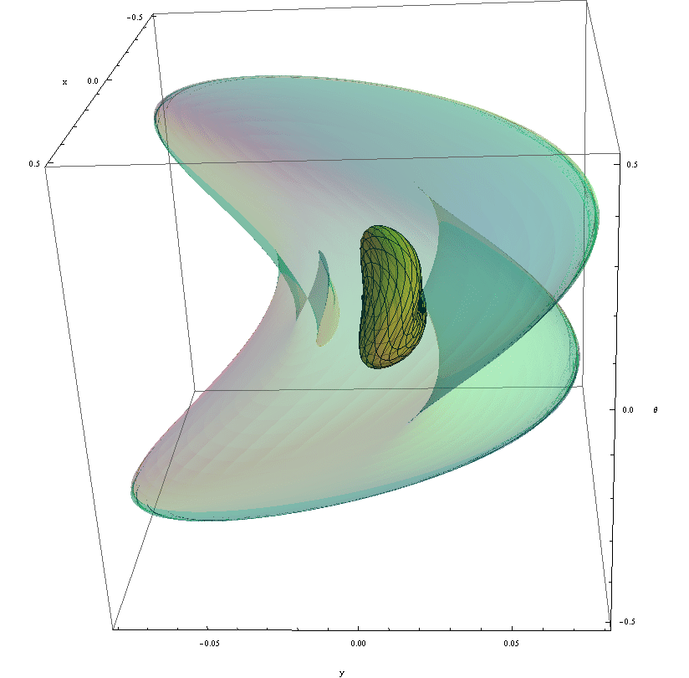


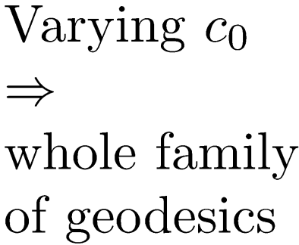
Sub-Riemannian Wave Front
Notes:
Then, by Varying of initial anglular velocity of mathematical pendulim c_0 from -\ifinity to \infinity we will obtain whole family of geodesics. Their endpoints form wavefront. You can see that wavefront intersect itself. It happends when geodesic reach first Maxwell set. So geodesic ending in interior part of wavefront is not SR minimizer, since there exists another geodesic reaches the same point in less time.

Slide 14
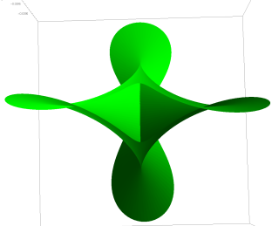
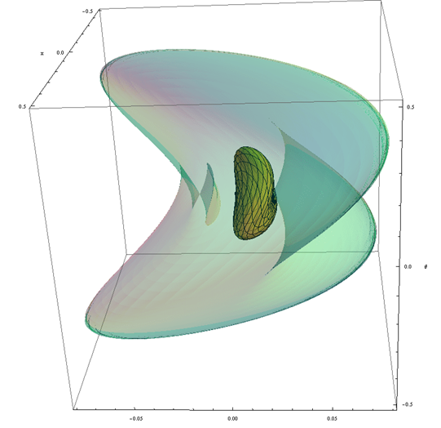
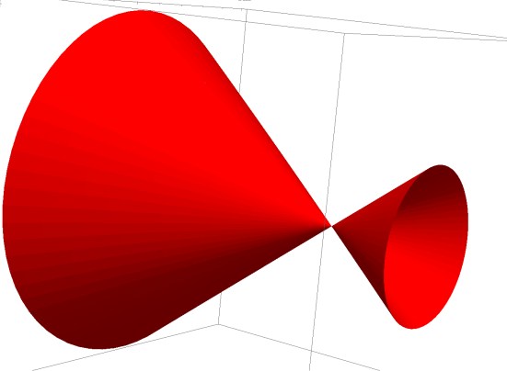
Self intersection of Sub-Riemannian Wave Front
General case: astroidal shape of conjugate locus
Special case with rotational symmetry
A.Agrachev, Exponential mappings for contact sub-Riemannian structures. JDCS, 1996.
H. Chakir, J.P. Gauthier and I. Kupka, Small Subriemannian Balls on R3. JDCS, 1996.

Slide 15
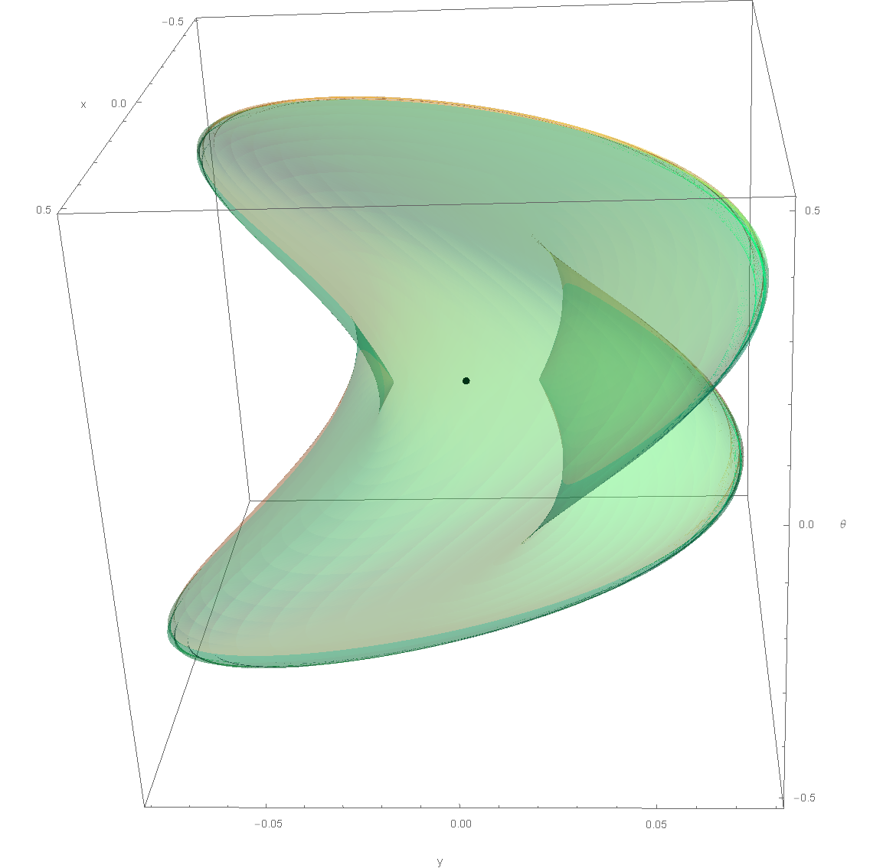
Sub-Riemannian Sphere

Slide 16
Sub-Riemannian problem on SE(2)
with given external cost
(with E.J. Bekkers, R. Duits and G. Sanguinetti)
16

Slide 17
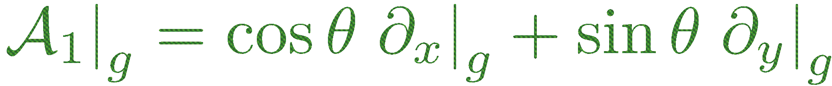
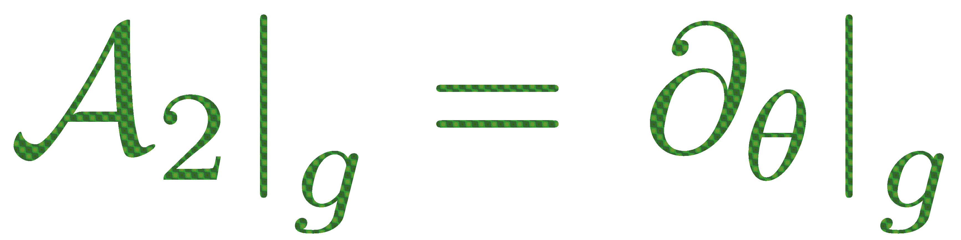
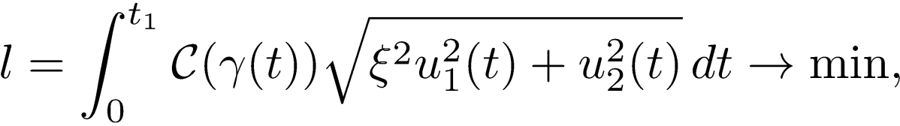
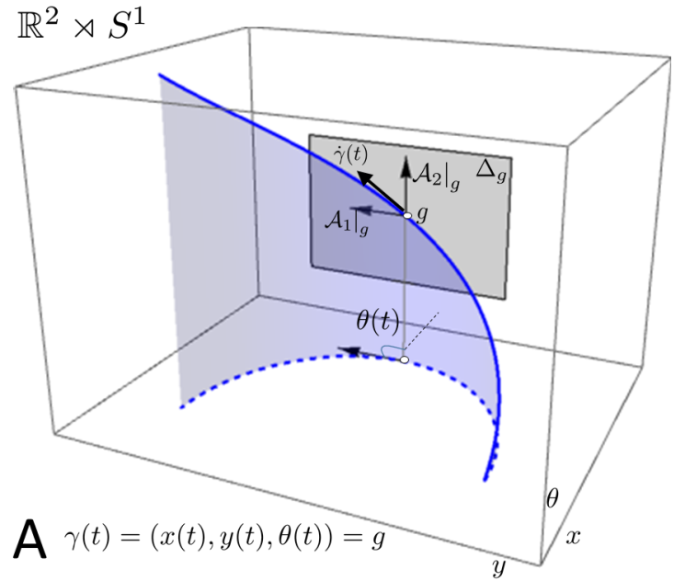
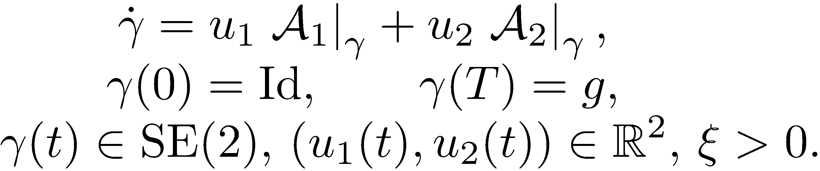
Data-driven Sub-Riemannian Geodesics in SE(2)
score
external cost
image

Slide 18
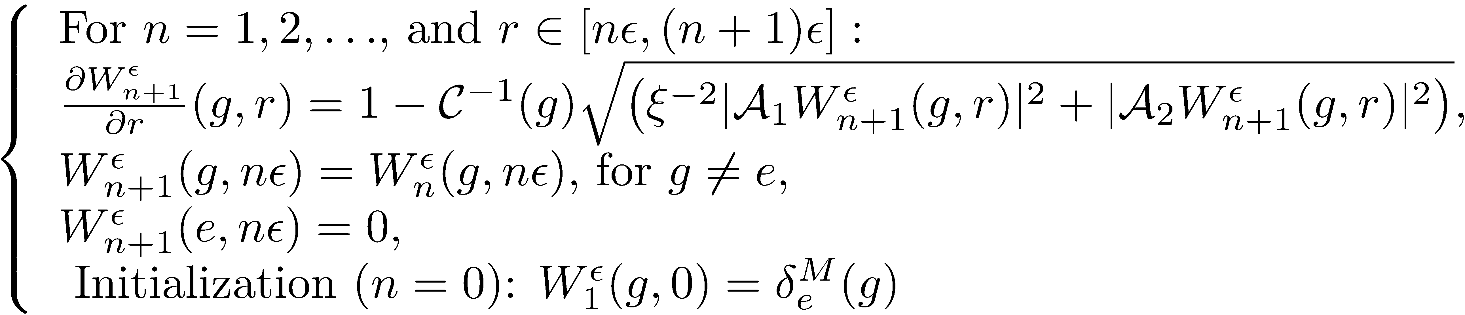
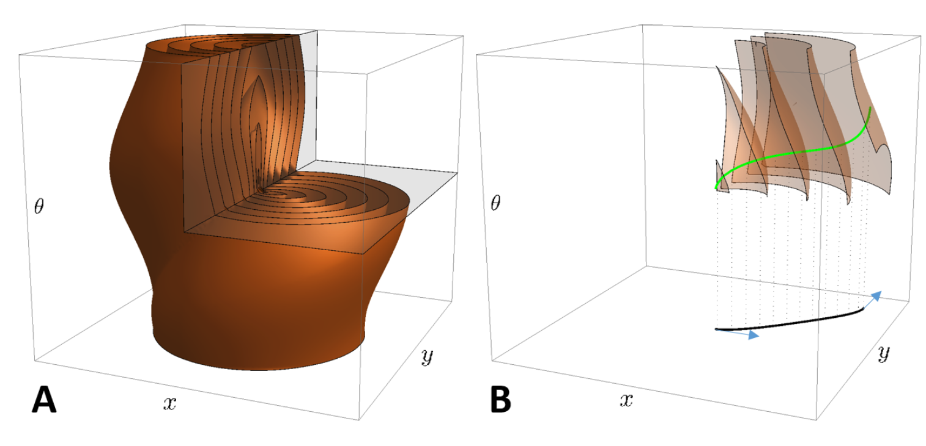
PDE-based Approach
HJB equation for wavefront propagation
Distance map
Minimizers by backward integration of the Hamiltonian system

Slide 19
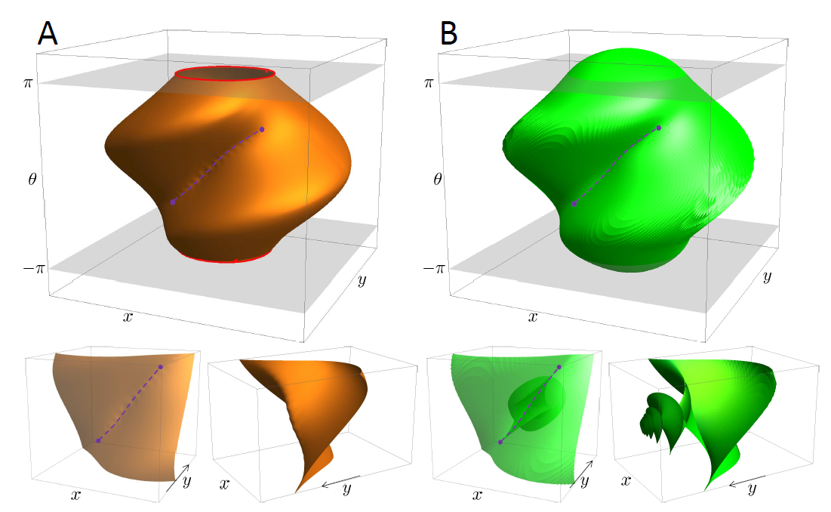
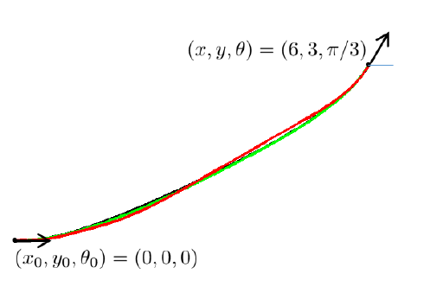
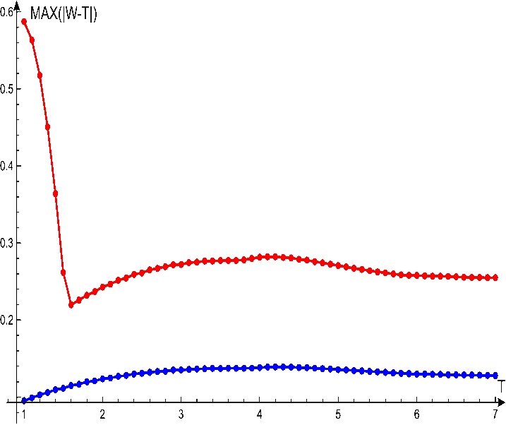
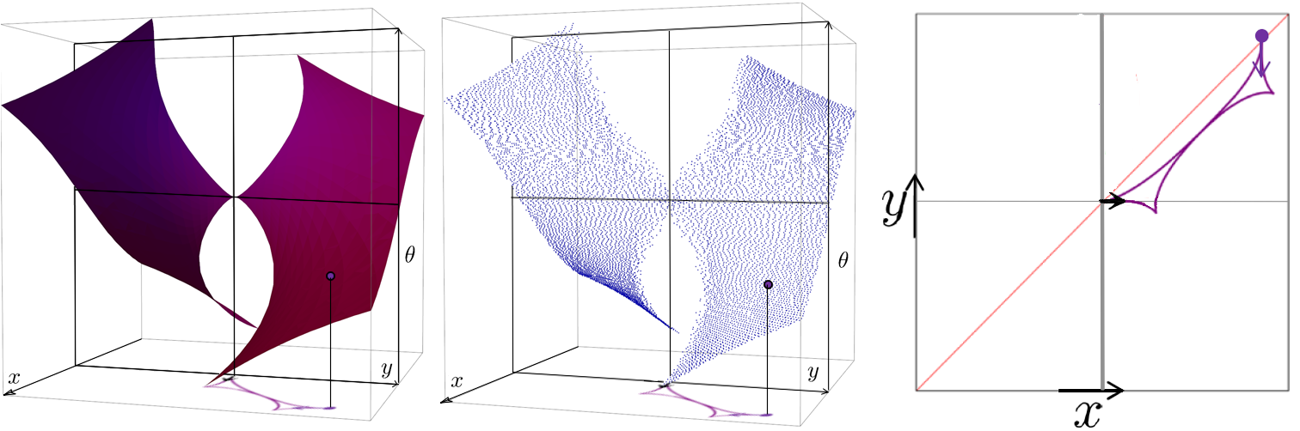
Numerical Verification for C=1
Converging to Exact Geodesics
SR-sphere Numerically
Exact Wavefront
Exact geodesic
Worse
sampling
Better sampling
Max Absolute Error
Maxwell Set Exact
Maxwell Set Numerically
Worse sampling
Better sampling
(T – radius of SR-sphere)

Slide 20
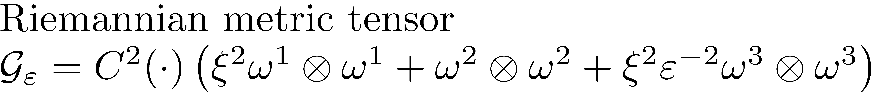
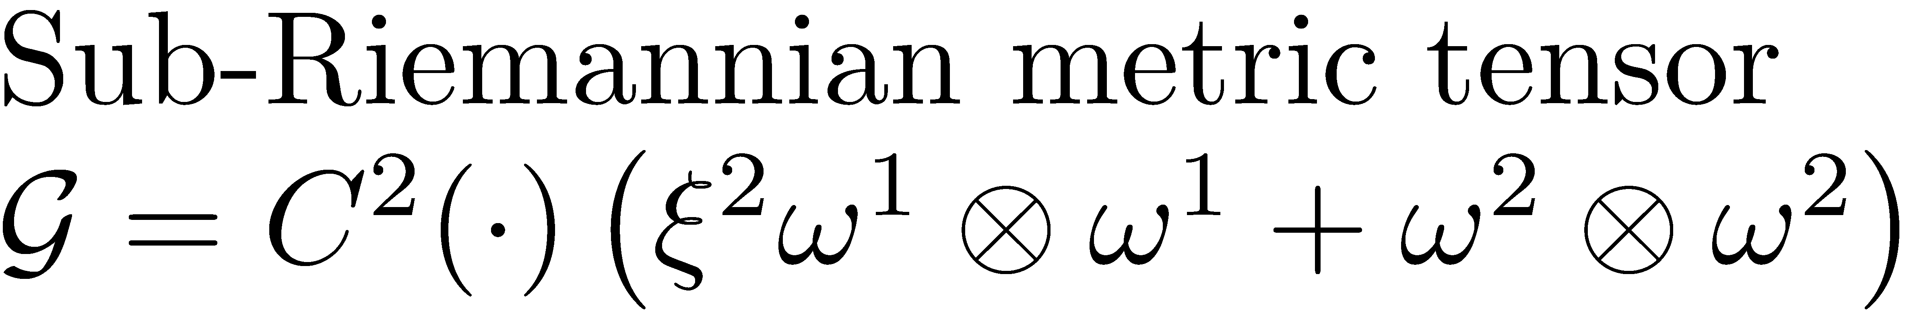
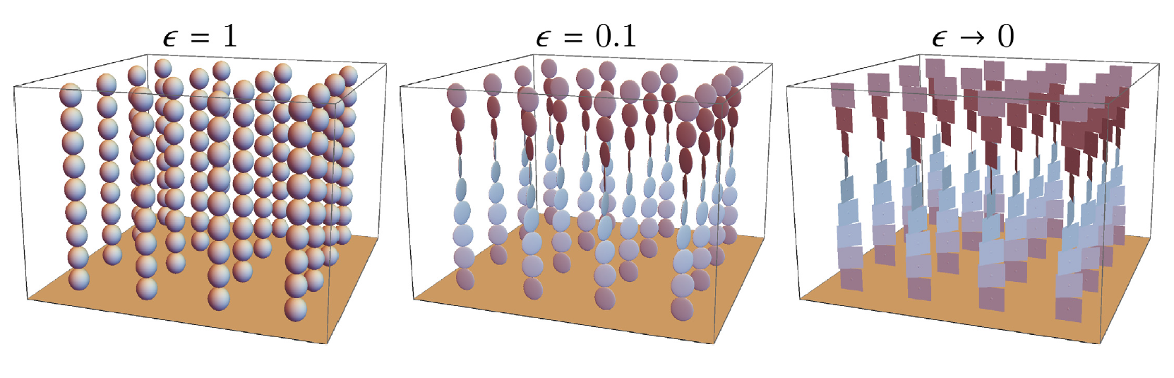
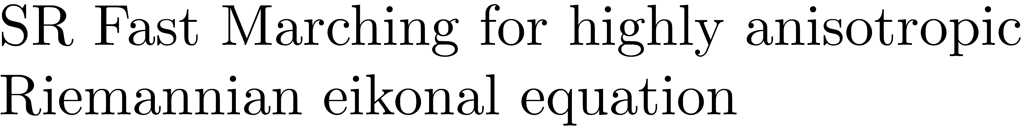
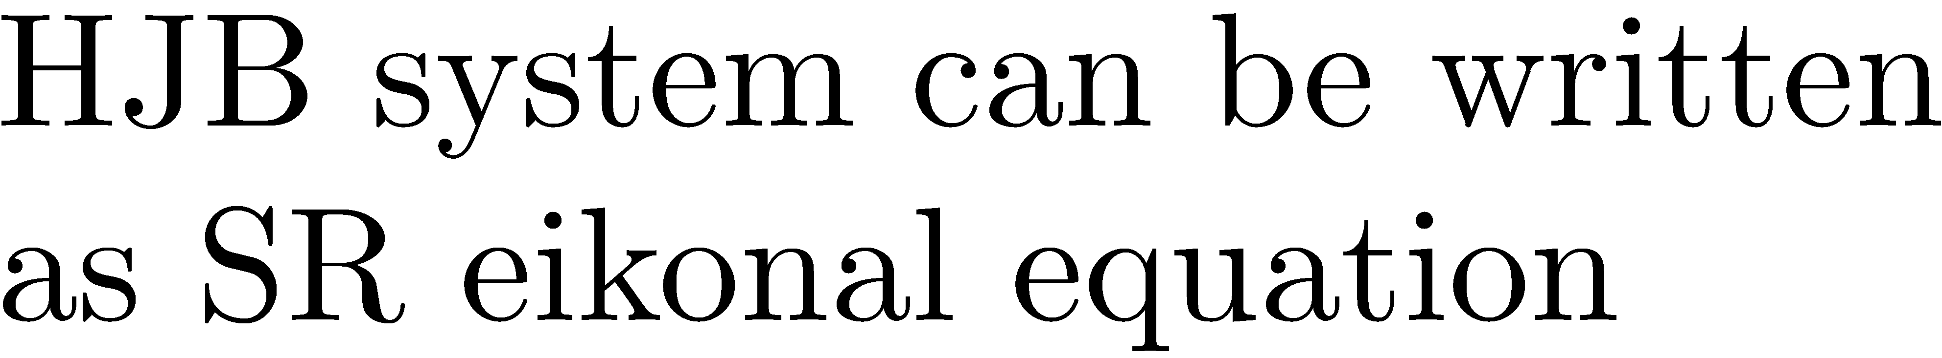
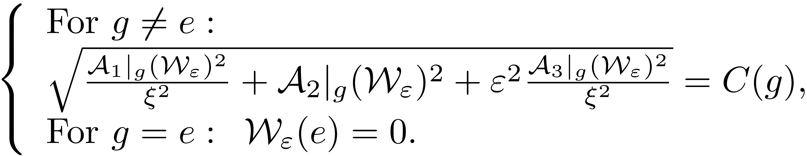
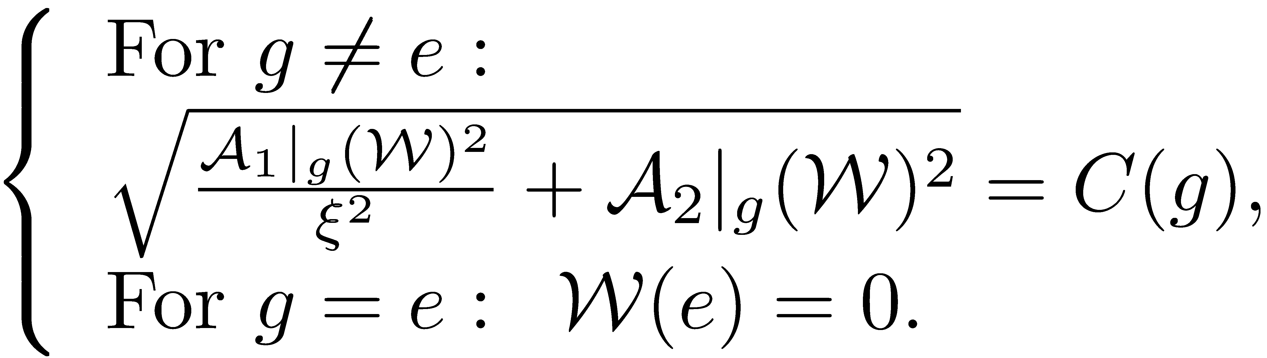
Riemannian Approximation and Fast Marching

Slide 21
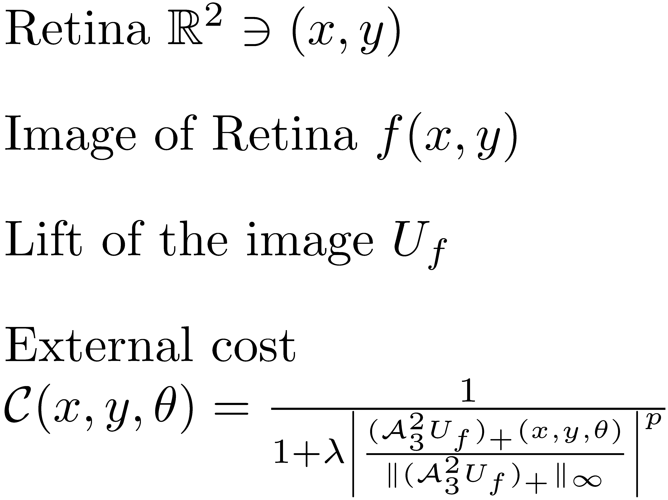

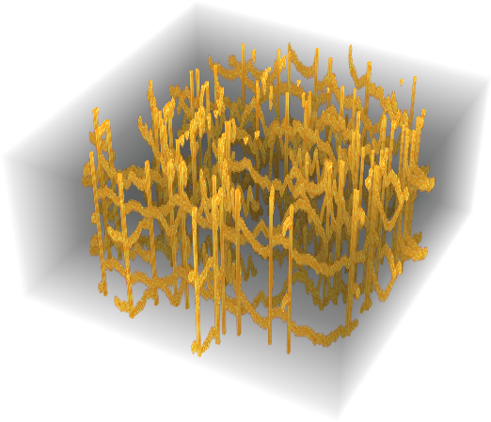
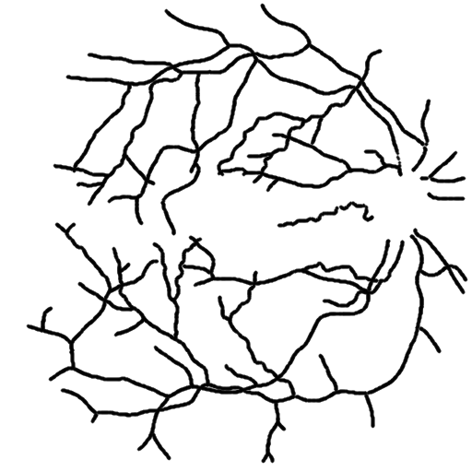
Retinal Vessel Tracking via Data-driven SR-geodesics on SE(2)

Slide 22


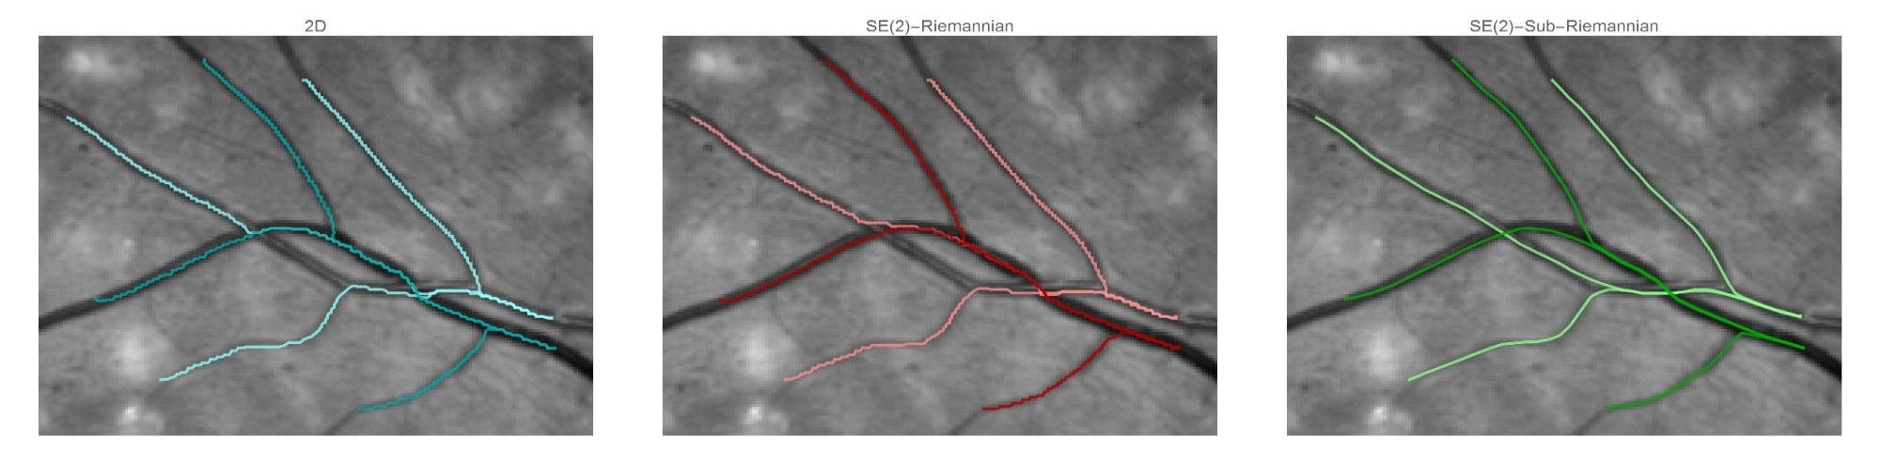



Comparison with Classical Methods

Slide 23
Data-driven Sub-Riemannian Geodesics on SE(2)
for Modelling of Geometrical Optical Illusions
(with B. Franceschiello, G. Citti and A. Sarti)
23

Slide 24

Cortical Based Model of Perceptual Completion

Slide 25


Geometrical Optical Illusion
Poggendorff illusion
Hering illusion
Idea: The illusory contour appears as a geodesic
in a metric induced by visual stimulus.

Slide 26
Geometrical Optical Illusion
Poggendorff illusion
Hering illusion
Idea: The illusory contour appears as a geodesic
in a metric induced by visual stimulus.

Slide 27






Illusory Contours as Data-driven SR-Geodesics in SE(2)

Slide 28
Tracking of Lines in Spherical Images
via Sub-Riemannian Geodesics on SO(3)
(with R. Duits, Y. Sachkov, E. Bekkers and I. Beschastnyi)
28

Slide 29


Sub-Riemannian Geodesics on SO(3)
Aim: data-driven SR geodesics on SO(3) for detection and analysis of vessel tree in spherical images of retina, to reduce distortion.
Spherical extension of cortical based model of perceptual completion on retinal sphere
29

Slide 30









Problem Pcurve(S²) and Pmec(SO(3))
Given
Pcurve(S²)
Find a smooth curve
s. t.:
where
Pmec(SO(3))
30
Notes:
e^{y A_3} e^{- x A_2} e^{\theta A_1}

Slide 31





SR geodesics on SO(3) for the Uniform Cost C=1
Lift to sub-Riemannian problem on SO(3);
Hamiltonian system of PMP;
Classification by different dynamic of vertical part on elliptic ( ), linear ( ) and hyperbolic ( ) cases;
Explicit expressions for SR-geodesics in both SR-arclength and spherical arclength parameterization;
Evaluation of first cusp time and description of reachable end conditions;
Comparison cusp-surfaces and wavefronts w.r.t. SE(2)
31

Slide 32





Sub-Riemannian Fast Marching on SO(3)
Association Fields via Cuspless Data-driven SR-geodesics on SO(3)

Slide 33








Spherical Images of Retina

Slide 34






Vessel Tracking in Spherical Images of Retina
via Data-driven SR-geodesics on SO(3)

Slide 35


Vessel Curvature via Data-driven SR-geodesics on SO(3)
35

Slide 36
Conclusion
Data-driven SR-geodesics - useful tool for retinal vessel tracking
Fast and accurate method for computing data-driven SR-geodesics
Data-driven SR-geodesics - reasonable model of GOI
Association fields via cuspless data-driven SR-geodesics on SO(3)
Spherical images of retina reduce the distortion
Considerable difference in vessel tracking via SE(2) and SO(3) geodesics
Bigger effect in curvature measurement
36

Slide 37
Output
Conferences and workshops:
International Conference on Differential Equations and Dynamical Systems, July 4-9, 2014, Suzdal, Russia;
Workshop on Geometrical Models in Vision, October 22-24, 2014, Paris, France;
MAnET Workshop on Sub-Riemannian Analysis, PDE and Applications, January 26-30, Bern, Switzerland;
Fifth International Conference on Scale Space and Variational Methods in Computer Vision, 31st May - 4th June, Lège Cap Ferret, France;
International Conference on Mathematical Control Theory and Mechanics, July 3-7, 2015, Suzdal, Russia;
School and Workshop GEOMETRY, DYNAMICS AND CONTROL, July 6-17, 2015, Maksimikha, Lake Baikal, Russia;
Scientific Meeting "Nonholonomic days in Pereslavl“, August 6-8, 2015, Pereslavl-Zalesskiy, Russia.
Mid-Term Review Meeting of MAnET Project,
December 8-9, 2015, Helsinki, Finland.
37

Slide 38
Output
Publications:
Bekkers E.J., Duits R., Mashtakov A., Sanguinetti, G.R.: Data-Driven Sub-Riemannian Geodesics in SE(2). In book: Scale Space and Variational Methods in Computer Vision. Lecture Notes in Computer Science;
Bekkers E.J., Duits R., Mashtakov A., Sanguinetti, G.R.: A PDE Approach to Data-driven Sub-Riemannian Geodesics in SE(2). SIAM Journal on Imaging Sciences;
G. Sanguinetti, R. Duits, E. Bekkers, M.H.J. Janssen, A. Mashtakov, J.M. Mirebeau:
Sub-Riemannian Fast Marching in SE(2). In book: Progress in Pattern Recognition, Image Analysis, Computer Vision, and Applications. Lecture Notes in Computer Sc.
A. Mashtakov, Yu. Sachkov: Integrability of left-invariant sub-Riemannian structures on the special linear group SL 2(R). Differential Equation;
A. Mashtakov, Yu. Sachkov: Superintegrability of Sub-Riemannian Problems on Unimodular 3D Lie Groups. Differential Equation;
R. Duits, A. Ghosh, T.C.J. Dela Haije, A. Mashtakov: On sub-Riemannian geodesics in SE(3) whose spatial projections do not have cusps. Journal of Dynamical and Control Systems, accepted.
Preprint:
A. Mashtakov, R. Duits, Y.L. Sachkov, I. Beschastnyi: Tracking of Lines in Spherical Images via Sub-Riemannian Geodesics in SO(3).
38

Slide 39
Thank you for your attention!

Slide 40
Discarded Slides
40

Slide 41


Left-invariant sub-Riemannian structures

Slide 42


Cusp Surfaces
Red surface: endpoints of geodesics starting from cusp.
Blue surface: endpoints of geodesics ending in cusp.
SO(3):
SE(2):

Slide 43





SR-geodesics in SO(3) with cuspless spherical projections
First cusp time in elliptic case
First cusp time in hyperbolic case
Some geodesics have no cusp
Results:
Lift to sub-Riemannian problem on SO(3);
Hamiltonian system of PMP;
Classification by different dynamic of vertical part on elliptic ( ), linear ( ) and hyperbolic ( ) cases;
Explicit expressions for SR-geodesics in both SR-arclength and spherical arclength parameterization;
Evaluation of first cusp time and asymptotic analysis
Comparison cusp-surfaces and wavefronts w.r.t. SE(2)
43

Slide 44
Sub-Riemannian problem on SE(3)
with cuspless spatial projection constraint
(with R. Duits, A. Ghosh and T.C.J. Dela Haije)
44

Slide 45





Problem Pcurve(R³): Shortest Path on R³ x S²
Given
Find a smooth curve
s.t.
and
where
45

Slide 46



SR-geodesics on SE(3) with cuspless spatial projections
Results:
Lift to sub-Riemannian problem on SE(3);
Hamiltonian system of PMP;
Liouville integrability of the Hamiltonian system;
Explicit expressions for SR-geodesics in spatial arclength parameterization;
Evaluation of first cusp time;
Admissible boundary conditions reachable by cuspless geodesics;
Geometrical properties: bounds on torsion, planarity conditions, symmetries;
Numerical investigation of absence of conjugate points;
Numerical solution to the boundary value problem.
46

