Slide 1
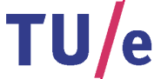

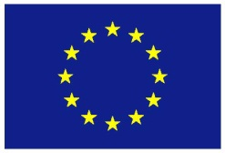
Sub-Riemannian Problems on 3D Lie Groups with Applications to Retinal Image Processing
A.P. Mashtakov
EU-Marie Curie FP7-PEOPLE-2013-ITN, MANET TU/e (no. 607643)
R. Duits, Yu.L. Sachkov, G.R. Sanguinetti, E.J. Bekkers, I. Beschastnyi
Promotor: Bart ter Haar Romeny
Funded by
the European Union
Seminar of Program Systems Institute of RAS
Pereslavl-Zalesskiy, Russia,
10 March, 2015

Slide 2
Structure of the talk
Motivation: Application in medical imaging
Image analysis on Lie groups
Sub-Riemannian problems on 3D Lie groups (short overview)
Sub-Riemannian problem in SE(2) with given external cost
Sub-Riemannian problem in SO(3) with cuspless spherical projection constraint

Slide 3
Motivation:
Computer Aided Diagnosis
system for early detection and prevention of diabetic retinopathy
3

Slide 4
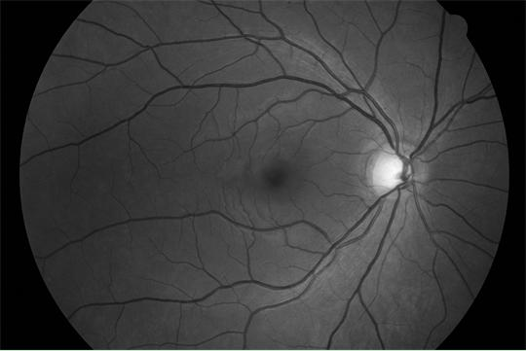
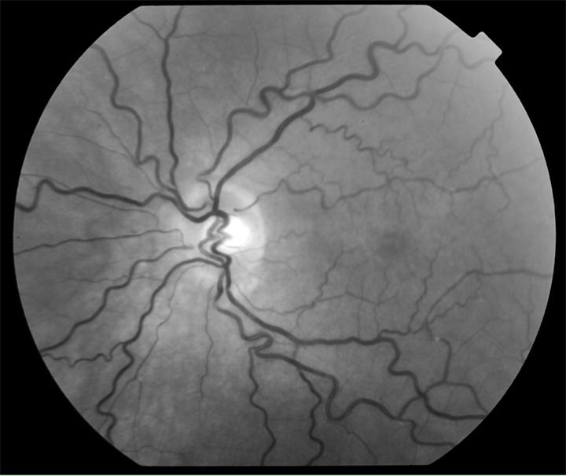
Analysis of Images of the Retina
Diabetic retinopathy --- one of the main causes of blindness.
Epidemic forms: 10% people in China suffer from DR.
Patients are found early --> treatment is well possible.
Early warning --- leakage and malformation of blood vessels.
The retina --- excellent view on the microvasculature of the brain.
Healthy retina
Diabetes Retinopathy with
tortuous vessels

Slide 5
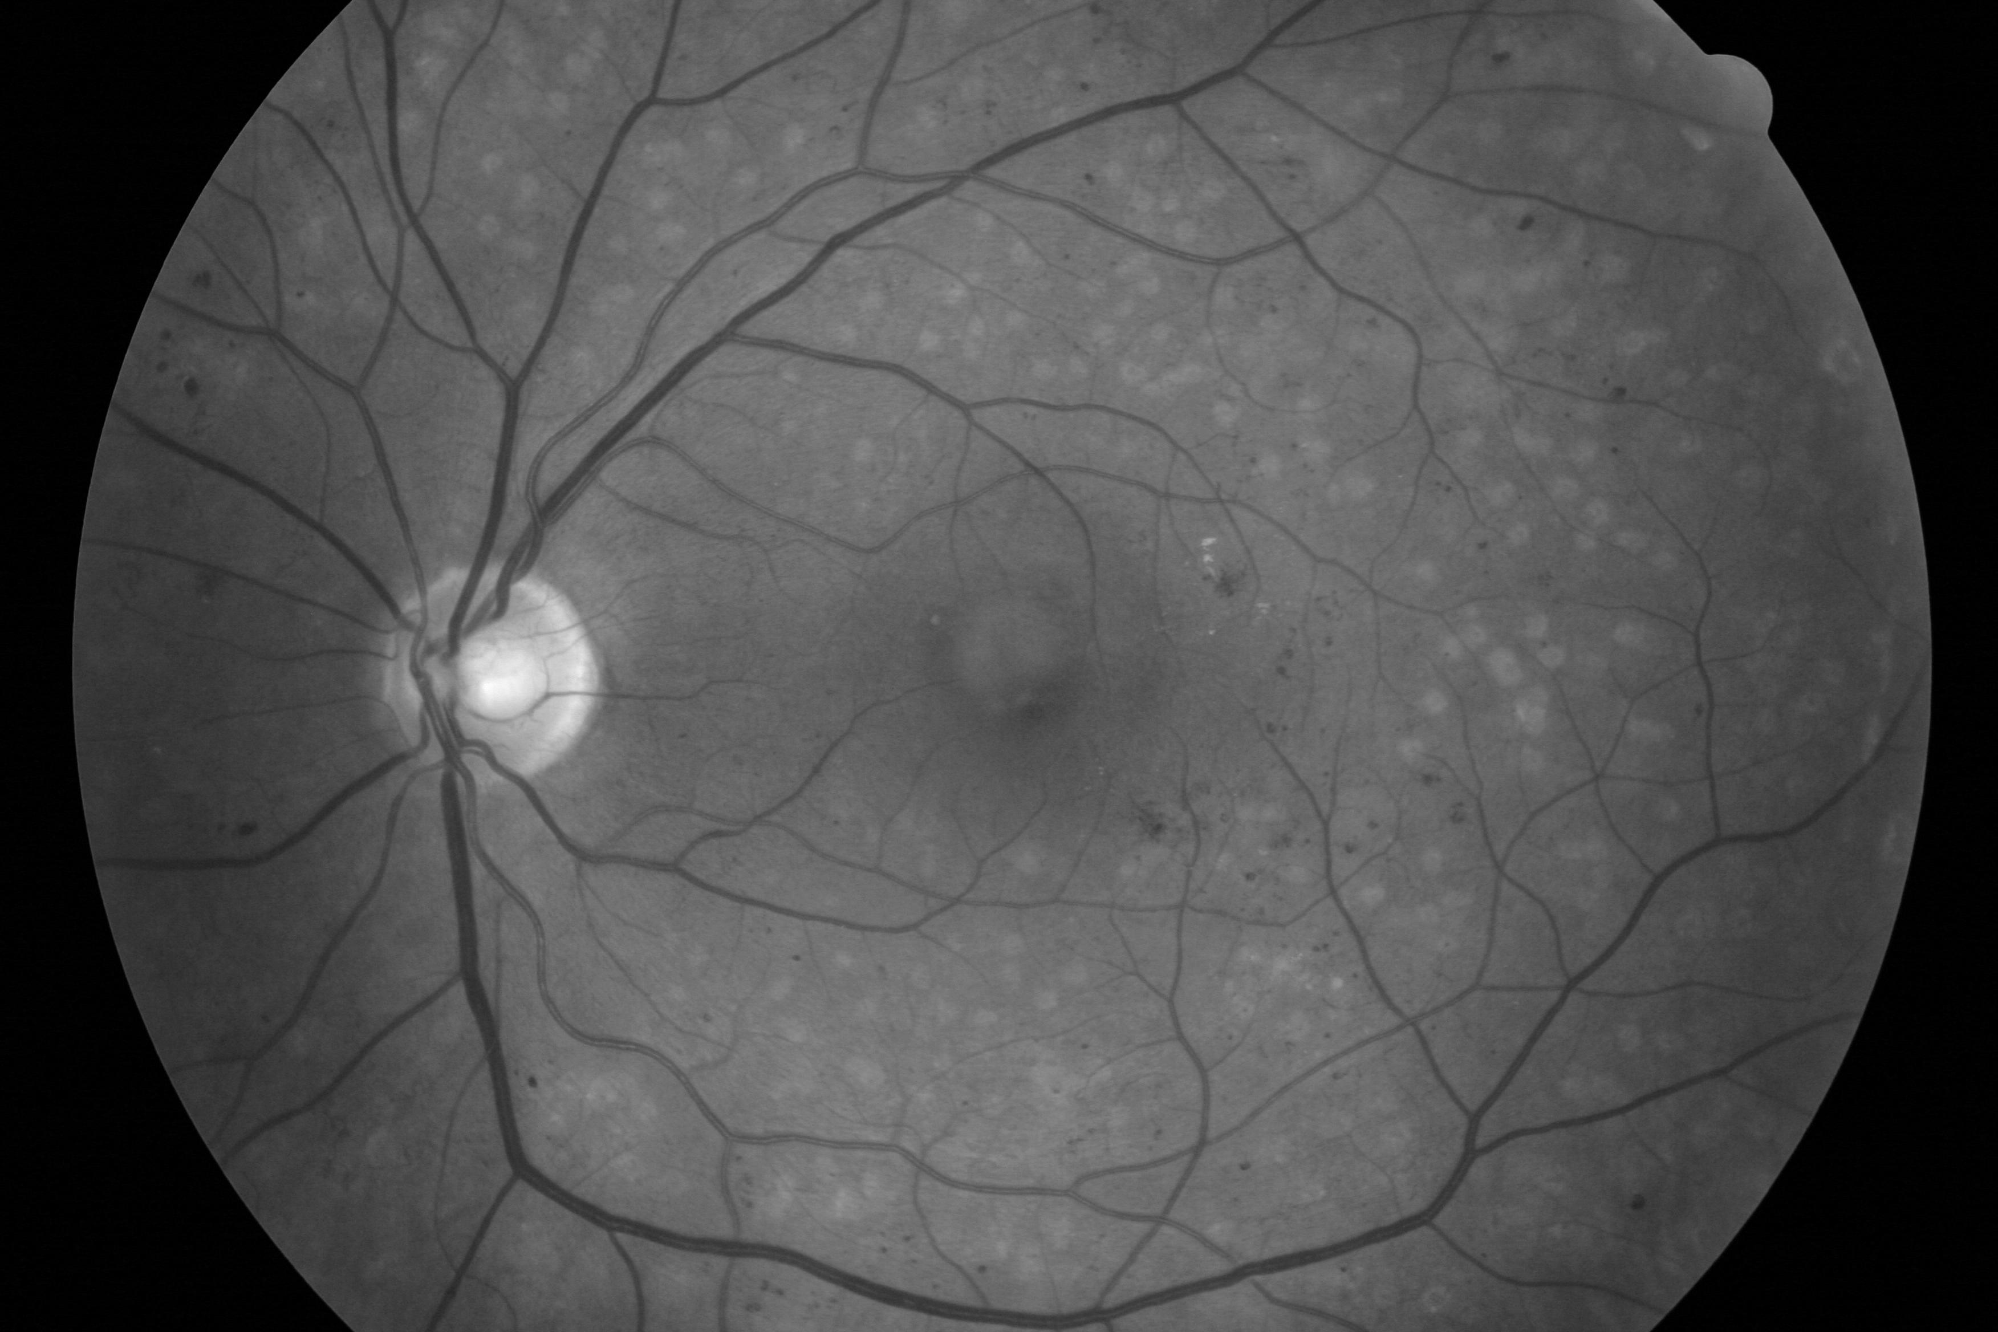
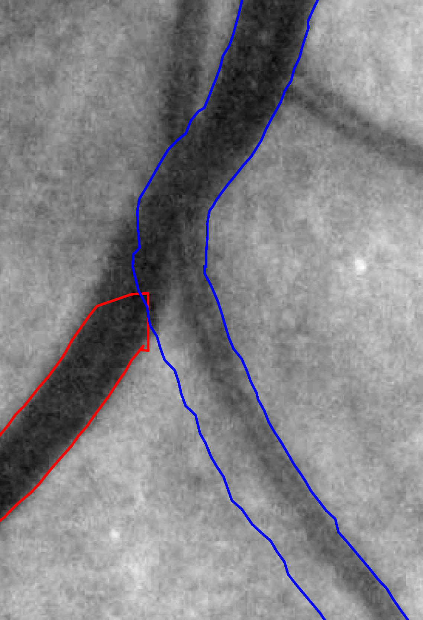
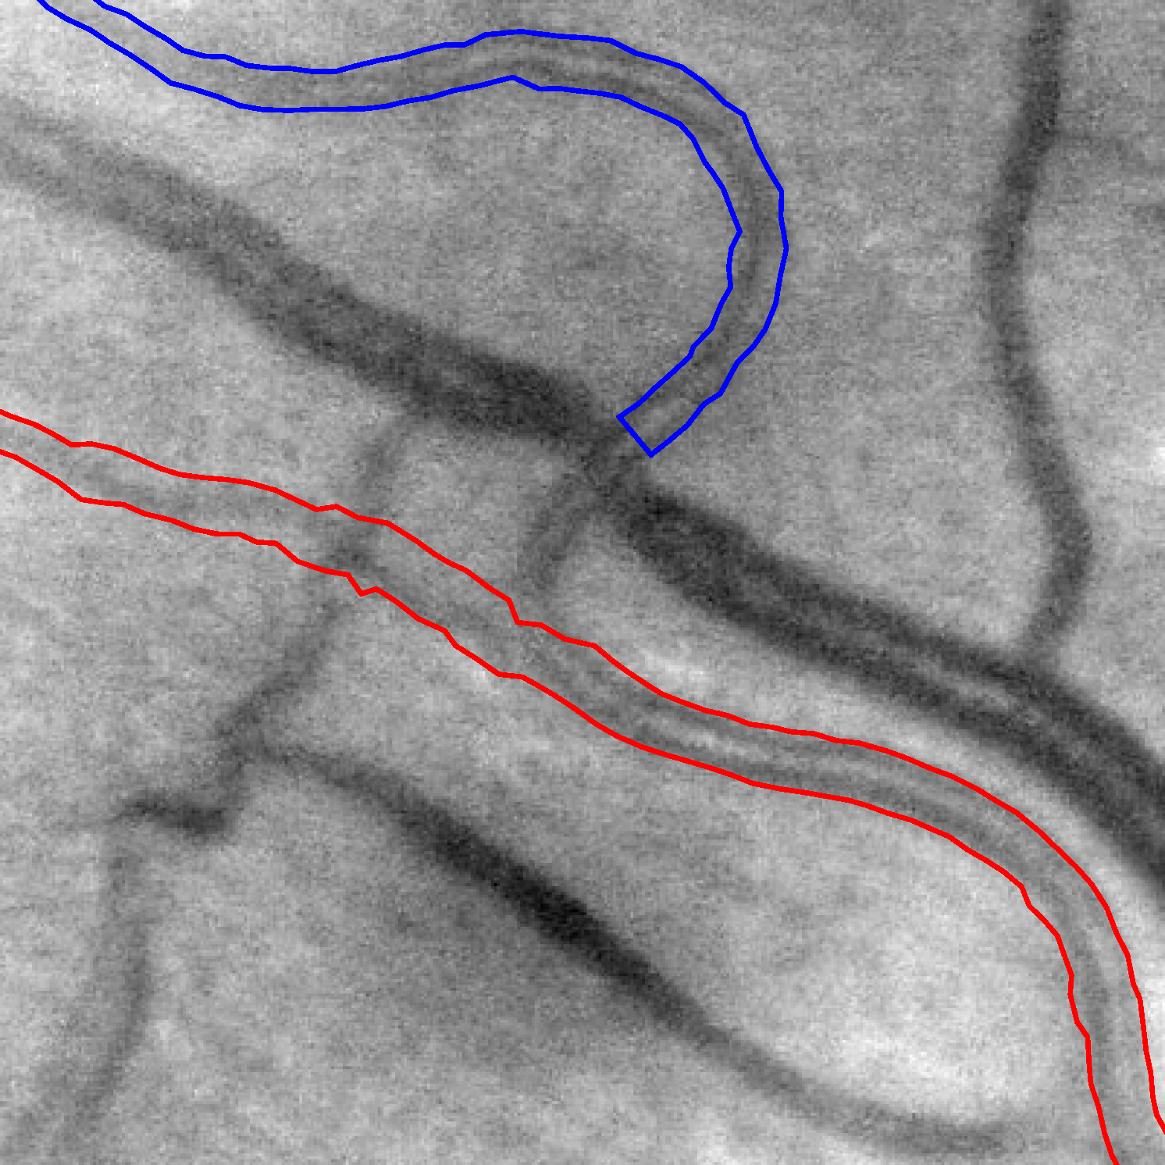
Detect Vascular Tree in Images of the Retina
Application: Early diagnosis of diabetes
Problem: Low contrast & crossings & bifurcations & scales
Aim: Reliable tracking of all blood vessels in retina

Slide 6
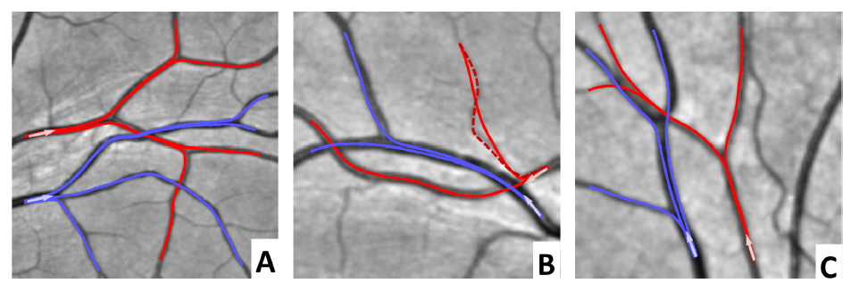
Sub-Riemannian Geodesics
We use data-driven sub-Riemannian geodesics for detection and analysis of blood vessel structure in optical images of the retina.

Slide 7
Lie groups image analysis
7

Slide 8
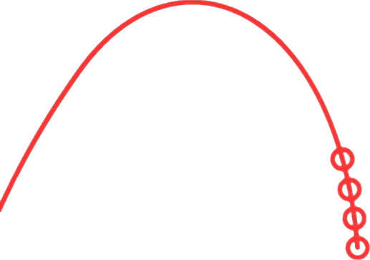

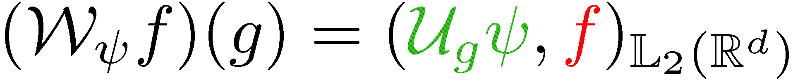
Contextual Image Analysis
R. Duits: generic mathematical model for contextual
image analysis via scores on Lie groups with many applications.

Slide 9



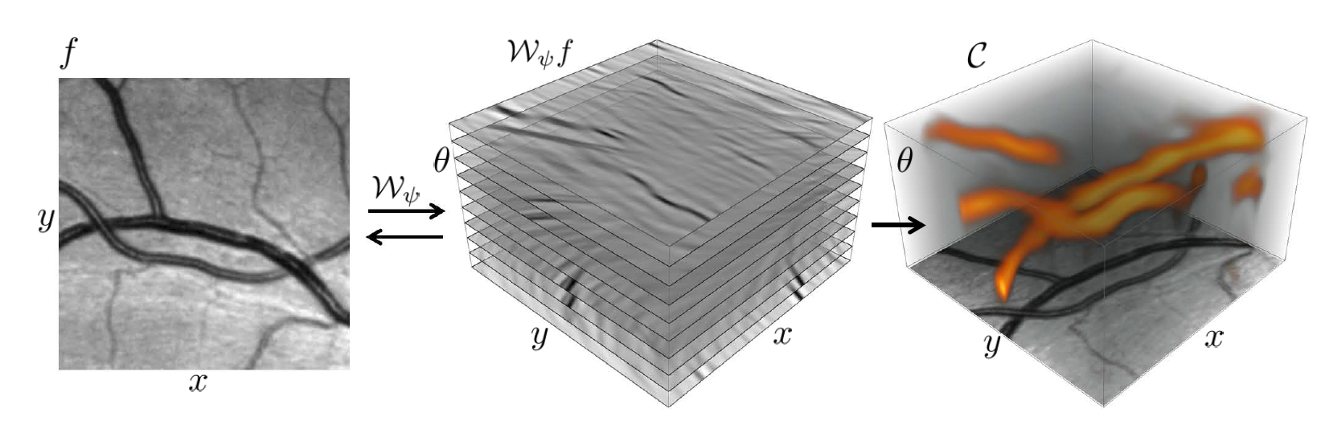
Lie Group Analysis via Invertible Orientation Scores
Image
Score
Processed
image
Processed
Score
9

Slide 10
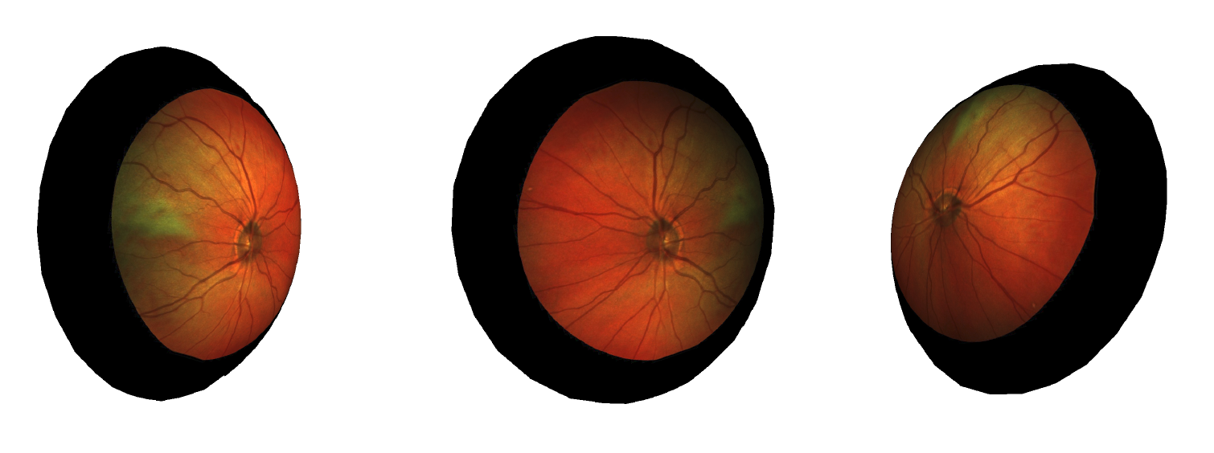
Application of 3D Lie Groups in Image Analysis
Group of roto-translations of Euclidean plane SE(2): processing of flat images
Group of rotations of Euclidean 3-dimensional space SO(3): processing of spherical images

Slide 11
Sub-Riemannian problems
on unimodular 3D Lie groups
11

Slide 12
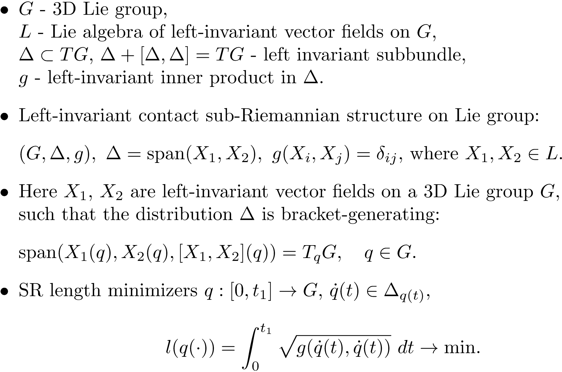
Left-invariant sub-Riemannian structures

Slide 13
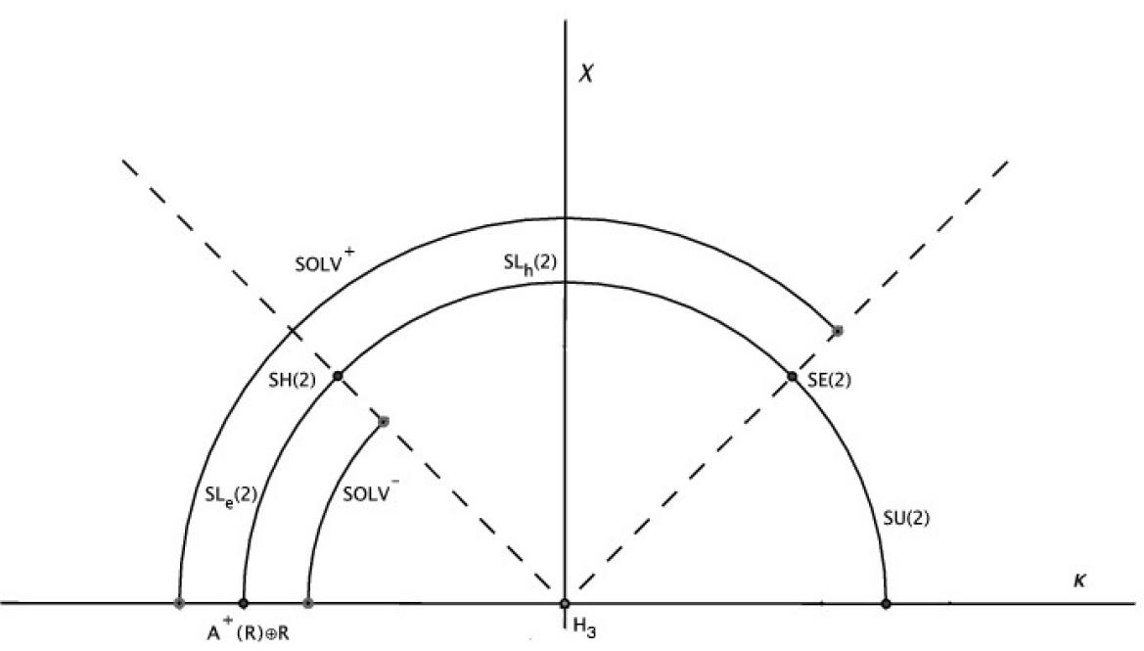


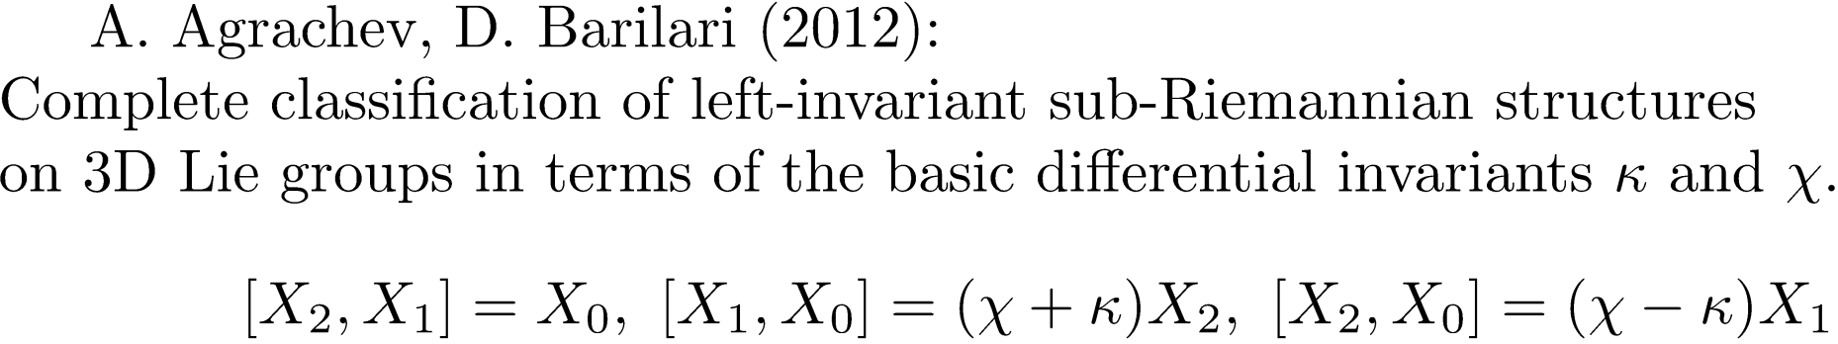
Classification of SR structures on 3D Lie groups

Slide 14
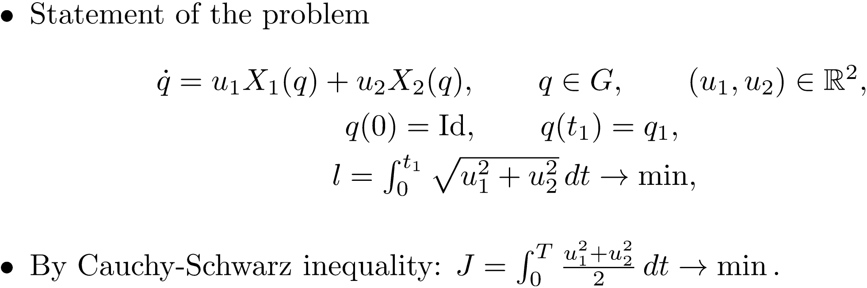
Optimal Control Problem
ODE-based Approach to Optimal Control Problem
Existence of SR length minimizers (optimal trajectories),
Parametrization of SR geodesics (extremal trajectories) via PMP,
Selection SR length minimizers among SR geodesics (study optimality of extremal trajectories).

Slide 15
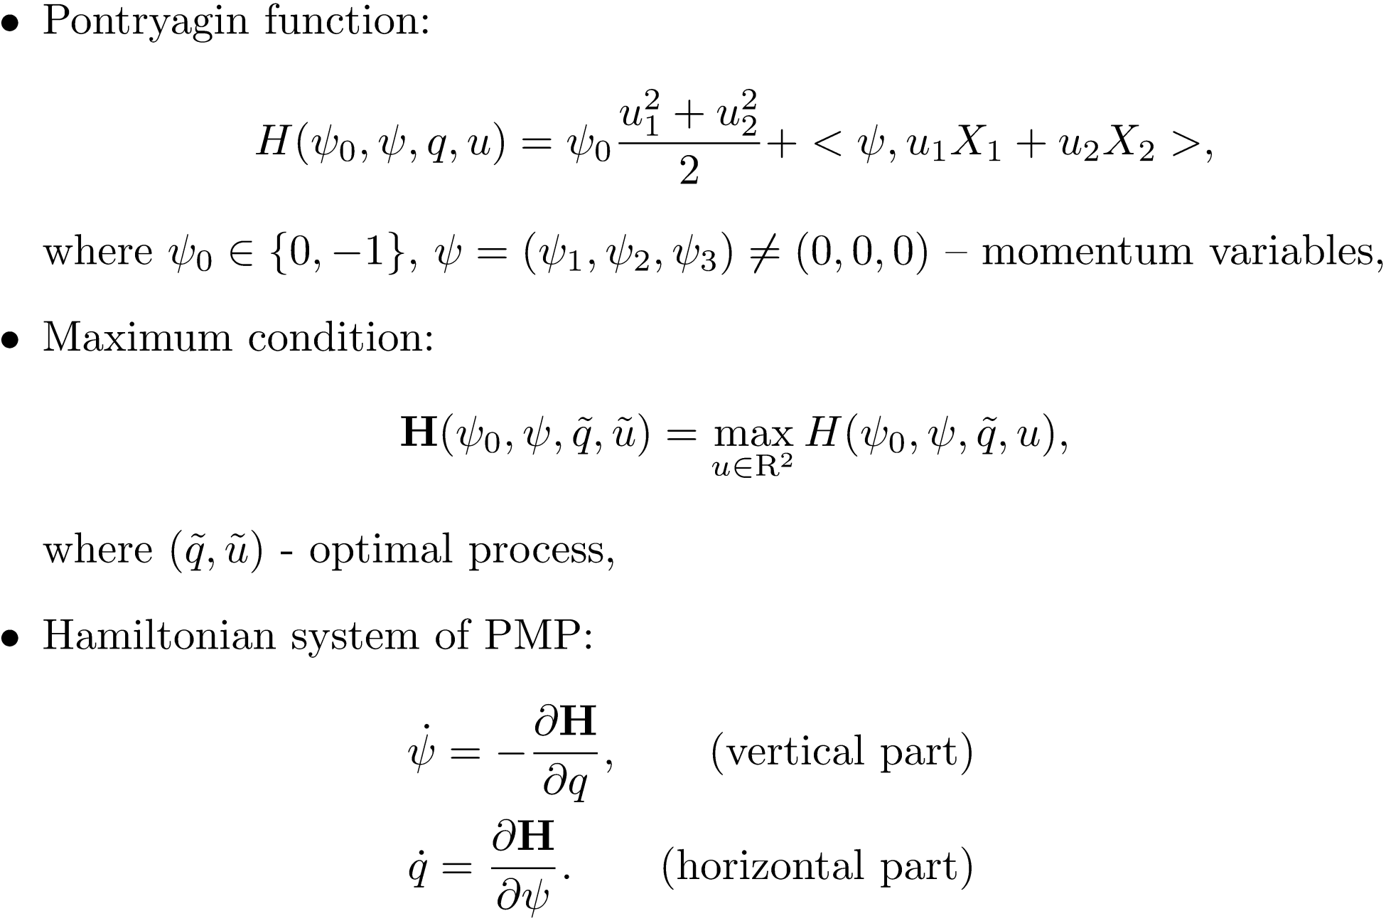
Pontryagin Maximum Principle

Slide 16
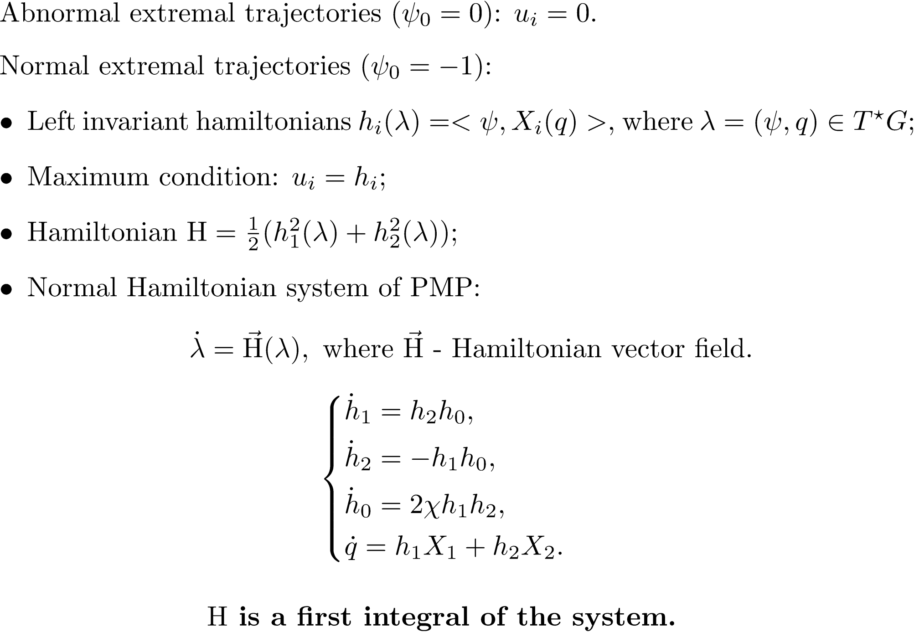
PMP in Moving Frame of References

Slide 17
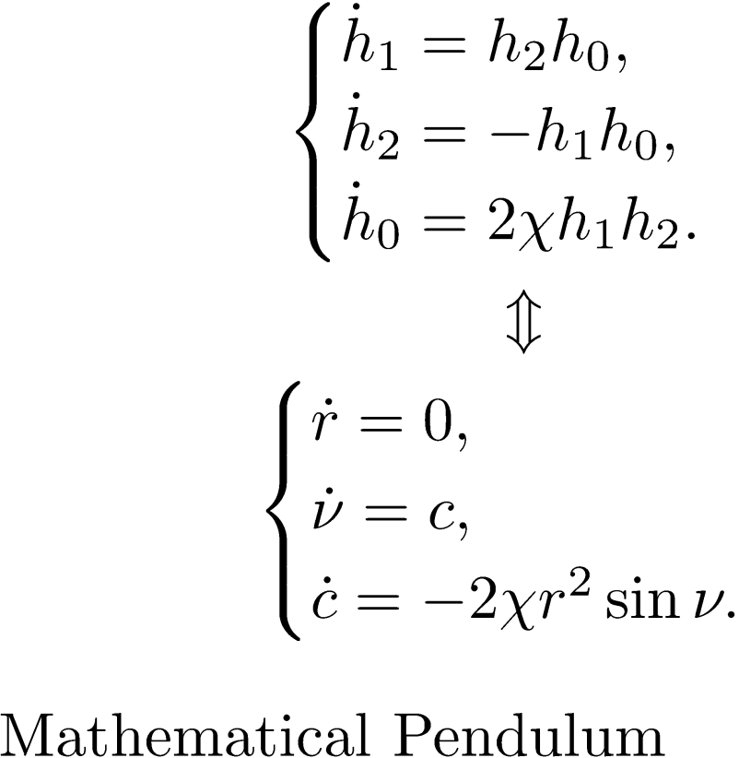
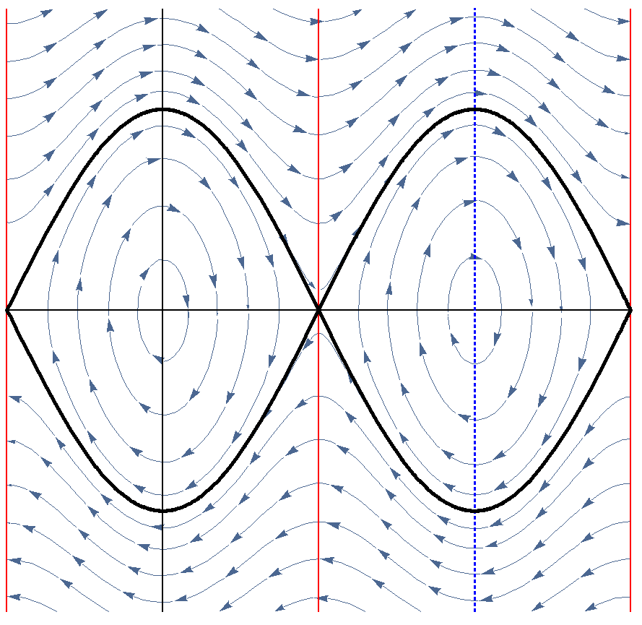




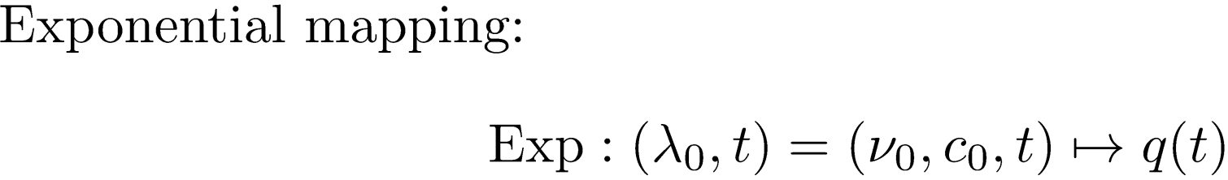
Vertical Part of the Hamiltonian System
Horizontal Part -> Extremal Trajectories

Slide 18
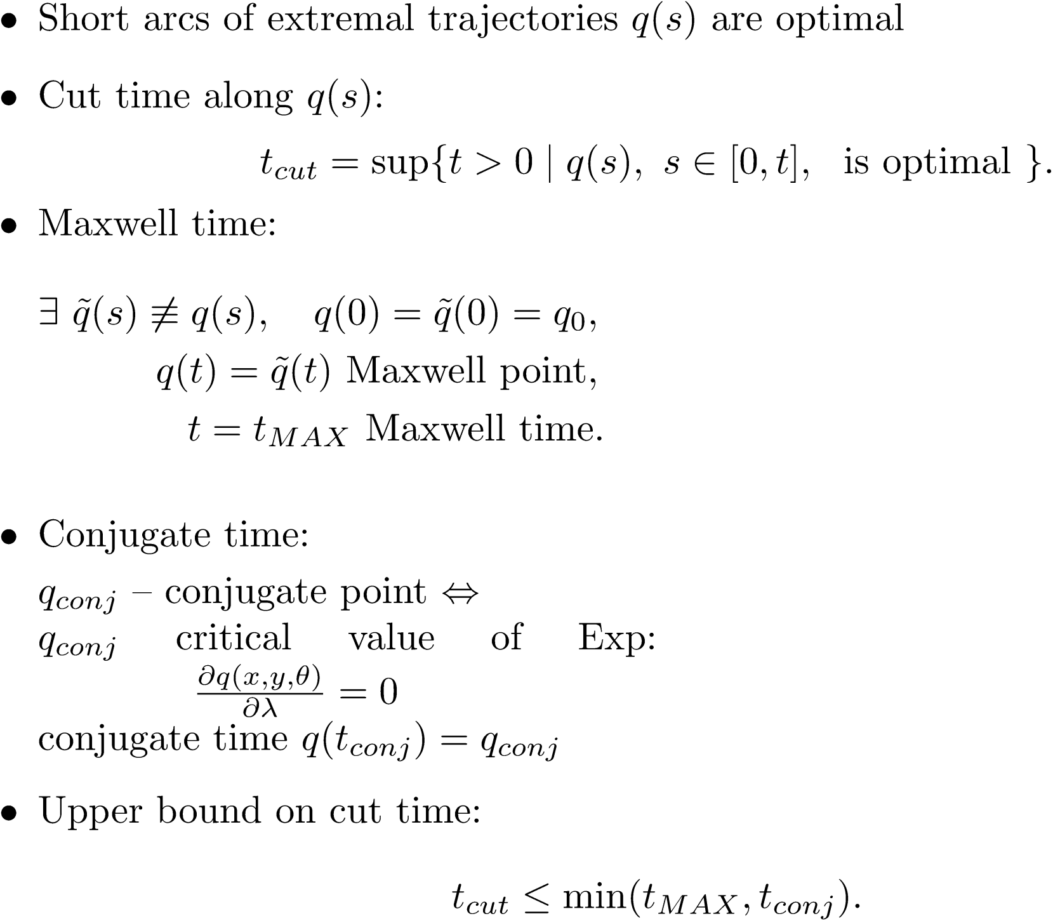

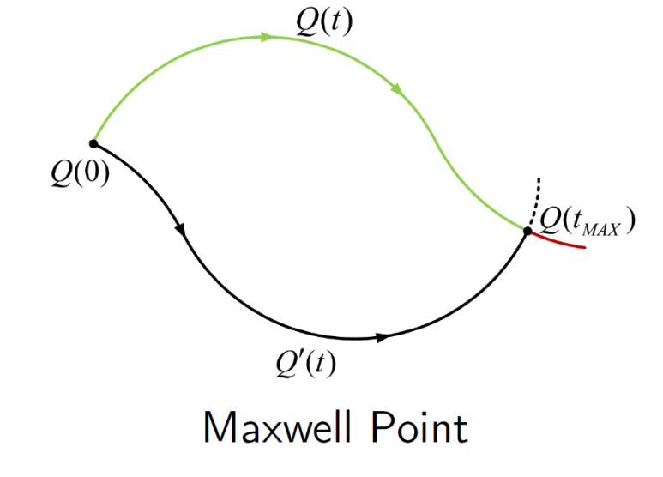



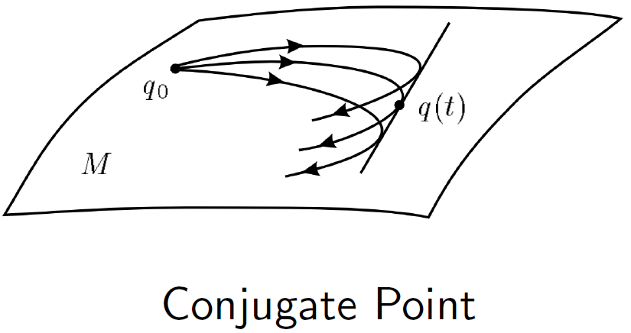

Optimality of Extremal Trajectories

Slide 19
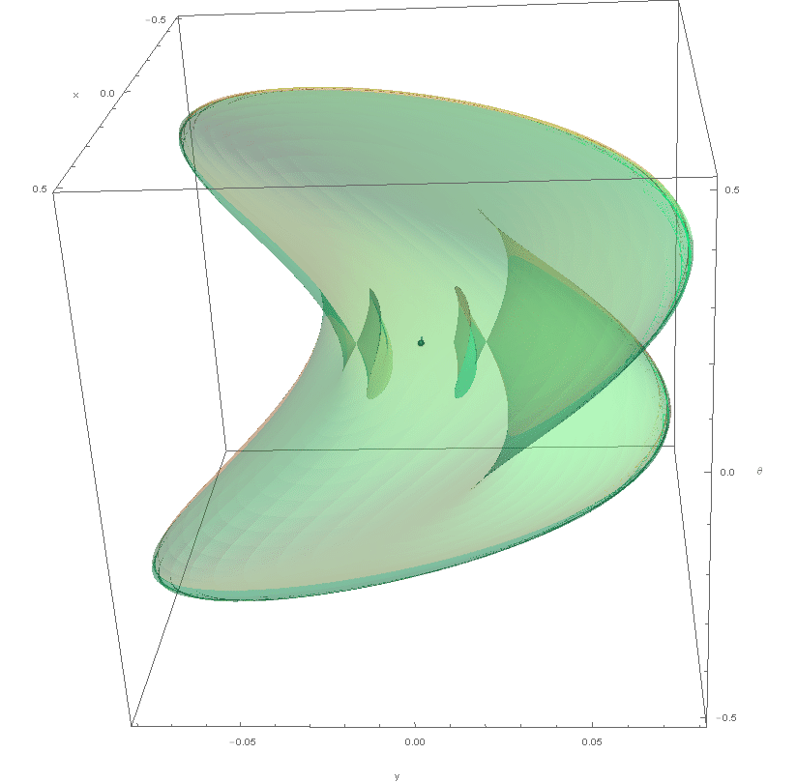

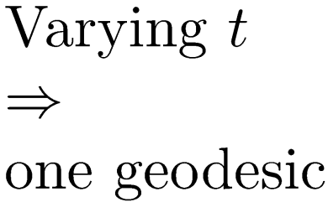
Sub-Riemannian Wave Front

Slide 20

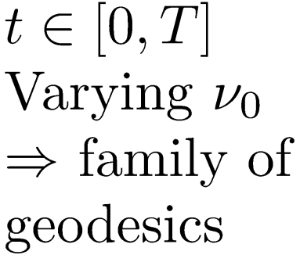
Sub-Riemannian Wave Front
Notes:
By Varying of initial angle of mathematical pendulim th_0 we obtain one-parametric family of geodesics.

Slide 21
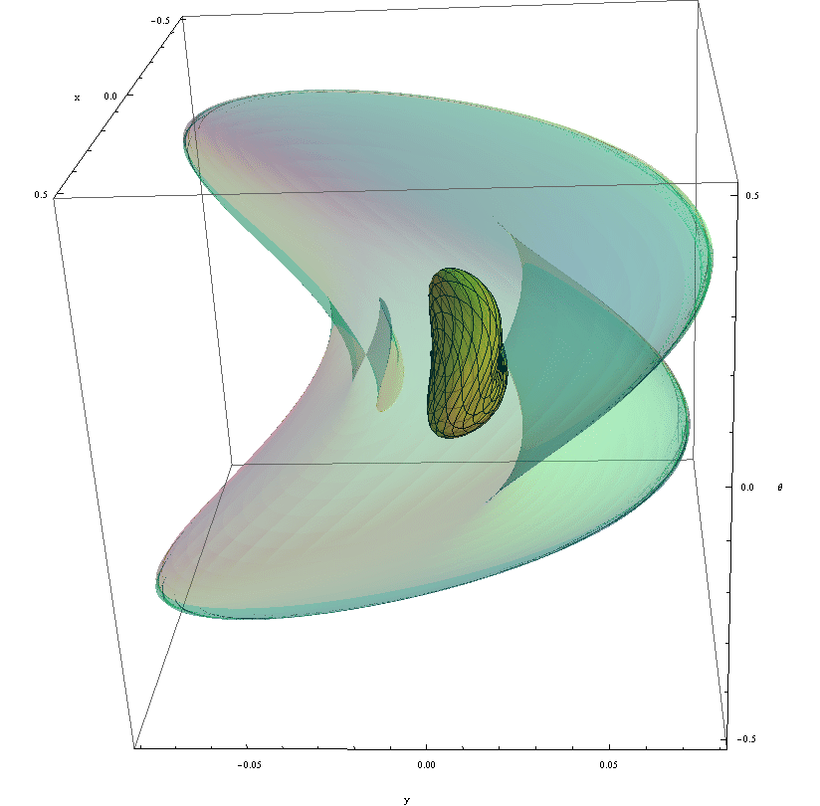


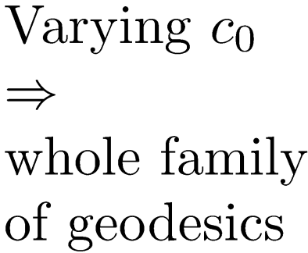
Sub-Riemannian Wave Front
Notes:
Then, by Varying of initial anglular velocity of mathematical pendulim c_0 from -\ifinity to \infinity we will obtain whole family of geodesics. Their endpoints form wavefront. You can see that wavefront intersect itself. It happends when geodesic reach first Maxwell set. So geodesic ending in interior part of wavefront is not SR minimizer, since there exists another geodesic reaches the same point in less time.

Slide 22
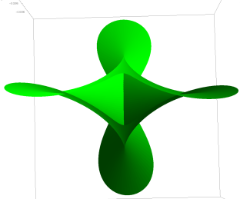
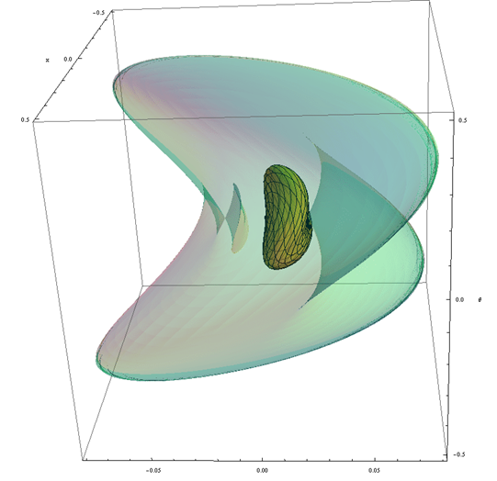
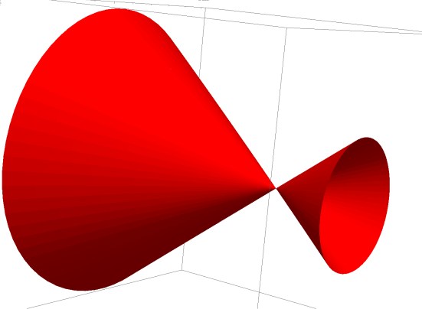
Self intersection of Sub-Riemannian Wave Front
General case: astroidal shape of conjugate locus
Special case with rotational symmetry
H. Chakir, J.P. Gauthier and I. Kupka, Small Subriemannian Balls on R3. JDCS, 1996.

Slide 23
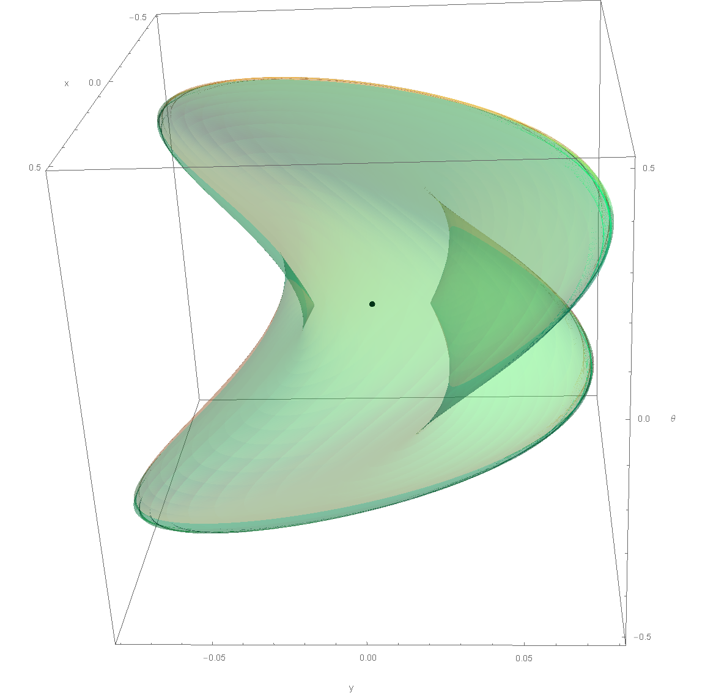
Sub-Riemannian Sphere

Slide 24
New PDE-based Approach to Optimal Control Problem
Numerical scheme based on Hamilton-Jacobi-Bellman PDE:
Derivation of HJB equation, that describe wave front propagation from Identity of the group;
Constructing the distance map (based on viscosity solution of HJB equation);
Computing of optimal trajectories by steepest decent on the distance map.
Advantage: It allows extension to non-uniform data-driven cost

Slide 25
Sub-Riemannian problem in SE(2) with given external cost
(E.J. Bekkers, R. Duits, A. Mashtakov, G. Sanguinetti)
25

Slide 26
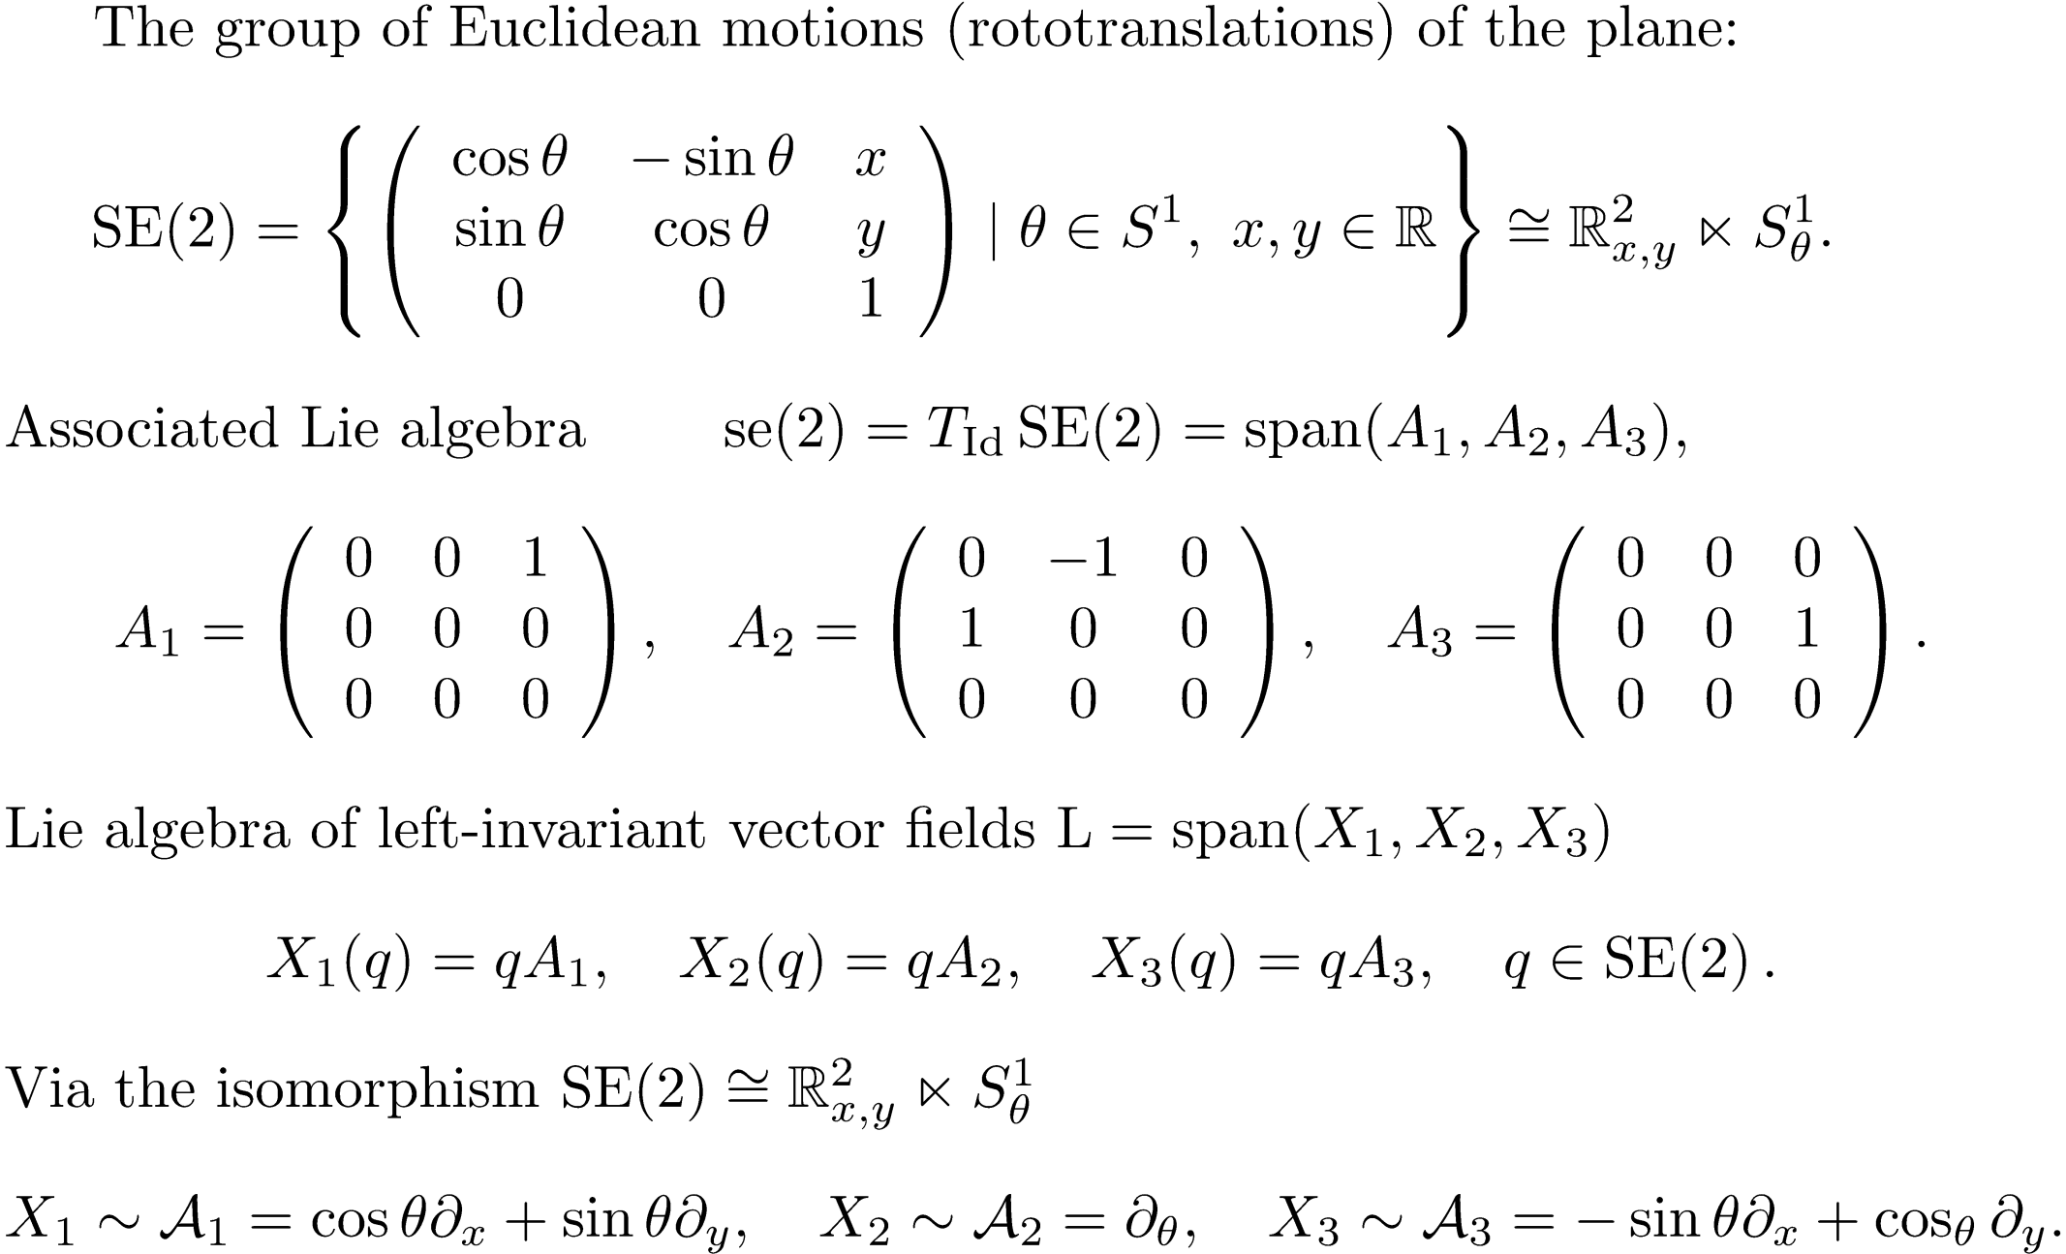
SE(2): Group of Roto-translations of a Plane

Slide 27
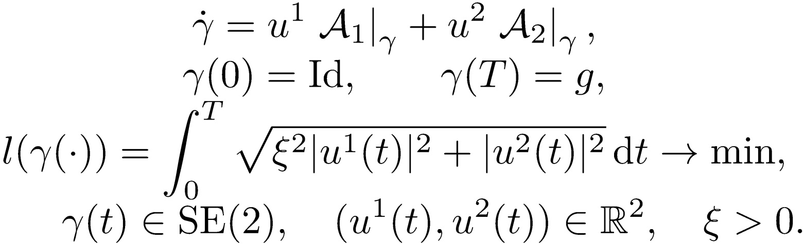
Left-invariant Sub-Riemannian Problem on SE(2)
Was solved in recent works:
I. Moiseev, Yu. L. Sachkov, Maxwell strata in sub-Riemannian problem on the group of motions of a plane, (2010)
Yu. L. Sachkov, Conjugate and cut time in sub-Riemannian problem on the group of motions of a plane, (2010)
Yu. L. Sachkov, Cut locus and optimal synthesis in the sub-Riemannian problem on the group of motions of a plane, (2011)

Slide 28
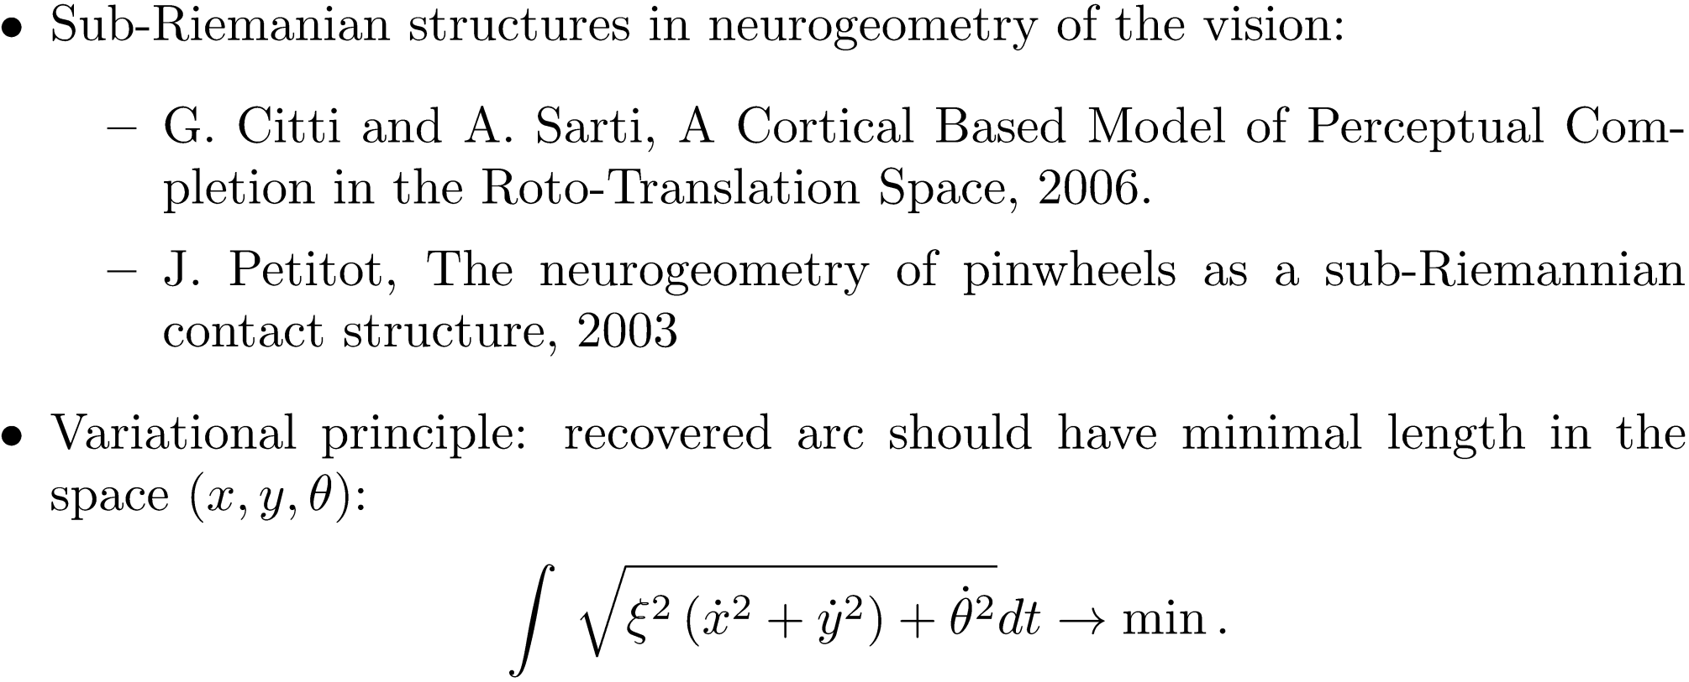
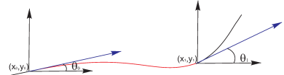
Applications: Cortical Based Model of Perceptual Completion

Slide 29
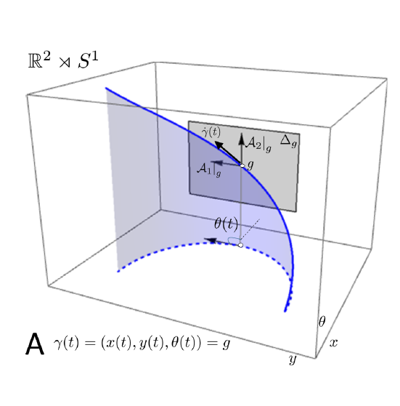
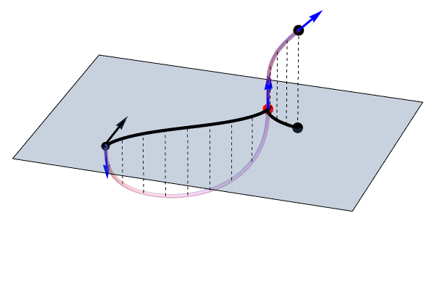
Application of SR-minimizers in Image Analysis
+ Disentanglement of intersecting structures,
+ Anthropomorphic contour completion,
- Existence of cusp points

Slide 30
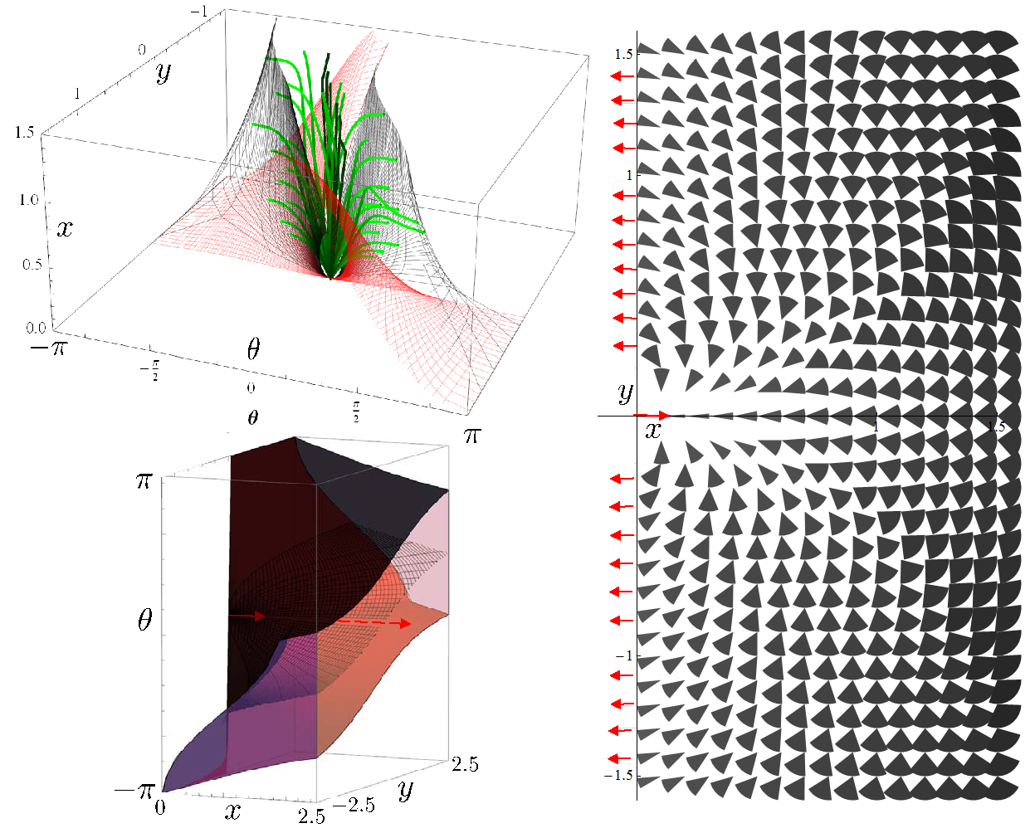


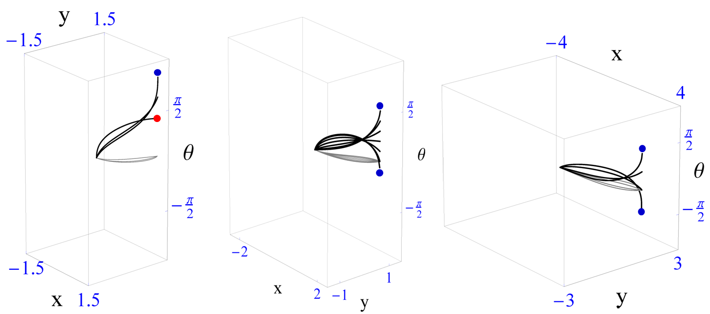
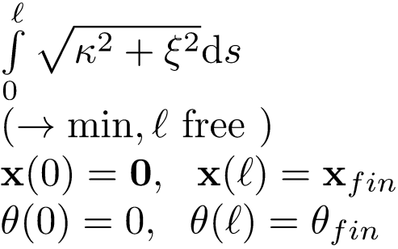

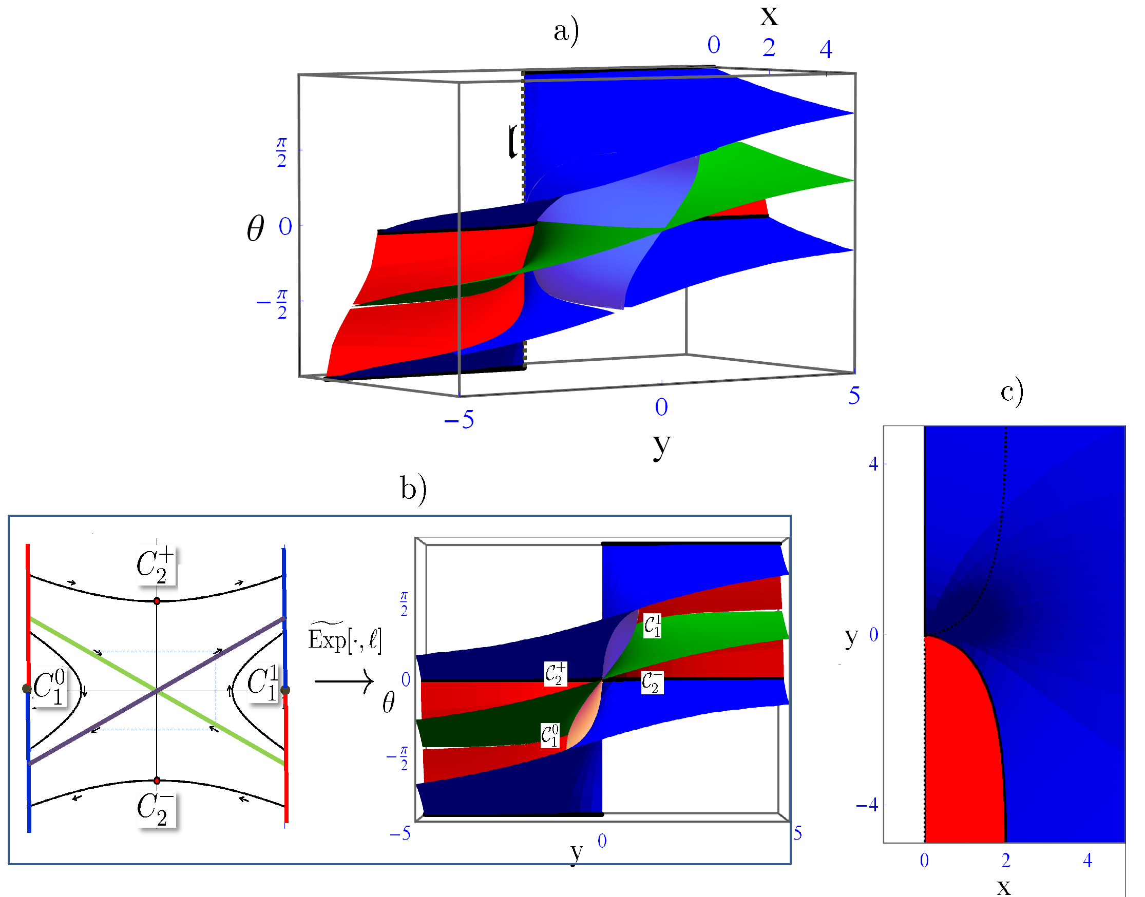




Cuspless Sub-Riemannian Geodesics in SE(2)
Reachable
cones
Range of the exponential map of
R. Duits, U. Boscain, F. Rossi and Yu. L. Sachkov:
Association Fields via Cuspless Sub-Riemannian Geodesics in SE(2), JMIV, 2014.

Slide 31
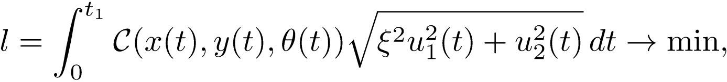
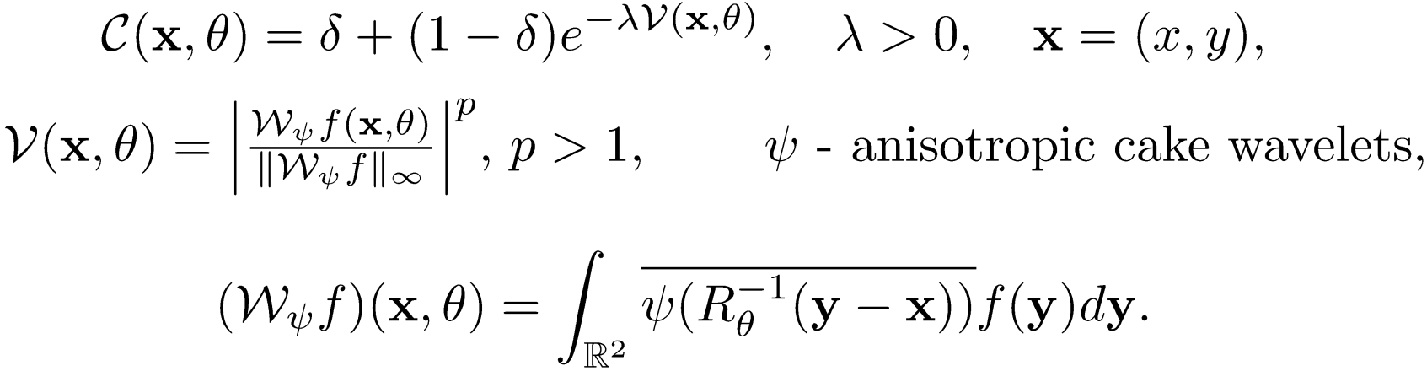
Data-driven Sub-Riemannian Geodesics in SE(2)

Slide 32
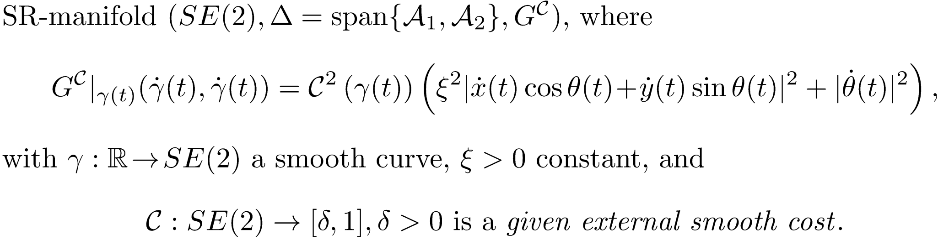
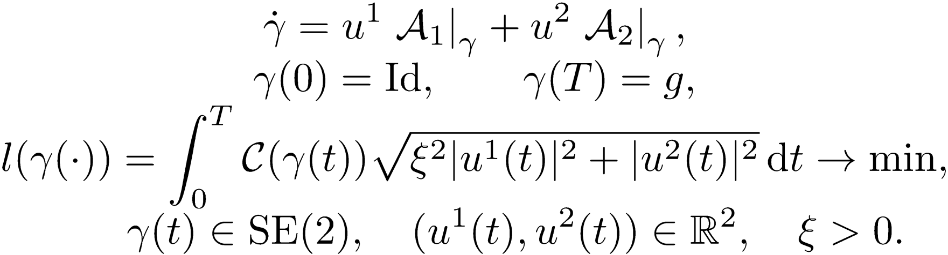
Problem Formulation
Optimal Control Problem:

Slide 33
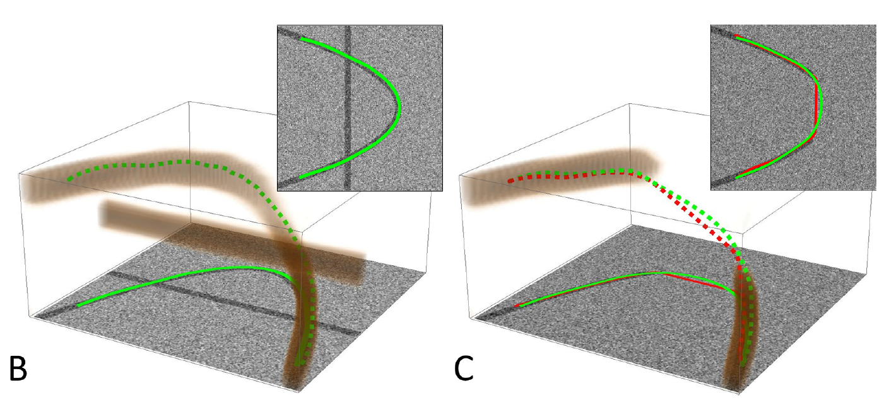
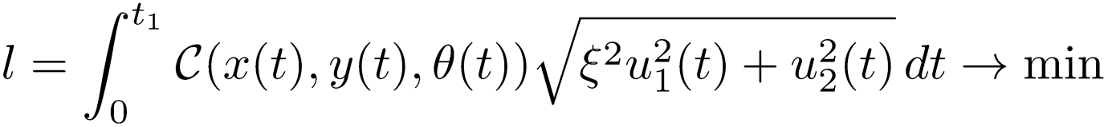
Motivation of Including of External Cost

Slide 34
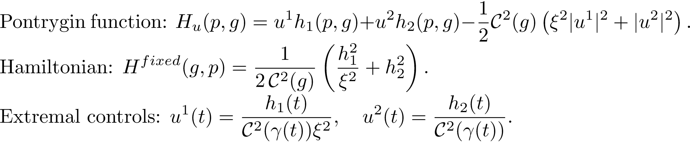

ODE-based Approach
Integration of this system is a very difficult task.
No method to obtain analytic formulas of solution for general C.
ODE-based approach stops here.

Slide 35

New PDE-based Approach
Derivation of HJB equation for propagation of geodesically equidistant surfaces;
Computing a distance map by numerical solution of BVP for HJB eq. describing propagation of geodesically equidistant surfaces;
Computing a minimizing geodesic satisfying boundary conditions by backward integration of Hamiltonian system.

Slide 36

Geodesically Equidistant Surfaces
Notes:
Given a SR manifold with covex Lagrangian. Introduce a continious real valued function in extended configuration space, where forth component represents time, that can be reparametrized. The level set of this function calls geodesically equidistant surface, if it satisfy the following condition. Then evolution of equidistant surfaces is given by solution of the HJB equation.

Slide 37


Viscosity Solution of HJB equation
L.C. Evans, Partial Differential Equations. Graduate Studies in Mathematics, 1998.
A. Bressan, Viscosity Solutions of Hamilton-Jacobi Equations and Optimal Control Problems.
Lecture Notes Dep. of Math., Pennsylvania State University, 2011.
Expression HJB in Eikonal form
Notes:
HJB-equations in general do not have unique smooth solutions. To avoid multiple solutions (*from the initial condition,*) one must impose the viscosity condition. It is commonly applied in wavefront methods acting directly in the image domain. The HJB equation derived for original length-minimization problem with free time and homogenious Lagrangian is expressed in Ekonal form.

Slide 38

Solutions via Data-driven Wavefront Propagation
Submitted to SSVM; JMIV paper in preparation

Slide 39

Implementation of Solution to the BVP

Slide 40



Solutions via Wavefront Propagation for C=1
Submitted to SSVM;
JMIV paper in preparation
Notes:
In case of uniform cost it was shown that proposed method provide propogation of SR-spheres, that consists of end points of optimal geodesics of fixed length. Recall that in Maxwell point two SR-geodesis of the same length meet. After Maxwell point SR geodesic is not longer a global minimizer. In Maxwell point SR-sphere is not smooth. Proposed method does not pass first Maxwell set, and produce SR-length minimizers. These figures give illustration of Maxwell points. First figure present a section of family of SR-spheres by horizontal plane. In second figure examples of geodesics ending in Maxwell points are presented.

Slide 41




Numerical Verification of New PDE Approach
Solutions given by algorithm do not pass first Maxwell set and conjugate locus:
Converging to exact solution when increasing sampling:

Slide 42



Application in Retinal Imaging
Tests on image patches exhibiting crossings:
1) Two seed points were selected manually (for artery and vein),
2) For each seed point the value function W was calculated,
3) Multiple end-points were traced back to the seed point.
Values of parameters in cost function:
Solid curves:
Dashed curves:

Slide 43
Sub-Riemannian Geodesics with External Data-cost via Wavefront Propagation: Results and Plans
Results: new PDE-based approach, that is
Fast and accurate for C=1,
Allows fast adaptation for general C,
At least for C=1 provides the global minimizers
and stays away from both Maxwell and conjugate points,
Shows promising results in retinal vessel tracking.
Plans:
Develop efficient SR Fast Marching,
Adapt to other Lie groups such as SE(3) and SO(3).

Slide 44
Sub-Riemannian problem in SO(3) with cuspless spherical projection constraint
(A. Mashtakov, R. Duits, Y.L. Sachkov, I. Beschastnyi)
44

Slide 45





Association Field Model on the Retinal Sphere
Statement of the problem Pcurve(S²):
Given
Find a smooth curve
s. t.:
where
Motivation: A natural extension of a model due to J. Petitot, G. Citti and A. Sarti which additionally takes into account the spherical nature of the retina. It is important both for cortical modeling and for processing retinal images.
45

Slide 46



Pmec(S²): Lift Pcurve(S²) to SR-problem on SO(3)
Analogy with close related sub-Riemannian problem on special Euclidean group.

Slide 47

Pontryagin Maximum Principle

Slide 48


Vertical Part in Spherical Arclength

Slide 49

Horizontal Part
Explicit expressions in terms of Jacobi elliptic functions.

Slide 50


Analysis of Plots of Wave Front

Slide 51



Singularities of Wavefront on SO(3)
Rotational symmetry in linear case .
Conjugate locus is a circle without a point.
For the rotational symmetry is destroyed.
Conjugate and Maxwell points are getting separated and
the conjugate locus has an astroidal shape.

Slide 52


Cusp Surfaces
Red surface: endpoints of geodesics starting from cusp.
Blue surface: endpoints of geodesics ending in cusp.
SO(3):
SE(2):

Slide 53
Application for Processing of Spherical Images of Retina
+ No distortion
+ Existence of geodesics with cuspless projections up to infinity

Slide 54









Sub-Riemannian geodesics in SO(3) with cuspless spherical projections: Results
First cusp time in elliptic case
First cusp time in hyperbolic case
Some geodesics have no cusp
Results:
Lift to sub-Riemannian problem on SO(3);
Hamiltonian system of PMP;
Classification by different dynamic of vertical part on elliptic ( ), linear ( ) and hyperbolic ( ) cases;
Explicit expressions for SR-geodesics in both SR-arclength and spherical arclength parameterization;
Evaluation of first cusp time and asymptotic analysis &
computation conjugate locus.
Comparison cusp-surfaces and wavefronts w.r.t. SE(2)
54

Slide 55
Conclusion
Results:
new PDE-based approach for computing SR-geodesics, that allows extension to data-driven cost
Numerical solution to sub-Riemannian problem in SE(2) with given external cost
Parameterization of range of exponential mapping in sub-Riemannian problem in SO(3) with cuspless spherical projections constraint
Plans:
Adaptation to other Lie groups such as SE(3) and SO(3)
Fast, efficient implementation using ordered upwind schemes
Algorithm for solving BVP for geodesics with cuspless spherical projection

Slide 56
Thank you for your attention!

